Slide 1
Arduino Uno circuit basics

Slide 2
What is an Arduino?
An Arduino can be used to develop interactive objects, taking inputs from a variety of switches or sensors, and controlling a variety of lights, motors, and other physical outputs.
Arduino projects can be stand-alone, or they can communicate with software running on your computer.
Our iLumin8 project will be a stand-alone Arduino project, the final light display will be controlled just by your Arduino board.
Let’s build our first circuit !

Slide 3
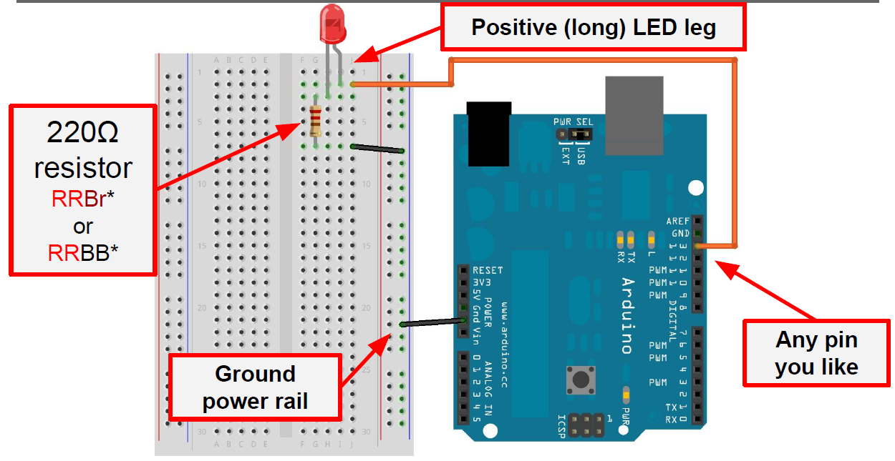

Slide 4
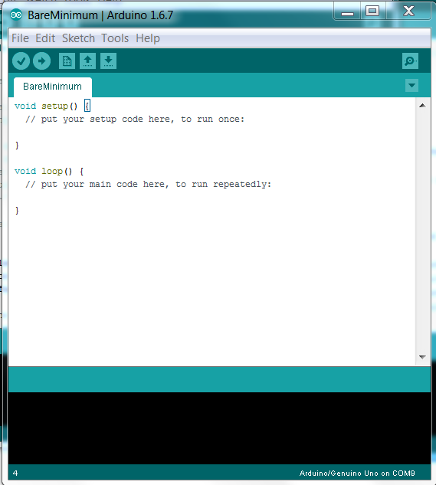
1. File → Examples → 01.Basics → Bare Minimum
Now copy the code below and paste into the sketch pad, to replace this code
// the setup function runs once when you press reset or power the board
void setup() {
// initialize digital pin 13 as an output.
pinMode(13, OUTPUT);
}
// the loop function runs over and over again forever
void loop() {
digitalWrite(13, HIGH); // turn the LED on (HIGH is the voltage level)
delay(1000); // wait for a second
digitalWrite(13, LOW); // turn the LED off by making the voltage LOW
delay(1000); // wait for a second
}

Slide 5
Arduino Code Basics

Slide 6
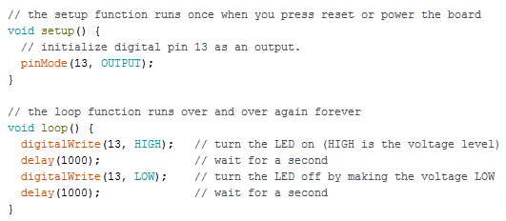
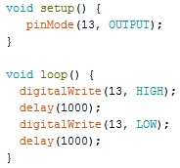
‘Blink’ example code:
The example code above contains a lot of ‘comments’.
The symbol // is used to write a ‘comment’ in the program to allow another user to understand how the program works.
The comments are not part of the code.
Without comments, the code would look like this:

Slide 7
Change the Code!
Try changing the delay time from 1000 to 200 (milliseconds)
Can you make the code work from pin 9 instead of pin 13?
What else can you do to change the code?

Slide 8
2. File → Examples → 01.Basics → Fade
Upload the ‘Fade’ example sketch
Use the same circuit as Blink
Which pin will need to be connected to the LED? (check the beginning of the sketch code)
Can you change the code to get the LED to
fade faster?
fade slower?
fade to only half the maximum brightness?

Slide 9
Adding a switch to the circuit

Slide 10
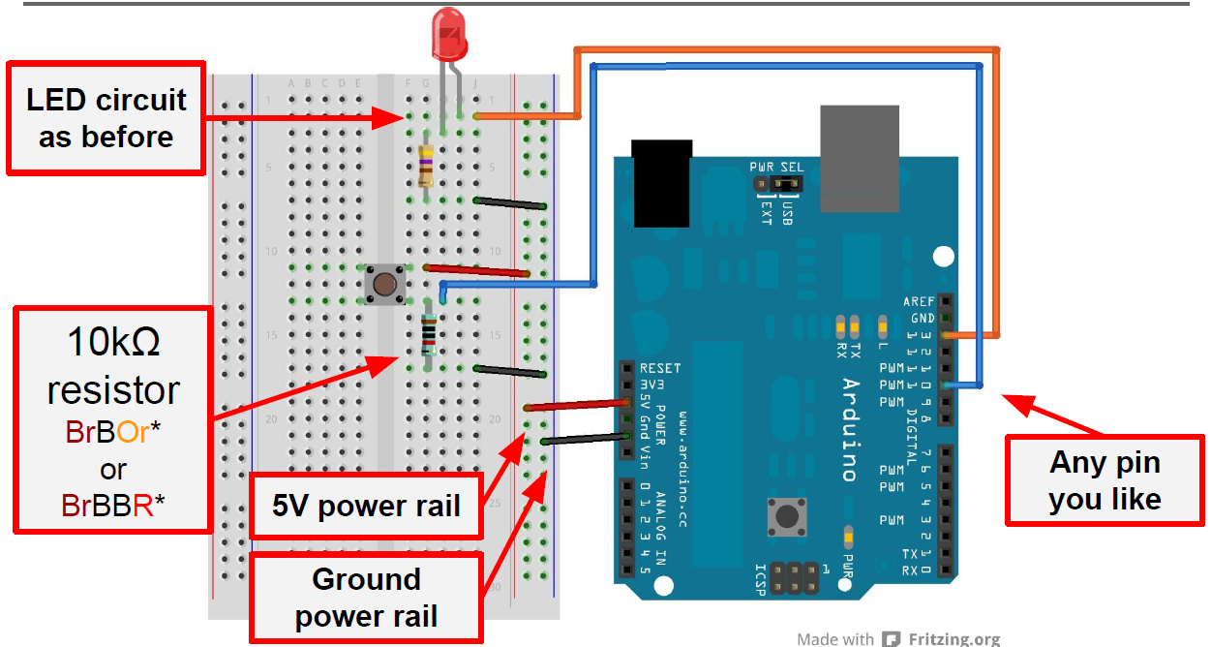
Make a Touch Lamp

Slide 11
3. File → Examples → 01.Basic → Bare Minimum Type the following code into the Bare Minimum sketch and save it on your desktop as Touch Lamp. Upload it and try it out!

Slide 12
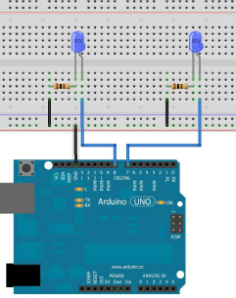
Flashing LEDs – remember the Flip Flop circuit? An Arduino can do the same with only a few parts – two LEDs and two 100Ω resistors:
void setup() {
// put your setup code here, to run once:
pinMode(7, OUTPUT); //Pin 7 is defined as output
pinMode(8, OUTPUT); //Pin 8 is defined as output
}
void loop() {
// put your main code here, to run repeatedly:
digitalWrite(7, HIGH); //turn on the LED on pin 7
delay(1000); //wait for 1000 milliseconds
digitalWrite(7, LOW); //turn off the LED on pin 7
digitalWrite(8, HIGH); //turn on the LED on pin 8
delay(1000); //wait for 1000 milliseconds
digitalWrite(8, LOW); //turn off the LED on pin 8
}
//Athe end of the loop the program starts again from the beginning of //the loop part. So..turn on LED on pin 7..wait for 1000
//milliseconds..etc..etc..

