Slide 1
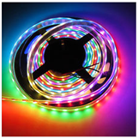
Arduino Uno – controlling LED strips
+

Slide 2
Are all LED strip lights the same?
An LED strip contains a large number of LEDs connected together on one strip of flexible plastic containing thin metal circuit tracks.
There are many different designs and types of strips.
Our strips have tiny WS2812b LEDs which can produce red, green and blue (RGB) light. These colours can mix to make many other colours.
WS2812b strips are called “addressable” as it is possible to turn on and change the colour of each LED independently of all the others. Many coloured patterns and effects can be created.
Let’s find out more!

Slide 3
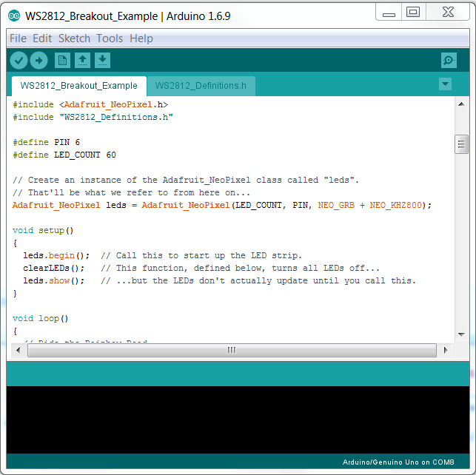
Arduino ‘Libraries’ – A ‘library’ is a type of code that makes it easier to use some devices like LED strips.
This sketch uses two libraries. Libraries are included at the beginning of the sketch code.

Slide 4
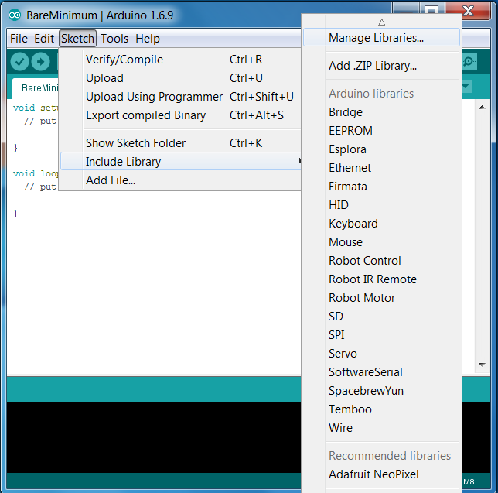
Collect libraries – we need to collect libraries that are used to control the LED strips.
You must be connected to the internet
Sketch → Include Library → Manage Libraries

Slide 5
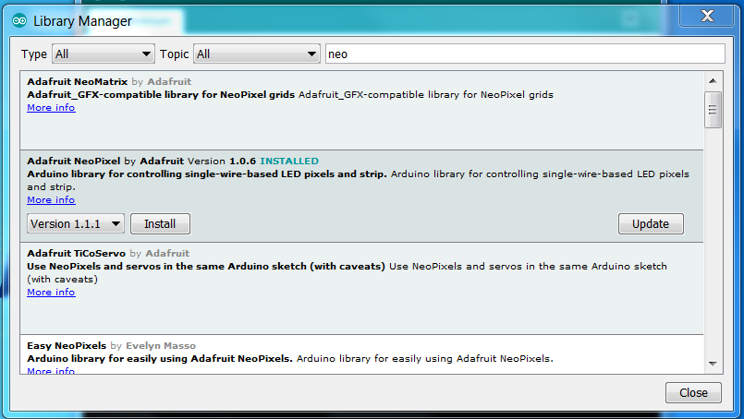
Type in ‘neo’ in the search bar and install the latest version (1.1.1) of Adafruit Neopixel

Slide 6
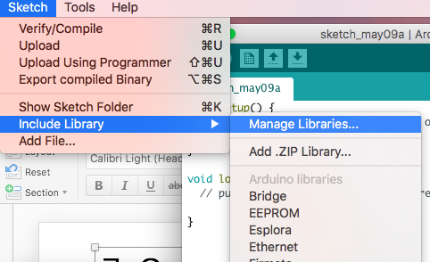
Go back to manage libraries
Go to sketch > include library > manage libraries

Slide 7
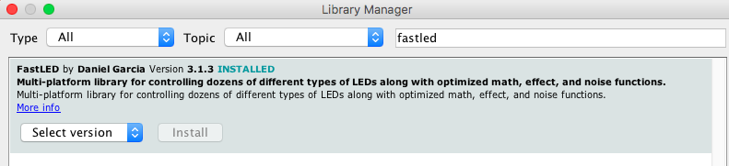
Type in fastLED in the search bar and install the latest version (3.1.3)

Slide 8
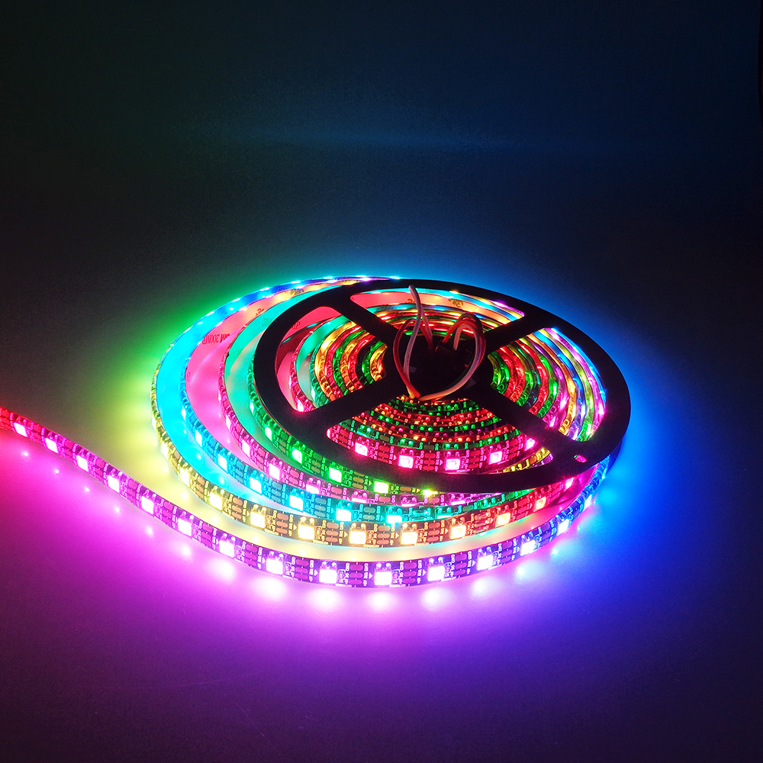
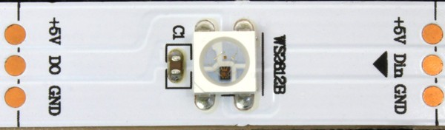
Time to fire up some WS2812b LED strips!
Take time to look at the WS2182b LED. It is a very advanced LED which contains its own tiny control circuit technology !

Slide 9
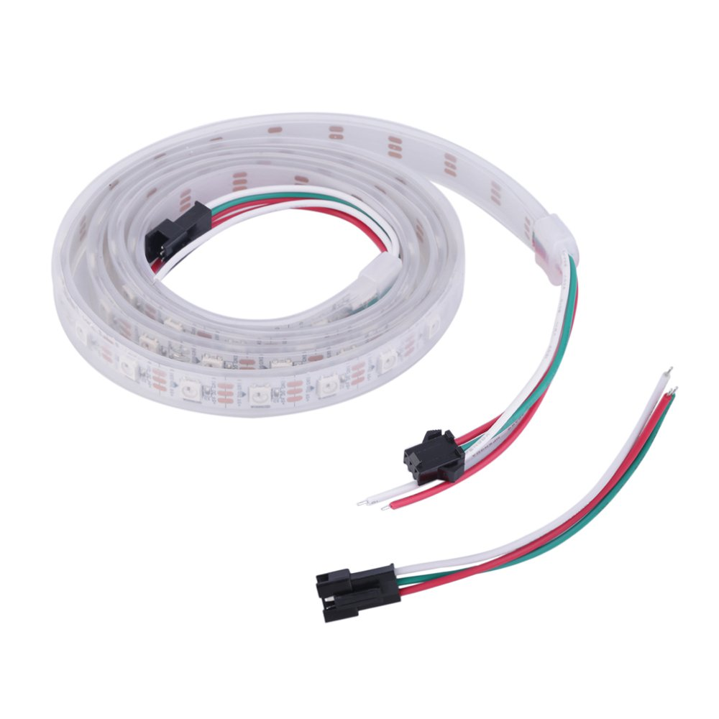
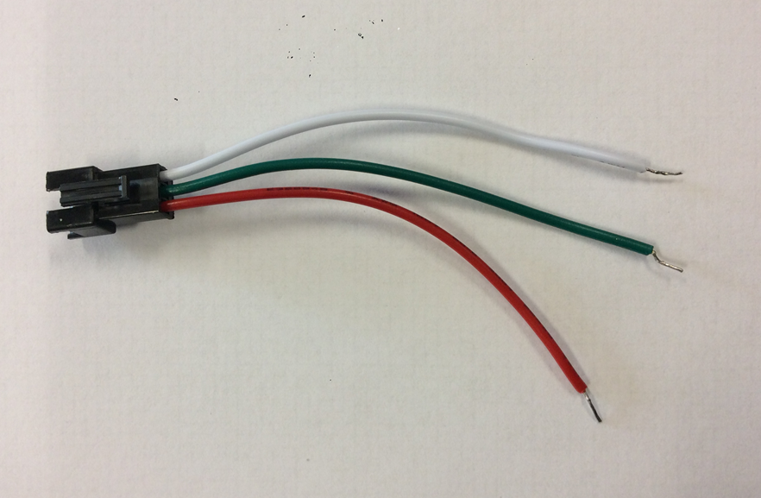
The WS2812b LED strips have 3 wires which can be connected to a breadboard using a short wire connector, or by pushing the pins of your coloured ‘jumper wires’ into the connector.
GND
DATA
+5V
GND = Ground or 0 V.
DATA = a wire which sends control signals to each LED
from the Arduino. It carries Serial Data In/Out.
+5V = power source, can be labelled as Vcc

Slide 10
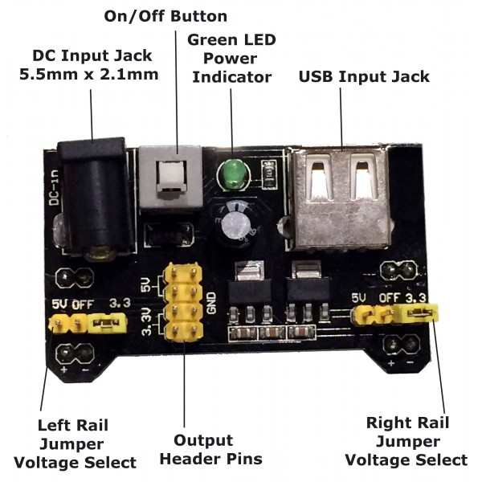
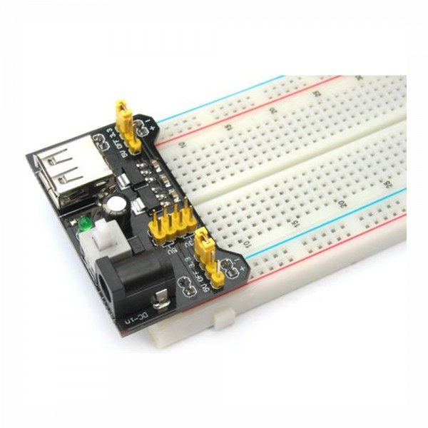
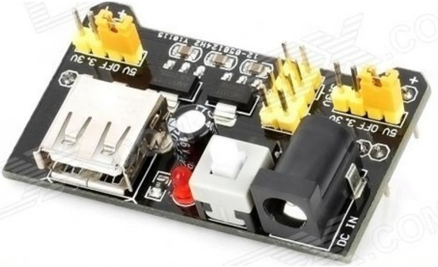
Power supply module:
1. connect the power supply module to the breadboard (check the pins are not bent!)
2. put the yellow rail jumpers on the 5V side
1.
2.

Slide 11
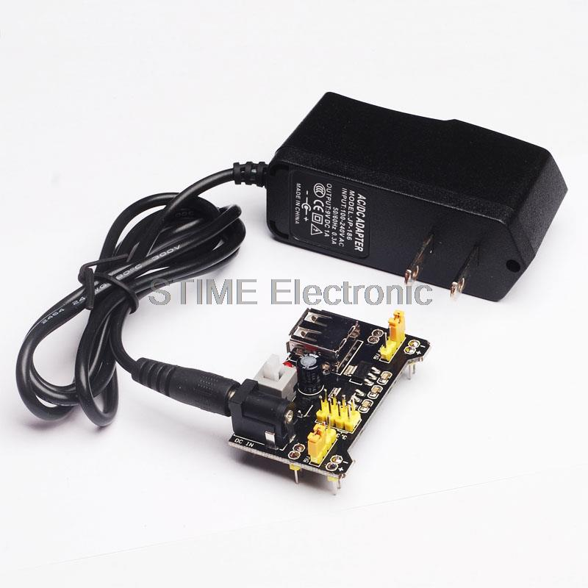
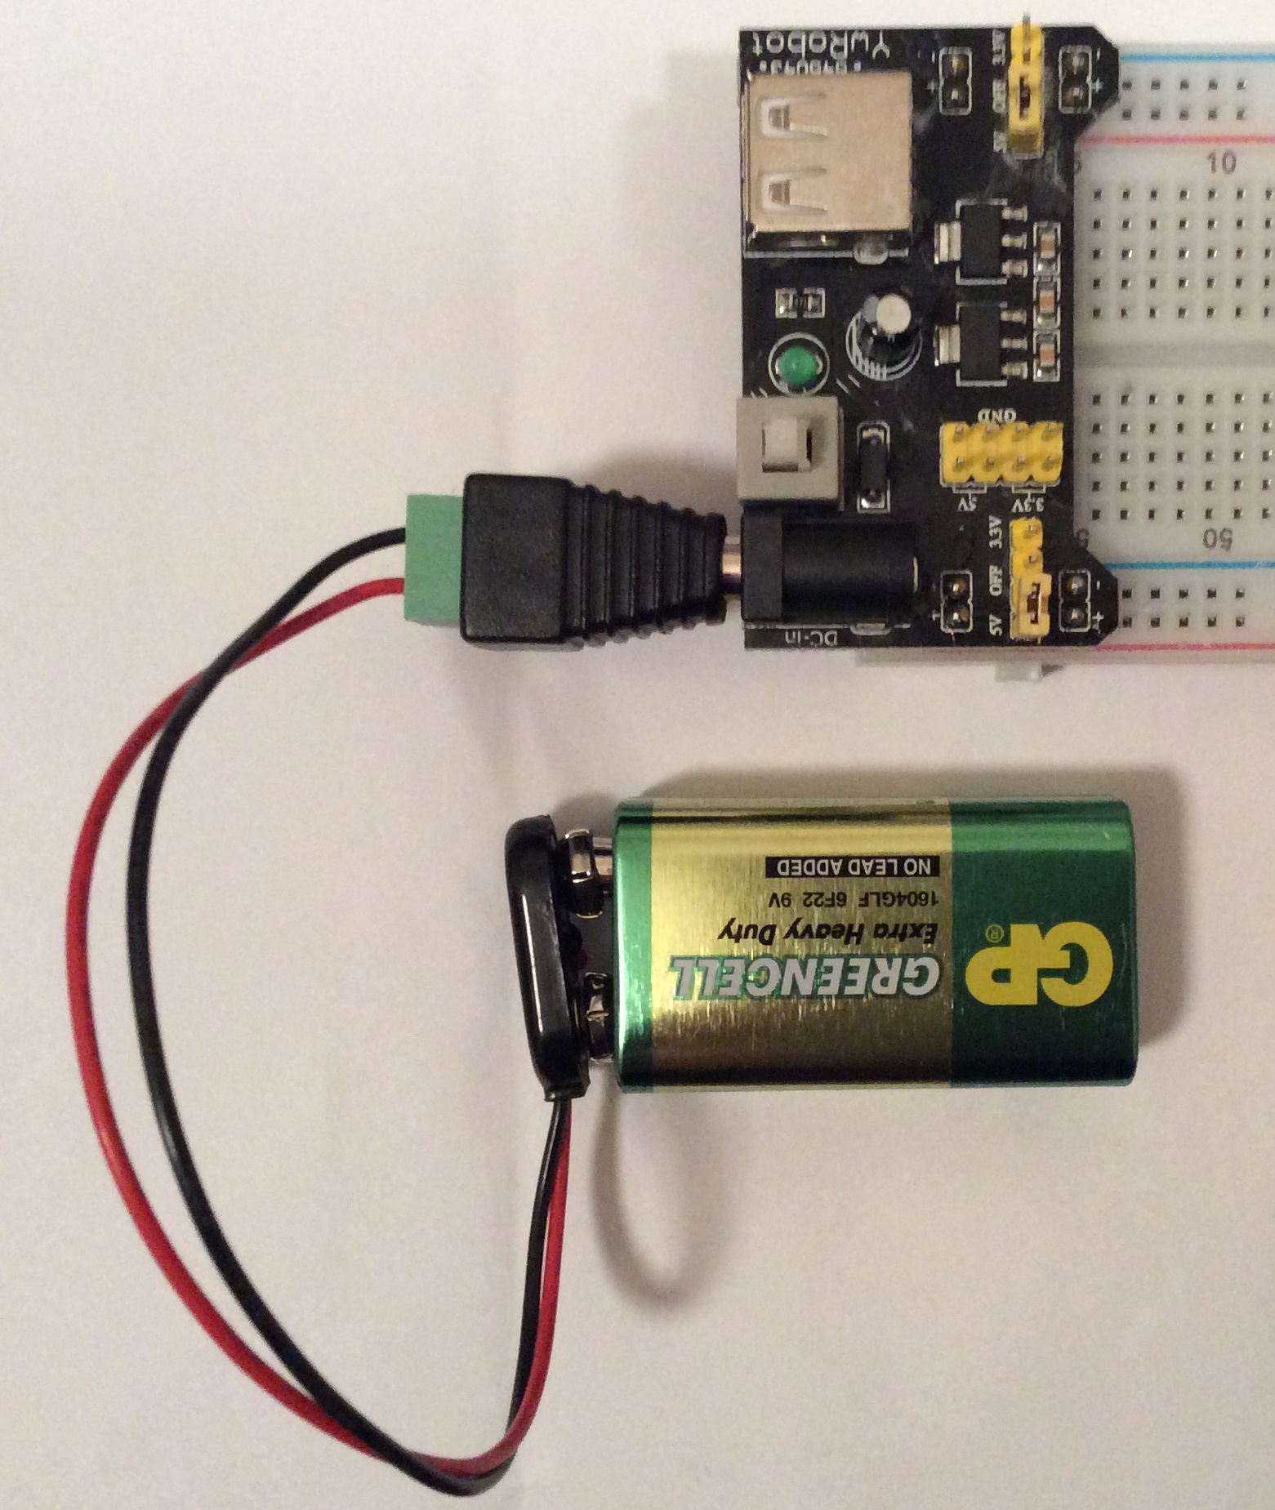
Power supply connection: connect your DC power supply (5V to 12V DC) to the black DC input jack:
Using an AC adaptor or charger
Using a 9V DC
battery
OR

Slide 12
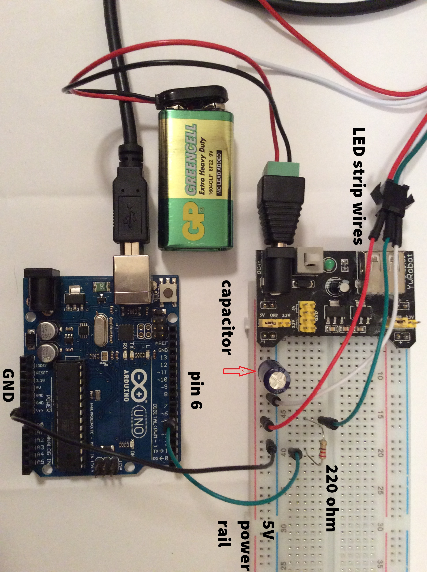
Your circuit should look like this…
Don’t turn on the power switch yet!

Slide 13
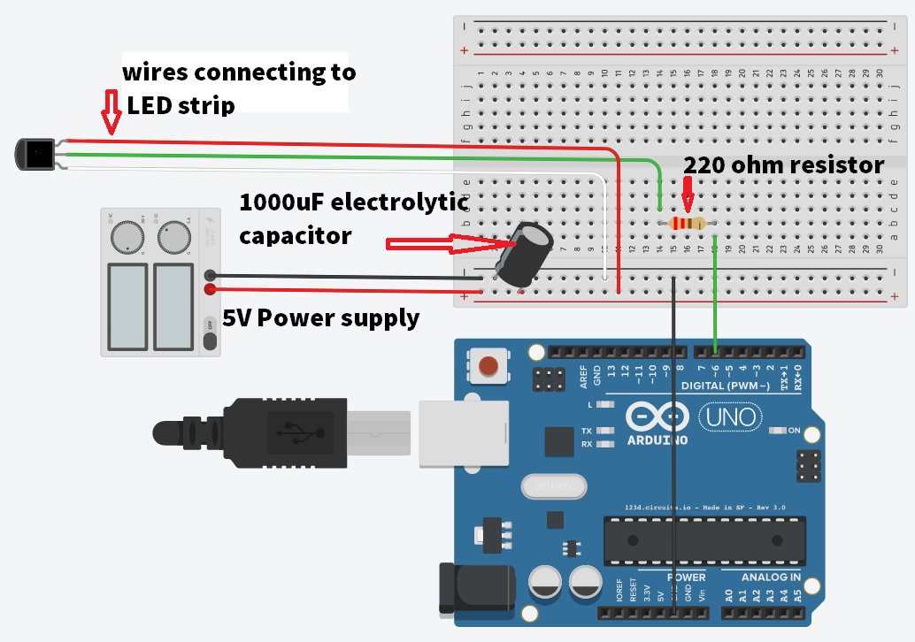
Check that your circuit connections look like the diagram:

Slide 14
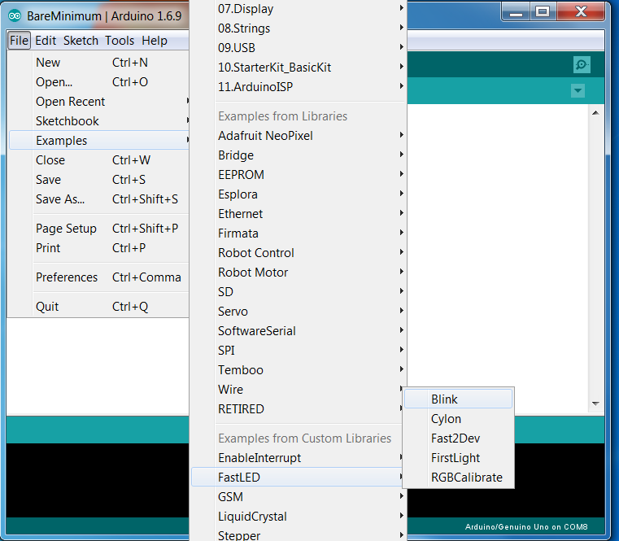
Connect your Arduino Uno to your computer
Open the Arduino software (IDE)
Select Cylon from the Custom Libraries examples
File → Examples (from Custom Libraries) → FastLED → Cylon

Slide 15
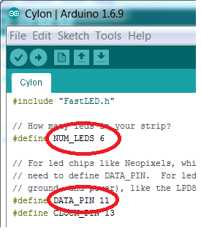
Set up the code for the LED strip:
1. Change NUM_LEDS to 30
2. Change DATA_PIN to 6
3. upload the code, then switch on the power button on the power module
Now,
Can you change the code to make the lights go Blue one way and come back Red?
What other colours can you do?
Can you change the speed of the Cylon pattern?

Slide 16
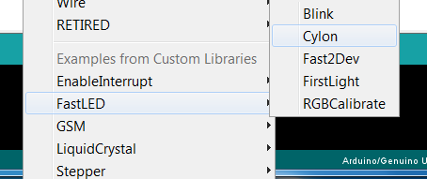
Now try some more light patterns!
1.Try FirstLight from the FastLED examples
2.Try strandtest from the Adafruit Neopixel library

