Slide 1
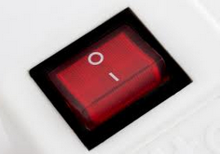
Binary is a number system with base 2.
Only two digits (1 & 0) are used to write every number.
This is the foundation of almost every computer program
Power switches often have these binary symbols on them.
1 means on
0 means off
Some power switches do both

Slide 2
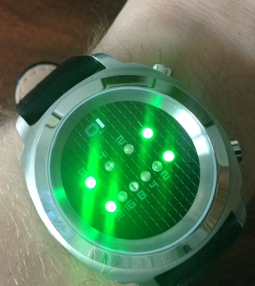
This is Mr Jones’ watch.
It is a binary watch.
Can you say what the
time is?

Slide 3
Next to each light is a number.
8
4
2
1
32
16
8
4
2
1

Slide 4
What’s the time on these watches?
Explain why this will never be shown

Slide 5
Colour in the circles to make the time below each watch face
1:11
4:17
8:28
12:40
7:15
11:45
9:56
3:59

Slide 6
You may have seen strings of 1’s and 0’s when people talk about ‘digital’.
These strings of 1’s and 0’s can be chopped up into shorter strings and converted into ordinary numbers and these numbers can represent a different symbol on a computer screen.
This is how communications are sent between phones, computers etc.

Slide 7
Here is an example
0110100001101000100010011
Break this string into shorter strings of 5 numbers.
16 | 8 | 4 | 2 | 1
0 | 1 | 1 | 0 | 1
The 8, 4 and 1 are switched on 8+4+1=13
so the 13th letter is M
Translate the rest of the code

Slide 8
1 | 2 | 3 | 4 | 5 | 6 | 7 | 8 | 9 | 10 | 11 | 12 | 13 | 14 | 15 | 16 | 17 | 18 | 19 | 20 | 21 | 22 | 23 | 24 | 25 | 26
A | B | C | D | E | F | G | H | I | J | K | L | M | N | O | P | Q | R | S | T | U | V | W | X | Y | Z

