Slide 1
Investigating circles
Did you know that it is possible to make a pyramid from a paper circle?

Slide 2
Action: Carefully read the “Circles Fact Sheet” and then write your own definitions.

Slide 3
Action: Place your circle with the coloured side up and the white side down.

Slide 4
Action: Place your circle with the coloured side up and the white side down.
Question 1: What is the edge of the circle called?

Slide 5
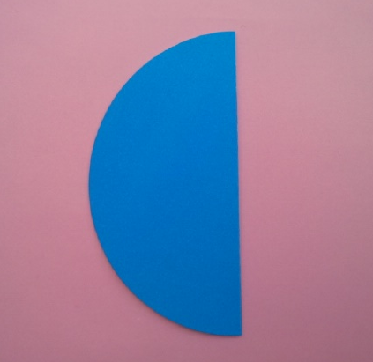
Action: Pick up your circle and fold it in half, with the colour on the outside

Slide 6
Question 2: What is this shape called?

Slide 7
Question 3: What is this line segment called?

Slide 8
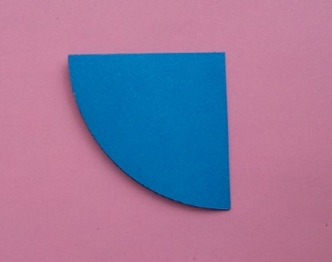
Action: Fold the semi-circle in half.

Slide 9
Question 4: What is this shape called?

Slide 10
Question 5: What are these shapes called?

Slide 11
Question 6: What is this line segment called?

Slide 12
Action: Unfold the paper

Slide 13
Question 7: What is this point called?

Slide 14
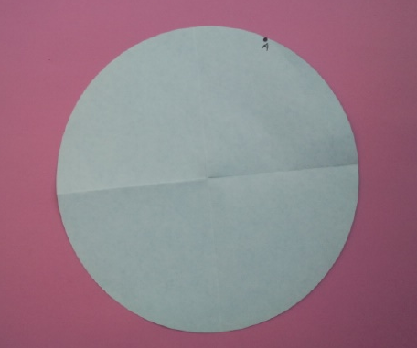
Actions:
Turn your circle over.
Mark the centre of the circle.
Choose a random point on the circumference. Label it A.

Slide 15
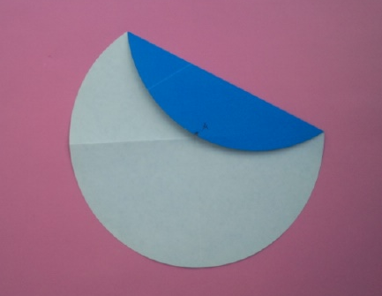
Action: Carefully fold the circle so that A meets the centre of the circle.

Slide 16
Question 8: What is this line segment called?

Slide 17
Question 9: What is this curve called?

Slide 18
Question 10: What is this blue region called?

Slide 19
Question 11: What is this region called?

Slide 20
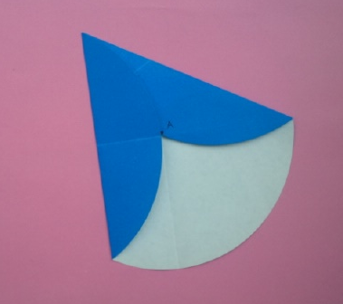
Action: Use one end of the previous fold to make a new fold, like this.

Slide 21
Action: Use one end of the previous fold to make a new fold, like this.
Question 12: Explain why this shape is NOT a sector of the original circle.

Slide 22
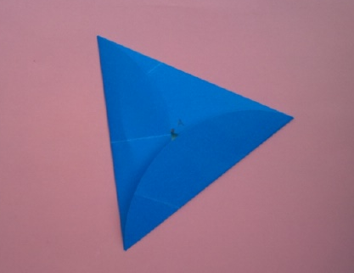
Action: Now make a third fold into the centre of the circle.
Question :

Slide 23
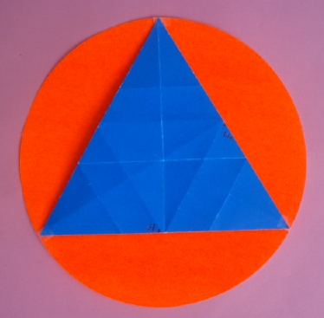
Action: Now make a third fold into the centre of the circle.
Question 13: In this image, which colour (orange or blue) has the larger visible area? Explain your choice.

Slide 24
Action: Now make a third fold into the centre of the circle.
Question 14: If this triangle costs $1, estimate a price for the entire original circle (in dollars and cents).

Slide 25
Action: Now make a third fold into the centre of the circle.
Question 15: This triangle is equilateral. Why?

Slide 26
Action: Now make a third fold into the centre of the circle.
Question 16:
How many degrees in this interior angle?

Slide 27
Action: Now make a third fold into the centre of the circle.
Question 17:
How many degrees in this exterior angle?

Slide 28
Action: Now make a third fold into the centre of the circle.
Question 18:
What is the order of rotational symmetry?

Slide 29
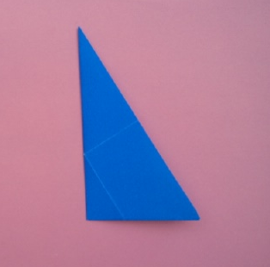
Action: Fold your triangle in half.
Question :

Slide 30
Action: Fold your triangle in half.
Question 19: (Complete this sentence)
This crease is called an axis of _____________

Slide 31
Question 20: How many axes of symmetry does this triangle have?

Slide 32
Question 21: How many axes of symmetry does this triangle have?

Slide 33
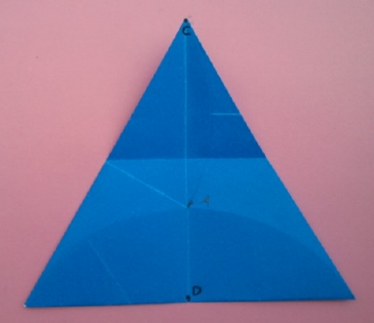
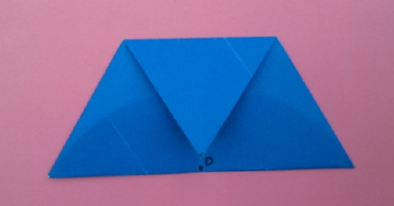
Actions:
Unfold your equilateral triangle.
Mark points C and D.
Fold C down to D.
Question :

Slide 34
Action:
Mark points C and D.
Fold C down to D.
Question 22: What shape is this?

Slide 35
Action:
Question 23: Is it possible to make a tessellation with this trapezium?

Slide 36
Action:
Question 24: (Complete this sentence)
This trapezium can be divided into __ congruent _______ triangles.

Slide 37
Action:
Question 25: This trapezium has 3 equal sides.
Draw a trapezium that only has 2 equal sides.

Slide 38
Action:
Question 26: This trapezium has 3 equal sides.
Draw a trapezium that has no equal sides.

Slide 39
Action:
Question 27: This trapezium contains no right angles.
Draw a trapezium in which 2 of the angles are 90 degrees.

Slide 40
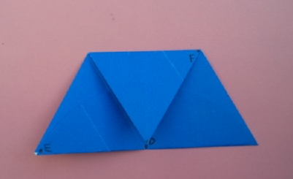
Action: Fold point E to point F

Slide 41
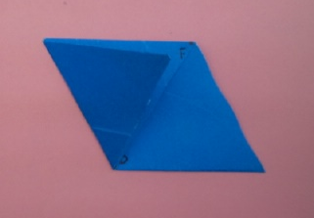
Action:
Question 28: What shape is this?

Slide 42
Action:
Question 29: How many axes of symmetry?

Slide 43
Action:
Question 30: What is the order of rotational symmetry?

Slide 44
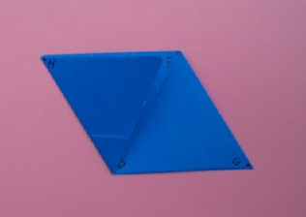
Action: Fold point G to point H
Question :

Slide 45
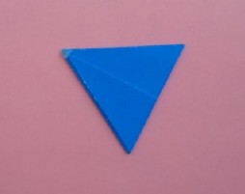
Action:
Question 31: What shape is this?

Slide 46
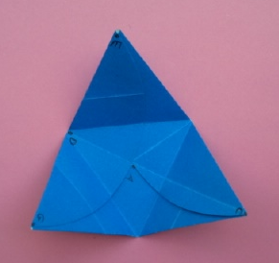
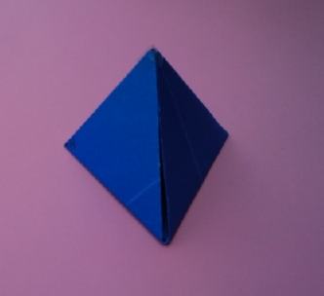
Action: Open up your 2 dimensional triangle and make a 3 dimensional triangular pyramid, which is also known as a tetrahedron. It is one of the 5 Platonic solids
Question :

Slide 47
Action: Open up your 2 dimensional triangle and make a 3 dimensional triangular pyramid, which is also known as a tetrahedron. It is one of the 5 Platonic solids
Question 32: Write down the number of faces (F), vertices (V) and edges (E).

Slide 48
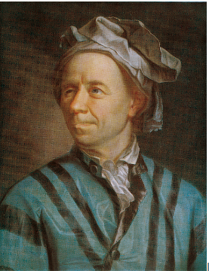
Information:
According to Leonhard Euler (1707 to 1783),
every 3 dimensional solid satisfies the formula
F + V –E = 2
Question :

Slide 49
Information:
According to Leonhard Euler (1707 to 1783),
every 3 dimensional solid satisfies the formula
F + V –E = 2
Question 33: Is F + V –E = 2 ?

Slide 50
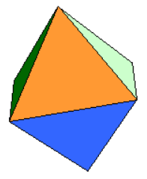
Information:
This solid is called an octahedron.
The faces are equilateral triangles.
Question :

Slide 51
Information:
This solid is called an octahedron.
The faces are equilateral triangles.
Question 34: Is F + V –E = 2 ?

Slide 52
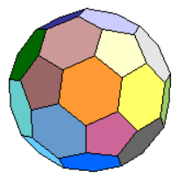
Information:
This solid is called a buckyball.
The faces are hexagons and pentagons.
It has 60 vertices and 32 faces.
Question :

Slide 53
Information:
This solid is called a buckyball.
The faces are hexagons and pentagons.
It has 60 vertices and 32 faces.
Question 35: F + V – E = 2
How many edges does it have?

Slide 54
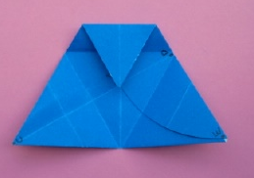
Action: Fold one vertex of the triangle to the centre.

Slide 55
Action: Fold one vertex of the triangle to the centre.
Question 36: What shape is this?

Slide 56
Action: Fold one vertex of the triangle to the centre.
Question 37: How many axes of symmetry?

Slide 57
Action: Fold one vertex of the triangle to the centre.
Question 38: (Complete this sentence)
The ratio of the 4 sides is __ : __ : __ : __

Slide 58
Action: Fold one vertex of the triangle to the centre.
Question 39: How many of these small triangles fit inside the trapezium?

Slide 59
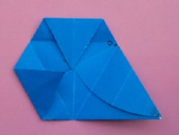
Action: Fold another corner to the centre
Question :

Slide 60
Action: Fold another corner to the centre
Question 40: What shape is this?

Slide 61
Action: Fold another corner to the centre
Question 41: How many axes of symmetry?

Slide 62
Action: Fold another corner to the centre
Question 42: Does it have rotational symmetry?

Slide 63
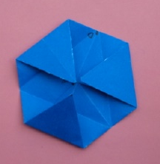
Action: Fold the third corner to the centre.
Question :

Slide 64
Action: Fold the third corner to the centre.
Question 43: What shape is this?

Slide 65
Action: Fold the third corner to the centre.
Question 44: How many axes of symmetry?

Slide 66
Action: Fold the third corner to the centre.
Question 45: What is the order of rotational symmetry?

Slide 67
Action: Fold the third corner to the centre.
Question 46: Does this shape tessellate?

Slide 68
Action: Fold the third corner to the centre.
Question 47:
What insect uses this shape to build a nest?

Slide 69
Information: In a regular shape, all the sides are equal and all the angles are equal.
Question 48: Is this a regular shape?

Slide 70
Action: Now make a third fold into the centre of the circle.
Question 49:
How many degrees in this interior angle?

Slide 71
Action: Now make a third fold into the centre of the circle.
Question 50:
How many degrees in this exterior angle?

Slide 72
Action: Hand in your answer sheet for marking.
Watch this amazing video clip about soap bubbles and rock formations, especially first few minutes and the section on soap bubbles (10:00 to 16:11)
The Code: Shapes
http://www.bing.com/videos/search?q=marcus+du+sautoy+the+code&qs=n&form=QBVR&pq=marcus+du+sautoy+the+code&sc=0-0&sp=-1&sk=#view=detail&mid=42EA65FD1CBCCC4B91E542EA65FD1CBCCC4B91E5

