Slide 1
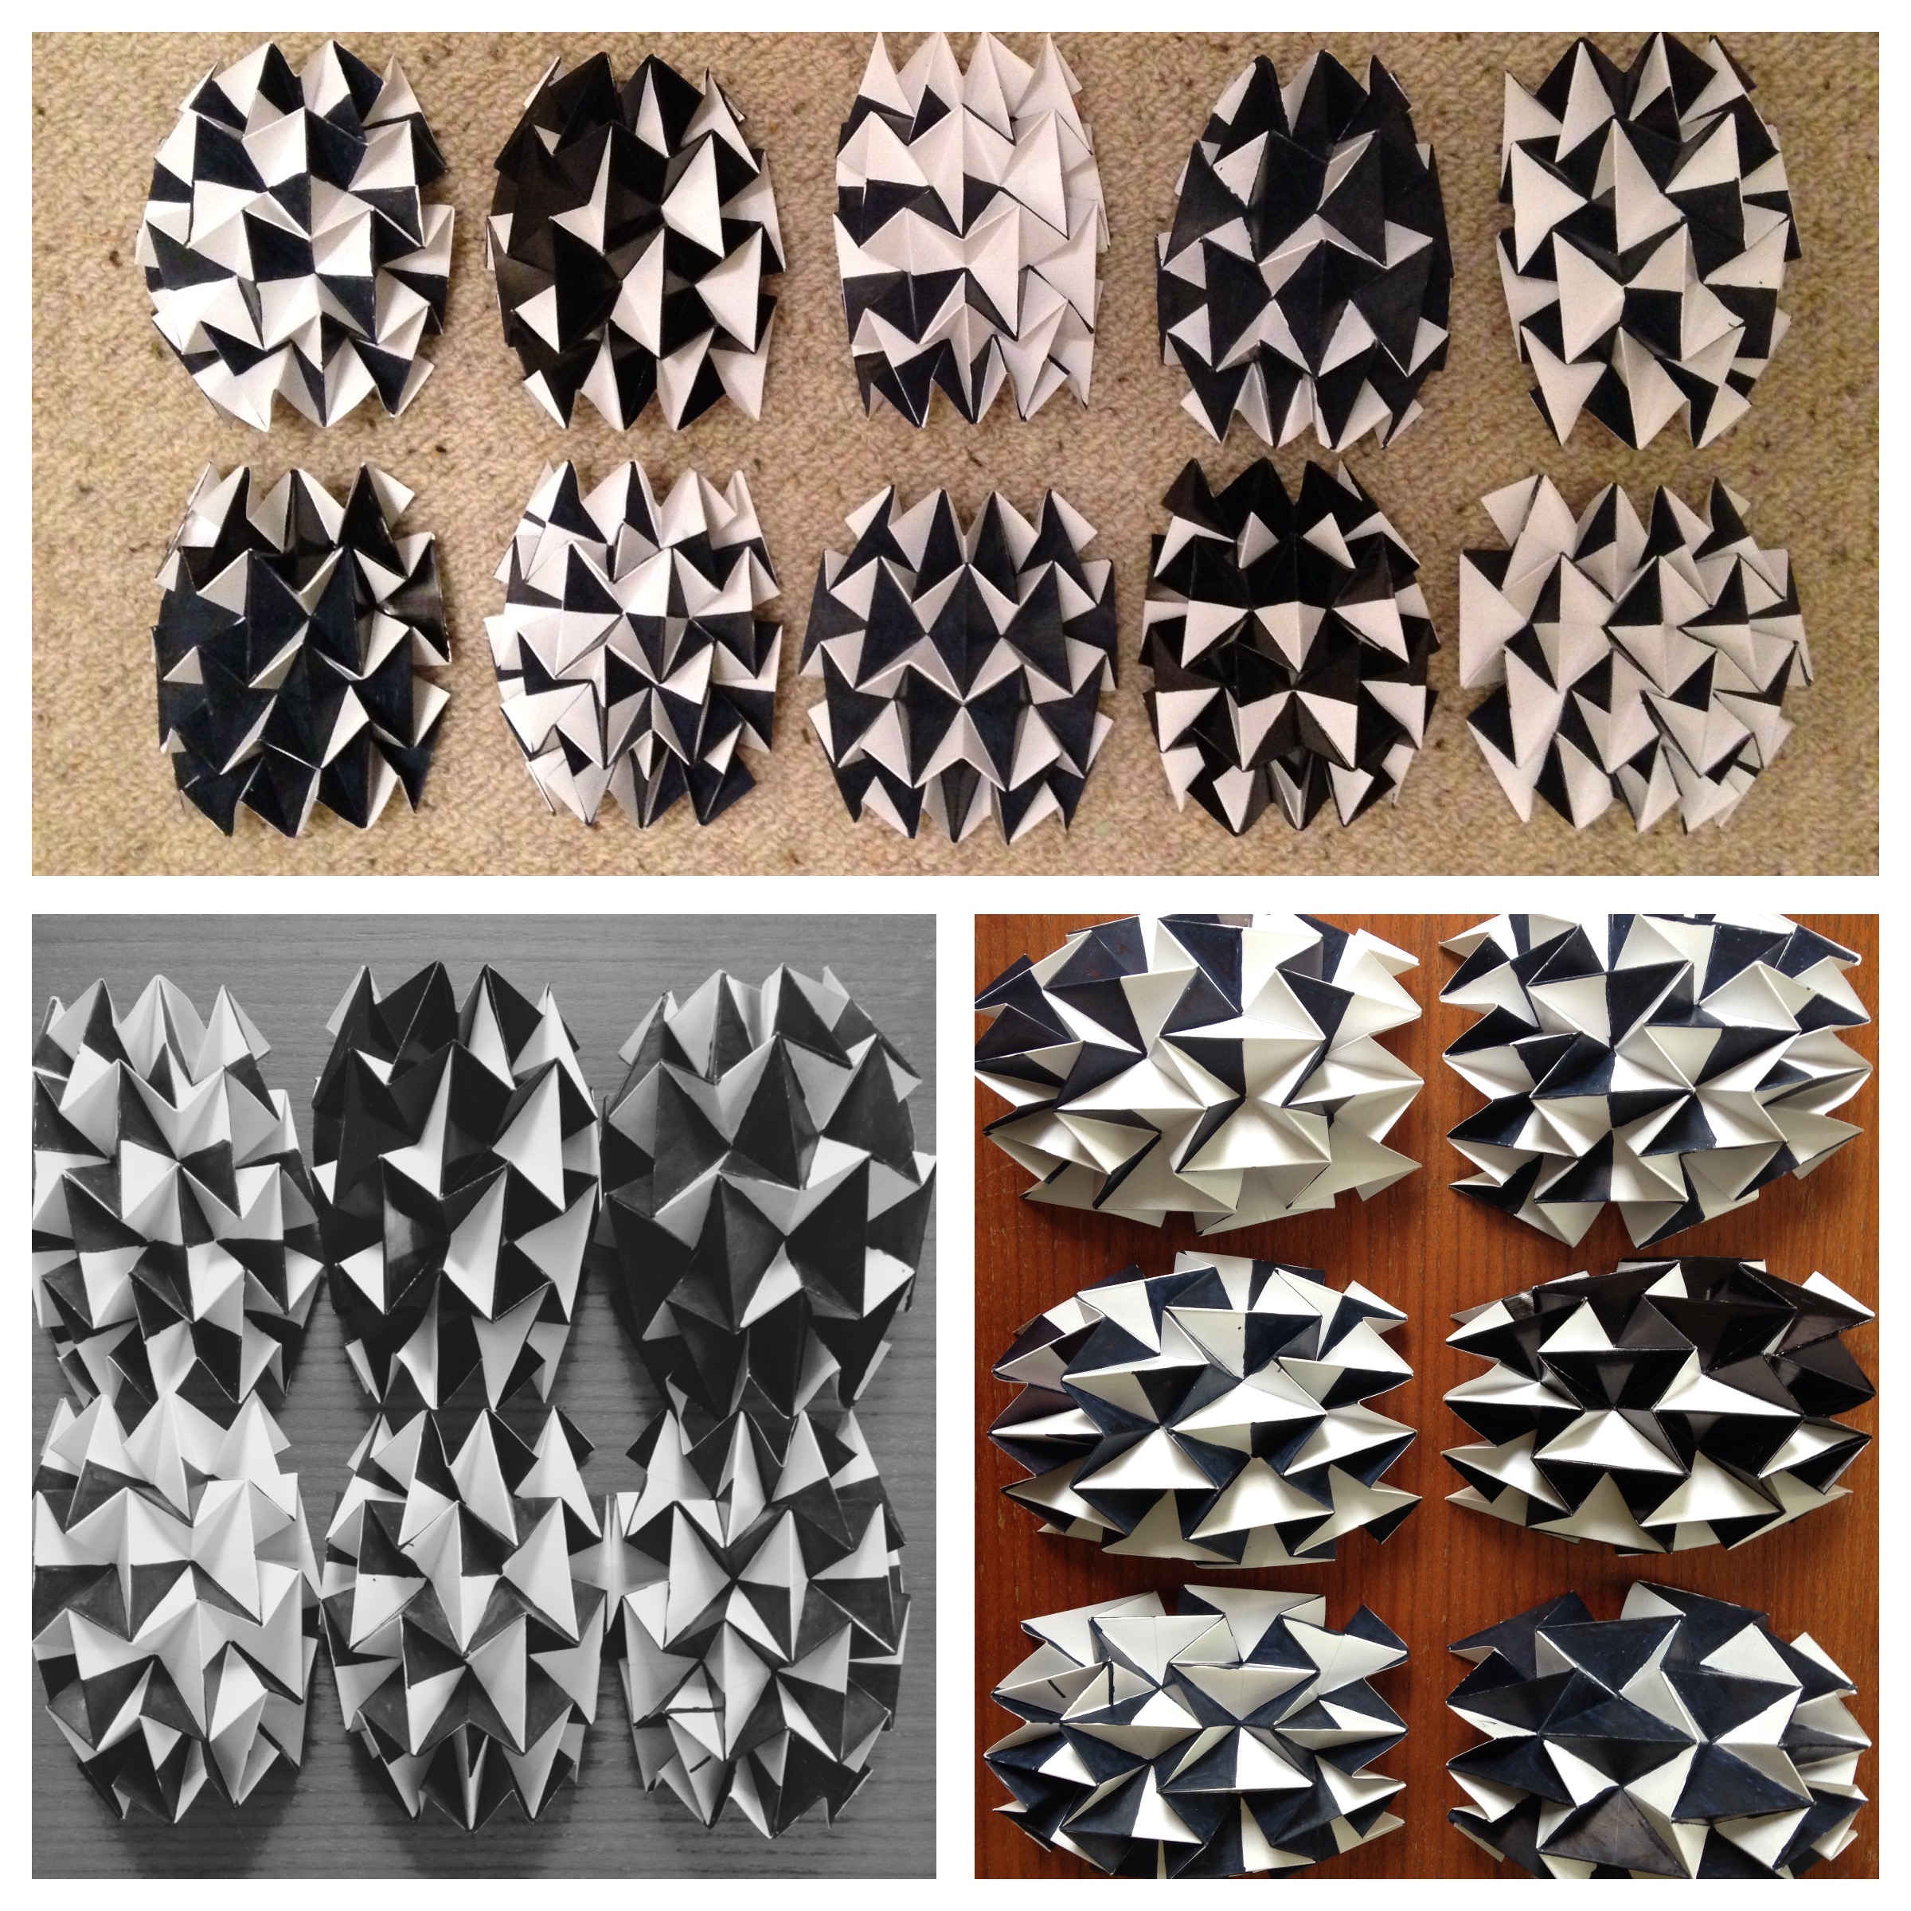

Designing the Binary Bug
Notes:
You will hear three important words related to this project: biomimicry, symmetry, iteration.
What do they mean and what do they look like?

Slide 2
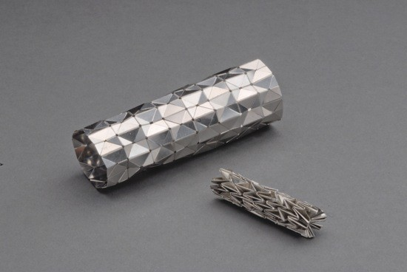
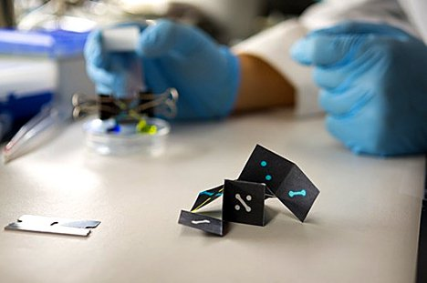
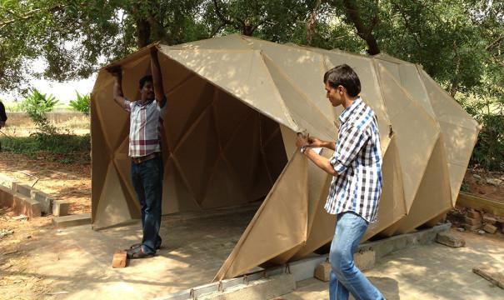
Folding has a variety of applications
Notes:
Often the function of a design that mimics nature doesn’t look like something from nature.
Such as the development of 3D paper sensors that can detect HIV and Malaria in seconds and Annapama Kundoo’s unfolding structures distributed in times of disaster to those in need of shelter.
Look at the the heart stent that expands after insertion. This is exactly the same fold we use will use in the Binary Bug project.

Slide 3
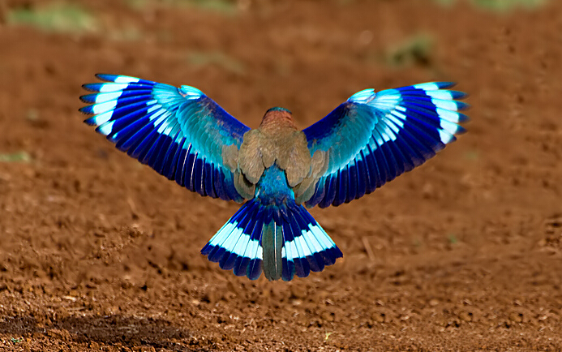
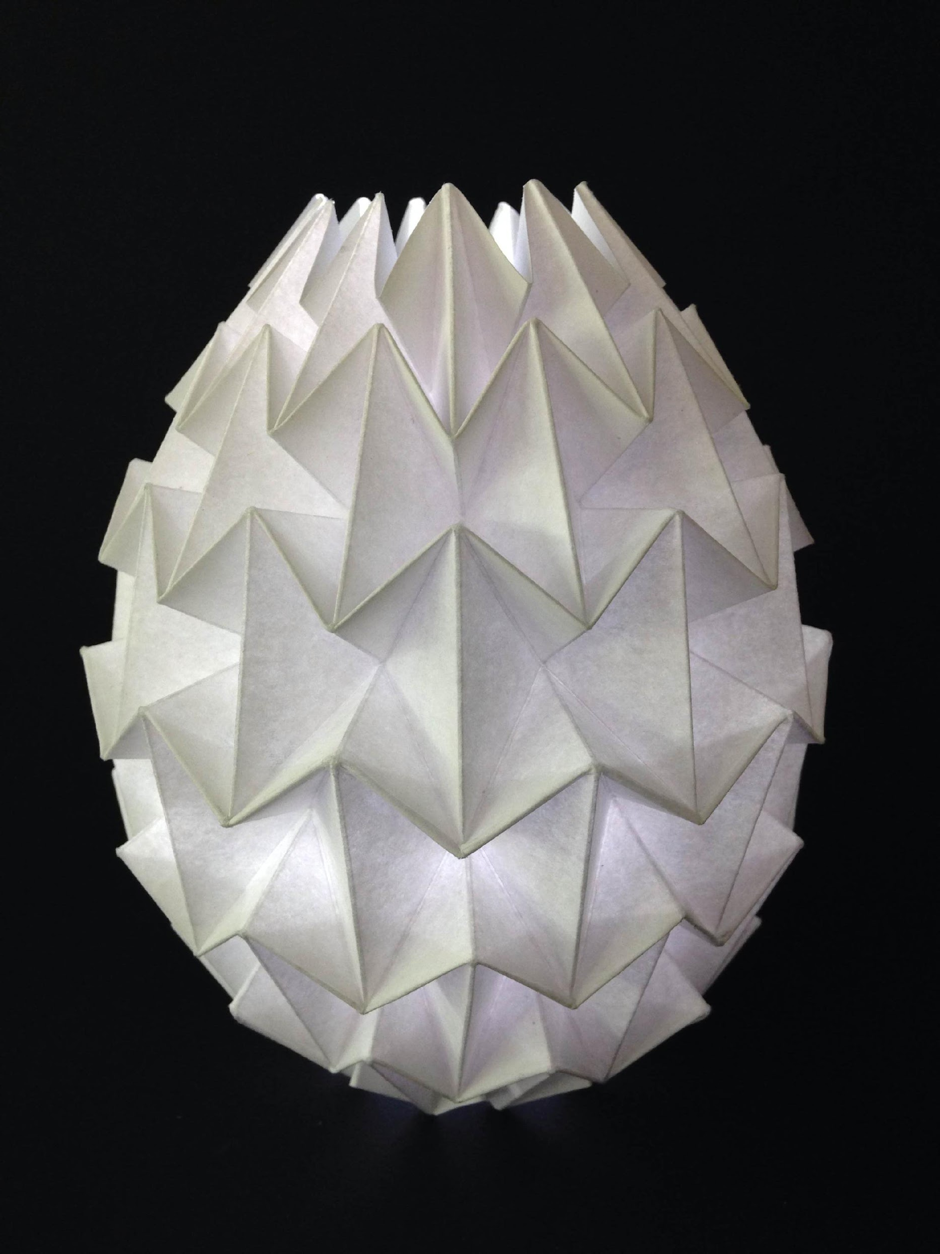
Symmetry is…
… an arrangement of exactly the same parts on opposite sides of a dividing line or plane or about a center or an axis
Notes:
Symmetry is the Mathematical thread that underpins and pulls the design elements of the project together…
…similar to those ferrocement origami dwellings designed by global architect Annapama Kundoo

Slide 4
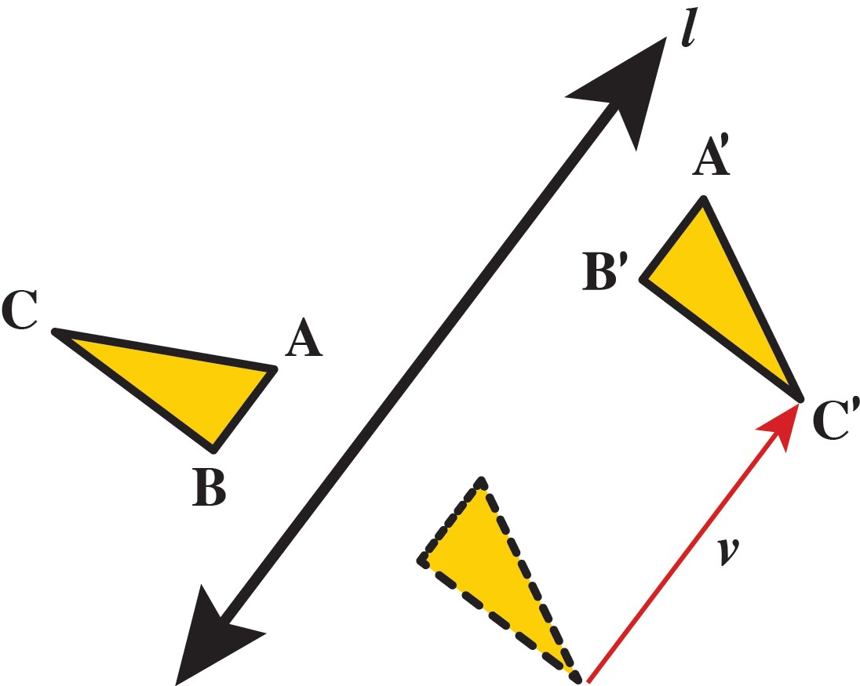

The “glide reflection” in Lumifold makes the symmetry complex.
A'B'C' is the image of ABC under a glide reflection that is a composition of a reflection over the line l and a translation through the vector v
Notes:
In maths, the word “glide” refers to a simple “translation”.
The maths in a glide reflection can be shown as a diagram, in an illustration or written in a sentence.
In any glide reflection, the line of reflection is parallel to the direction of the translation. There are no rules as to whether you glide then reflect or reflect then glide.
This is a commutative transformation.

Slide 5
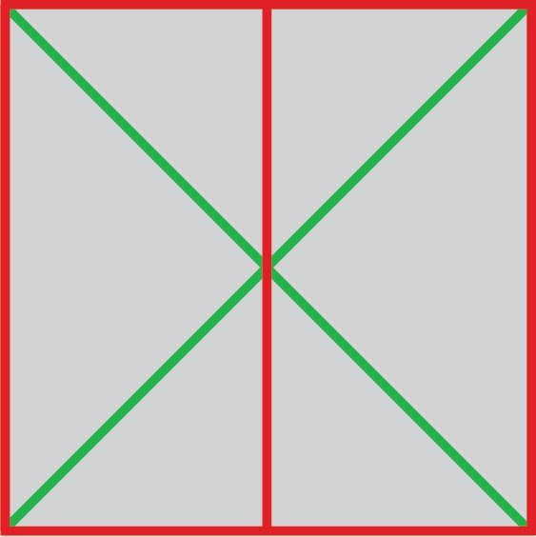
This is the single unit.
All lines are fold lines.
The nature of the form relies on the number of valleys and hills that meet at a point.
The total number must be even.
The number of valleys and hills must differ by two.
The choice between numbers determines whether the shape is formed up or down.
flat to form
2D to 3D
Notes:
The mathematical rules for transforming the flat shape into a glide reflection pattern.

Slide 6
Make sure the paper is facing the right way up. The diagonals should feel like a small hill and the horizontal centre
line should feel like like a small valley.
The horizontal axis is missing but you need to imagine it is there.
Notes:
Feel the paper with your hands. There will be hills and valleys according to which side is facing up. The image above shows the long lines as hills and the diagonal lines as valleys.
You will have already applied colour to this side of the paper.

Slide 7
Designing the Bug
Toss a coin to determine how to colour the binary pattern using probability.
Heads = White (No colour)
Tails = Black or other colour
Starting on the left side at 1. Toss the coin and colour accordingly.

Slide 8
Designing the Bug
Repeat the coin toss until you reach 8 tosses in total

Slide 9
Designing the Bug
You can choose to use a Glide Reflection pattern or a Double Translation pattern.
Ask your teacher and choose the correct set of instructions on the website.

Slide 10
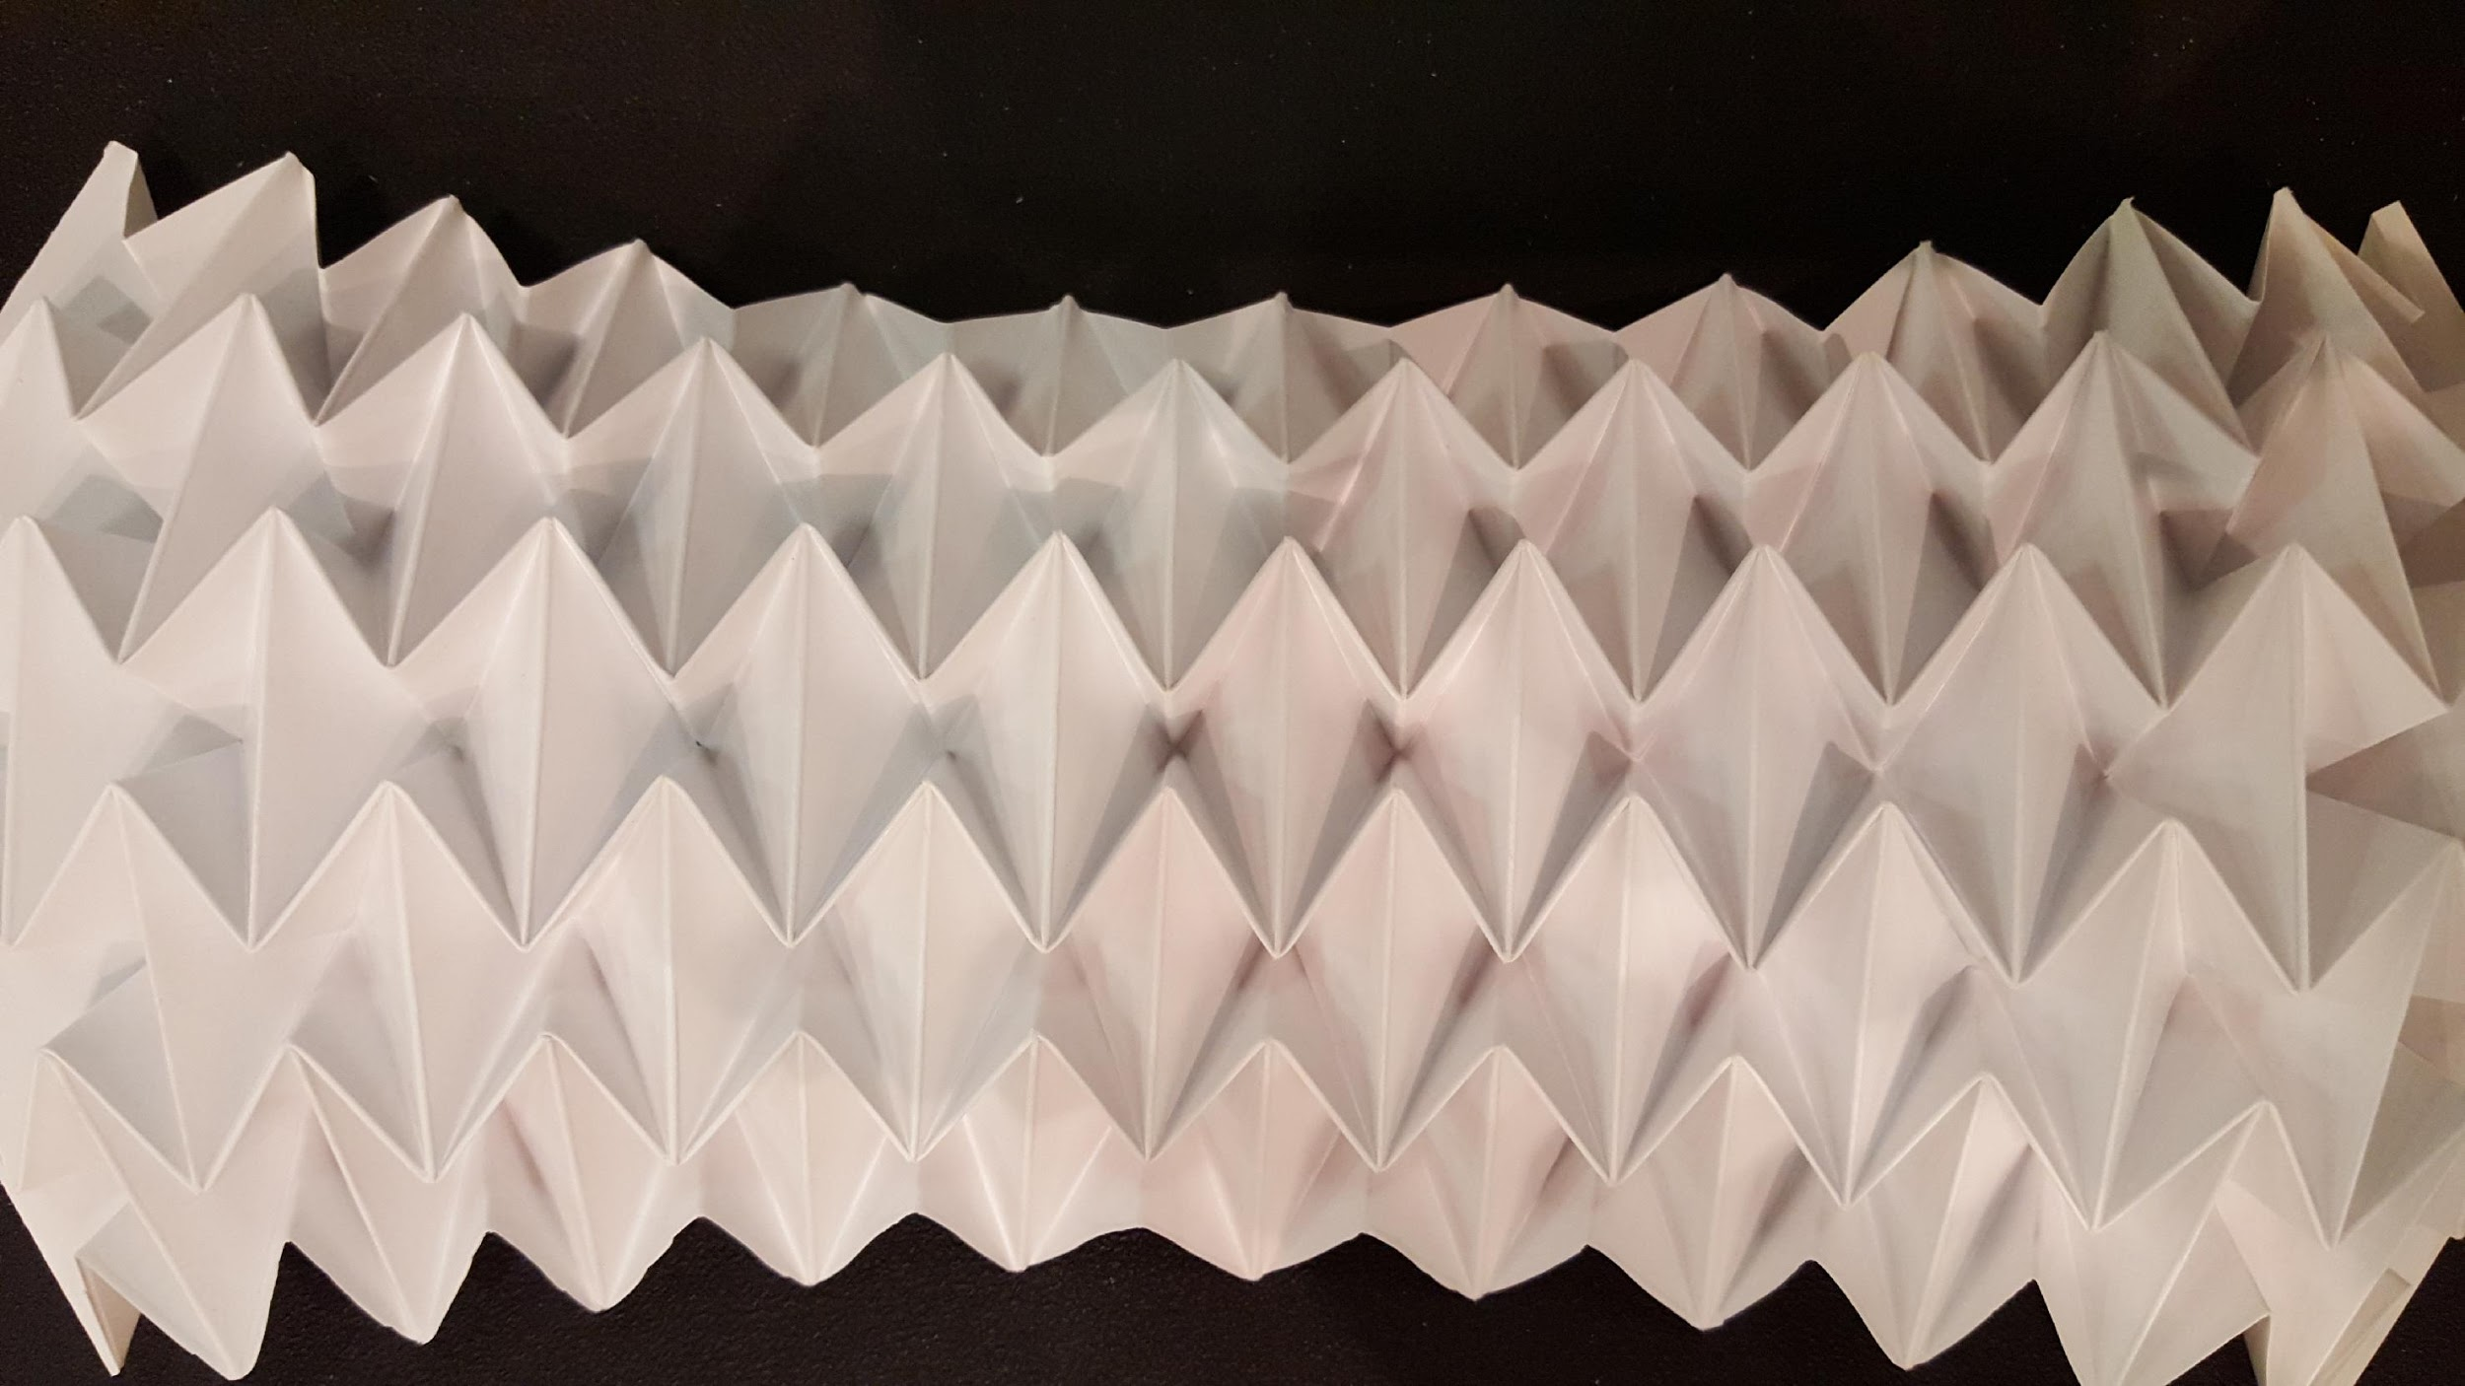
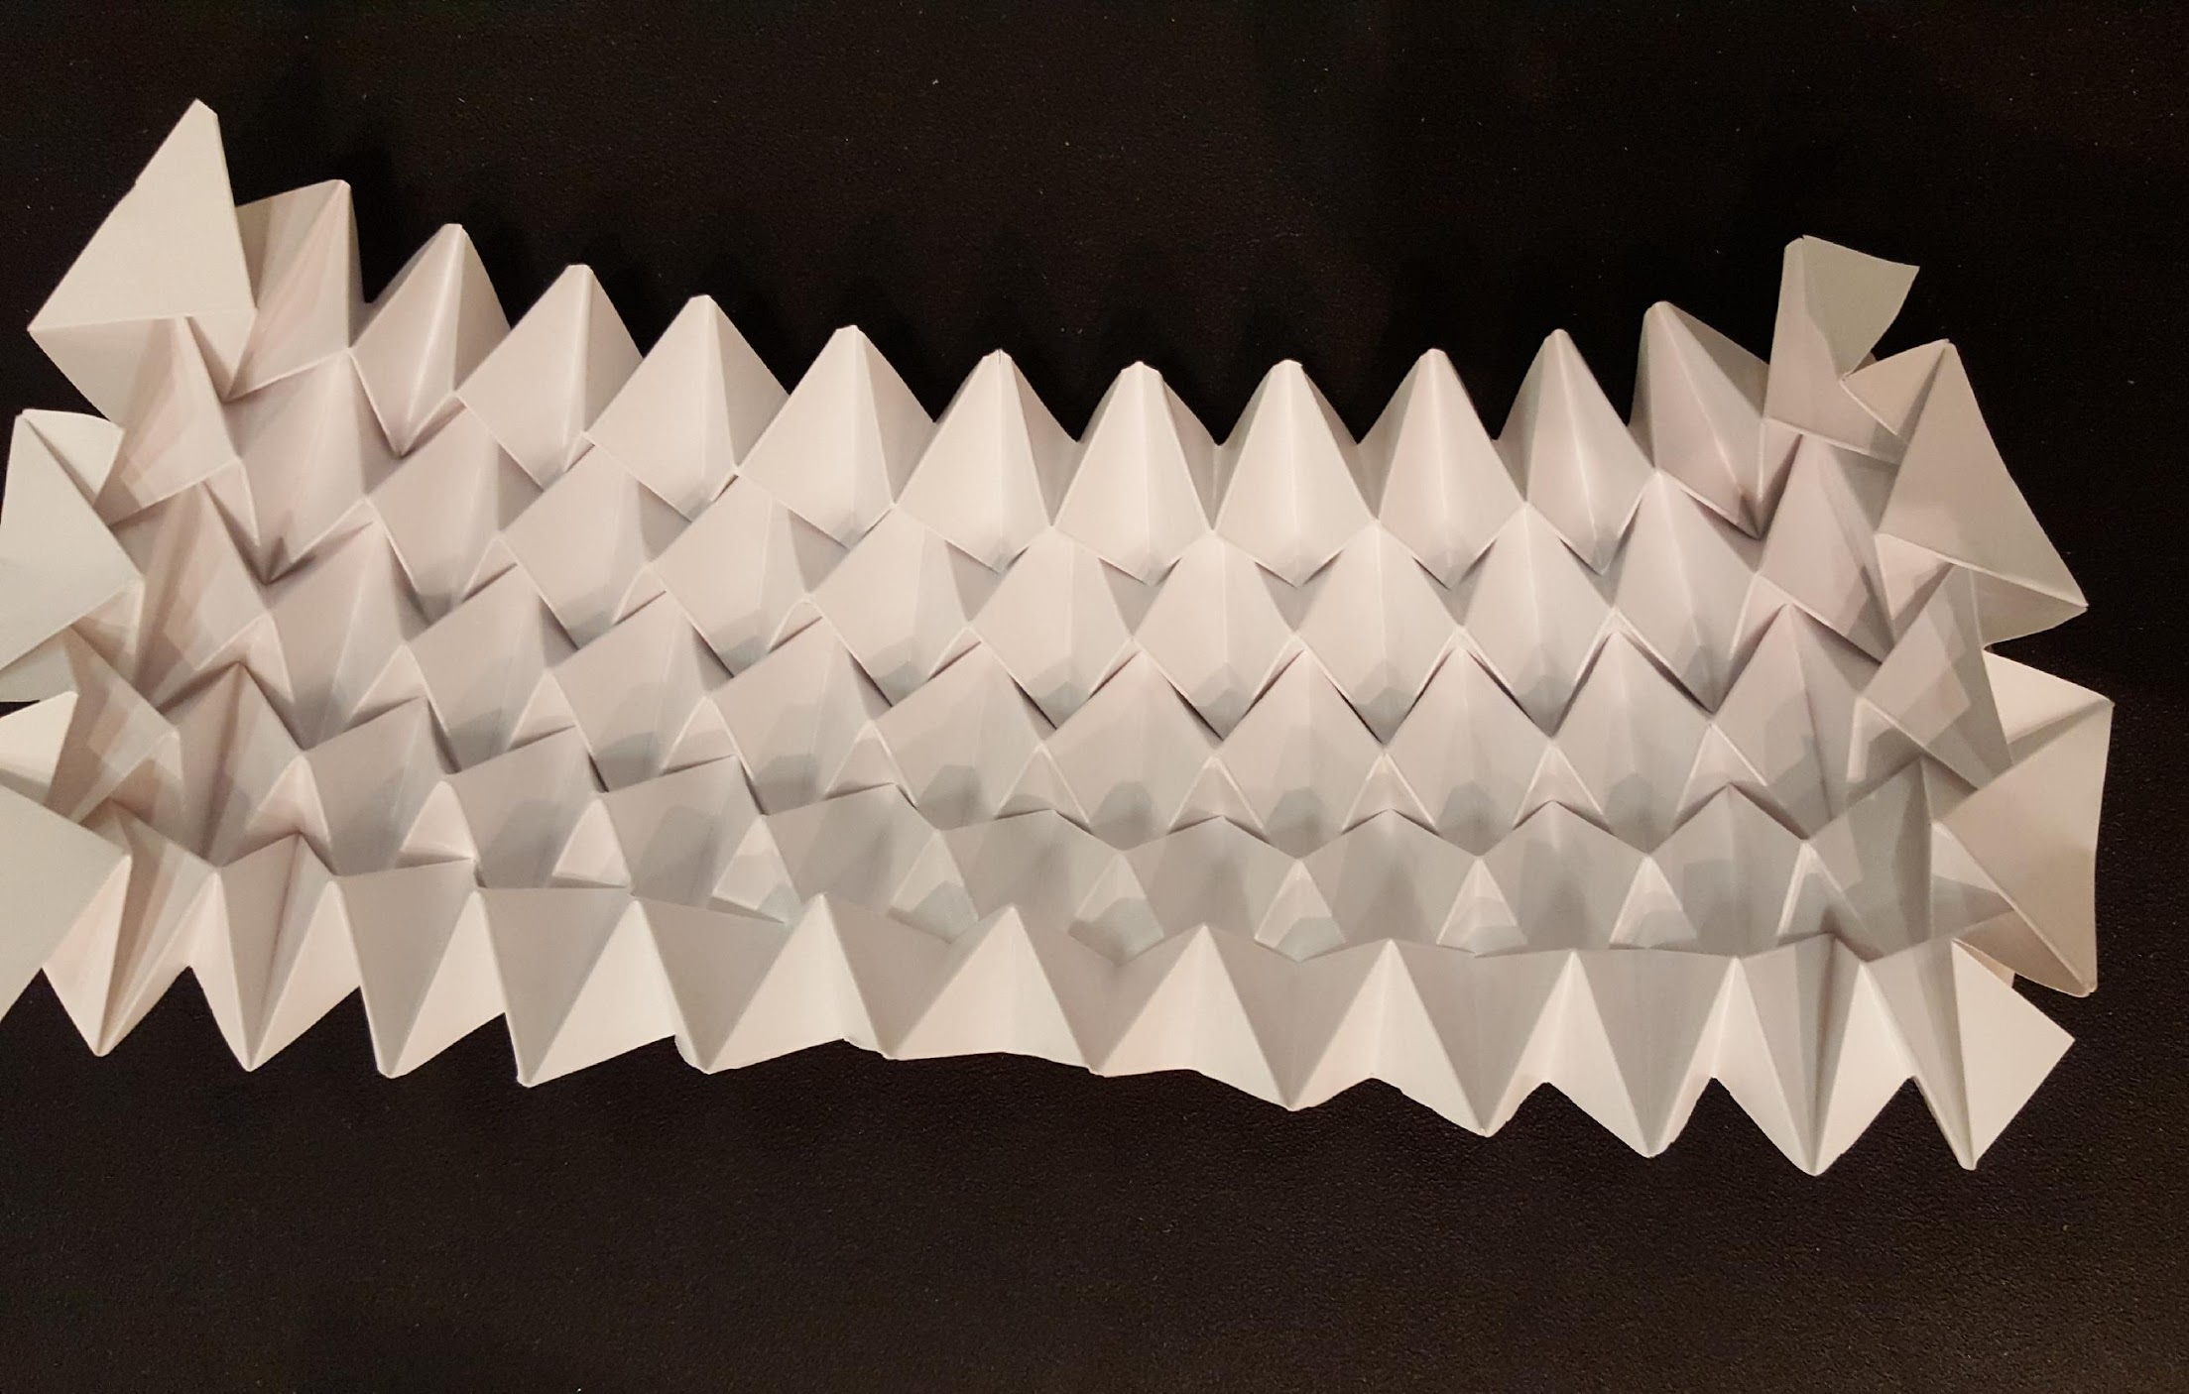
up
down

Slide 11
Notes:
These patterns were made using the double translation method. The folding uses the glide reflection method.

