Slide 1
Downloading Arduino
FOR MAC

Slide 2
1. Go to the website and download the software that corresponds with your device https://www.arduino.cc/en/Main/Software

Slide 3
2. Click ‘just download’

Slide 4
The file is in Zip format; if you use Safari it will be automatically expanded. If you use a different browser you may need to extract it manually.

Slide 5
3. Copy the Arduino application into the Applications folder (or elsewhere on your computer).

Slide 6
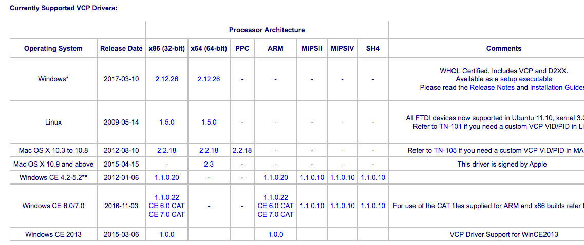
4. Go to the following link and download x64 for Mac OSC 10.9 and above
http://www.ftdichip.com/Drivers/VCP.htm

Slide 7
5. Go to the following link and download the CH34X driver
https://drive.google.com/file/d/0BwVeB5VOPU4RY2xVdUU3Tmx5Rmc/view?pageId=108203614547461735102

Slide 8
6. Connect the board to your computer using the USB cable. The green power LED (labelled PWR) should go on.

Slide 9
7. Go back to the Arduino app and select your Arduino board. Go to tools > board > Arduino Genuino Uno

Slide 10
8. Select the port. Go to tools > port > /dev/cu.wchusbserial1410

Slide 11
7. Once the board and port options are correct, install a new library. Go to sketch > include library > manage libraries

Slide 12
8. Type in FastLED in the search bar and install the latest version (3.1.3)

Slide 13
9. Go back to manage libraries Go to sketch > include library > manage libraries

