Slide 1
Downloading Arduino
FOR WINDOWS

Slide 2
1. Go to the website and download the software that corresponds with your device https://www.arduino.cc/en/Main/Software

Slide 3
2. Click ‘just download’

Slide 4
Choose ‘Save as’ to save the installation file on your Desktop. Or it may just download into your ‘Downloads’ folder.

Slide 5
3. If it downloaded to your ‘Downloads’ folder, open the folder and drag the file onto your desktop. Double click the arduino file icon on your desktop.

Slide 6
If you get a Windows security warning, click “Run” to begin the installation.

Slide 7
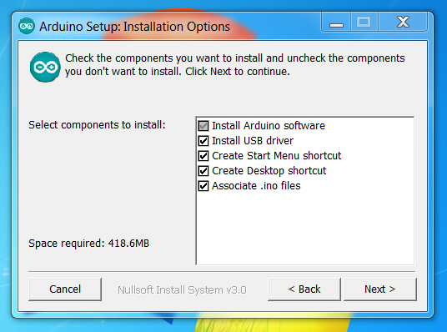
Click ‘I Agree’ for the licence agreement. Then click ‘Next’ for all the options to be installed

Slide 8
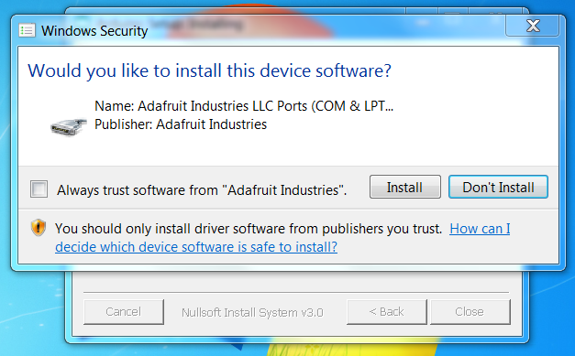
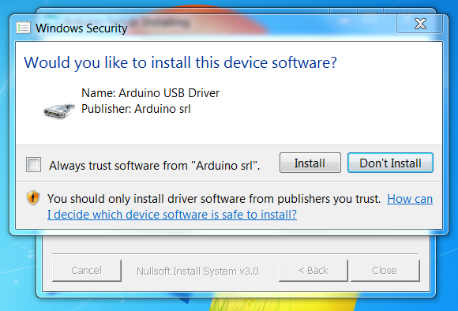
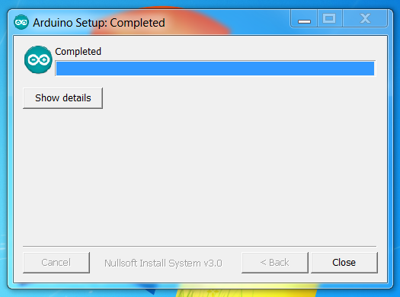
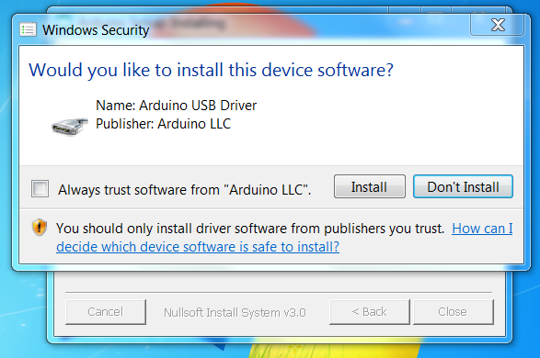
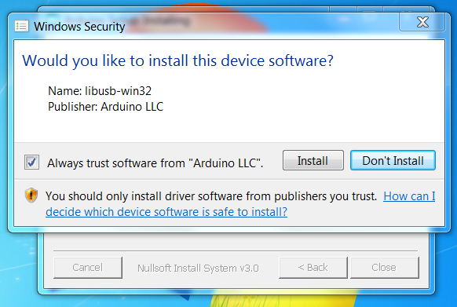
Click “Install” and install all the device software, finally click “Close”

Slide 9
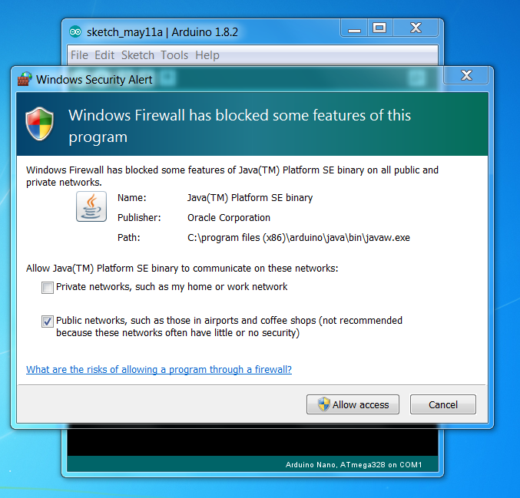
Double click on the new desktop icon, and “Allow access” for the firewall warning

Slide 10
4. Connect the board to your computer using the USB cable. The green power LED (labelled PWR) should go on.

Slide 11
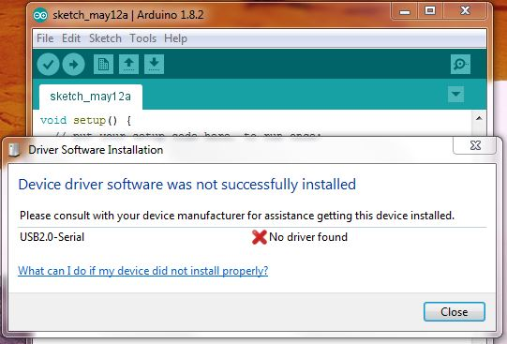
Windows may try to search for device driver software – this is good if successful. If not successful, device driver will be downloaded later.

Slide 12
5. Setting up your Arduino Uno board: Click on “Tools” in the sketch window

Slide 13
Select your Arduino board. Choose Arduino/Genuino Uno

Slide 14
Again, in “Tools” select the port (e.g. ‘COM 4’) then go to Step 6. If “Port” is greyed out, you will now need to download the device driver software…..

Slide 15
If the port is not there go to the link below, download the CH340 driver, follow the instructions
http://sparks.gogo.co.nz/ch340.html

Slide 16
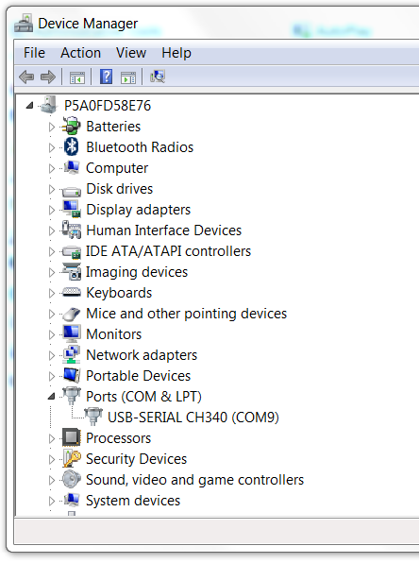
Now go back and choose the correct com port. You can check this in Device Manager.

Slide 17
6. Now try to upload the example sketch called ‘Blink’ to your Arduino board. File → Examples → 01.Basics → Blink

Slide 18
Now press the upload icon. If upload is successful, the small LED on the board will blink on and off.

