Slide 1
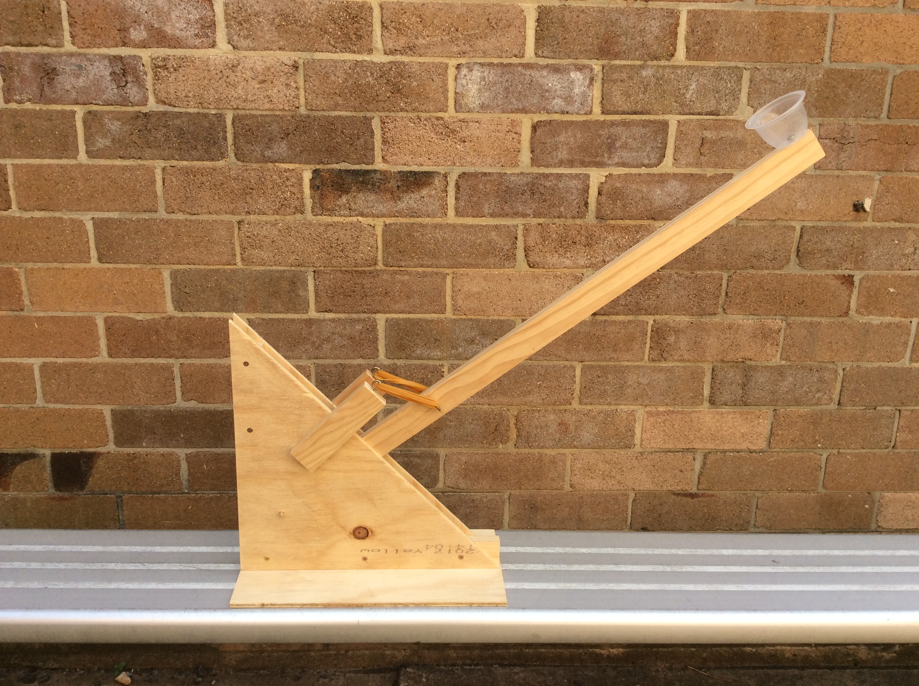
How to build a ballistic launcher
How to build a ballistic launcher

Slide 2
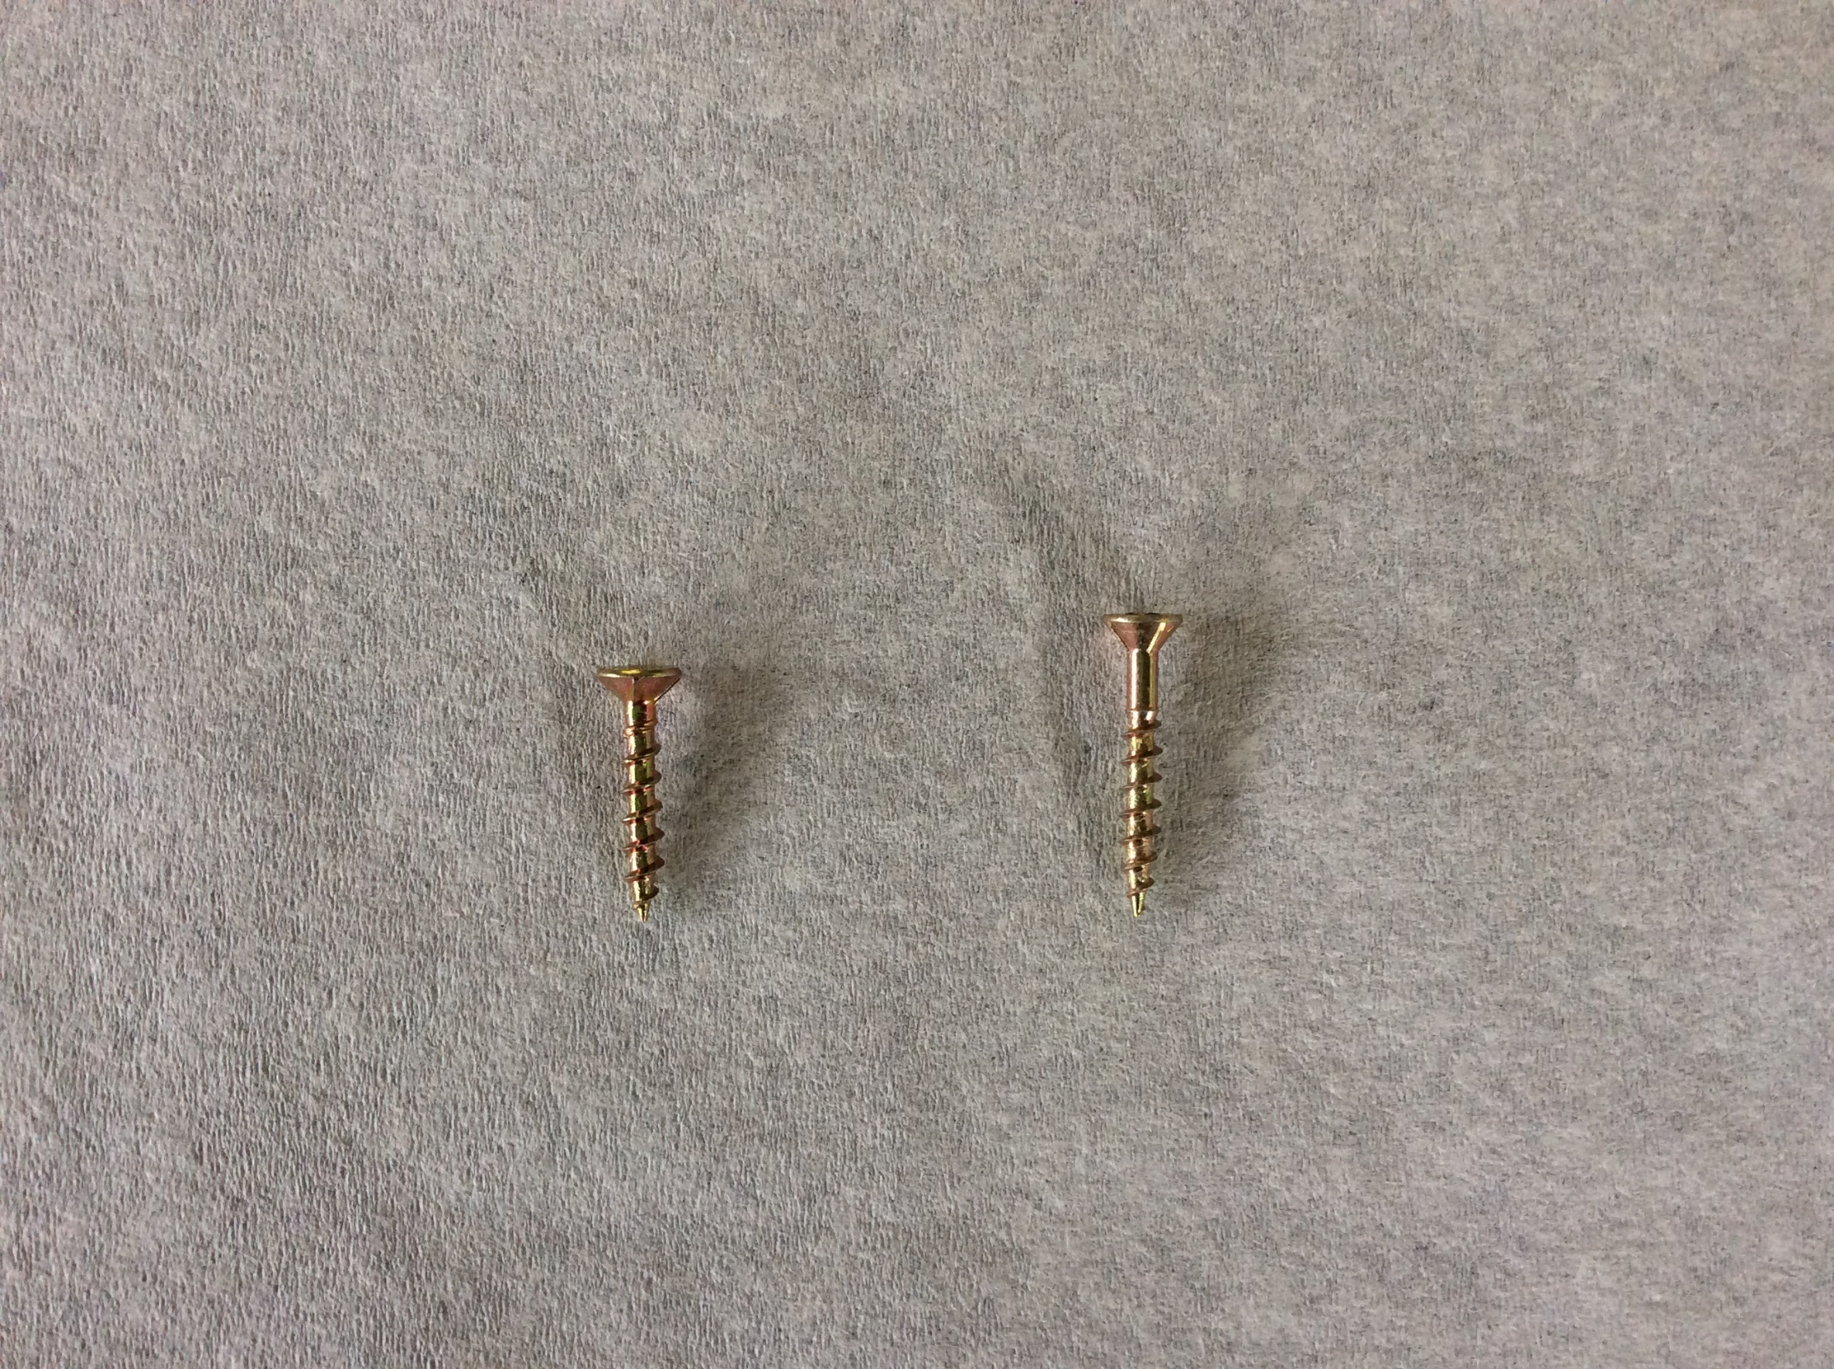
To make this launcher, we will use 9 short screws and 8 long screws:
SHORT LONG

Slide 3
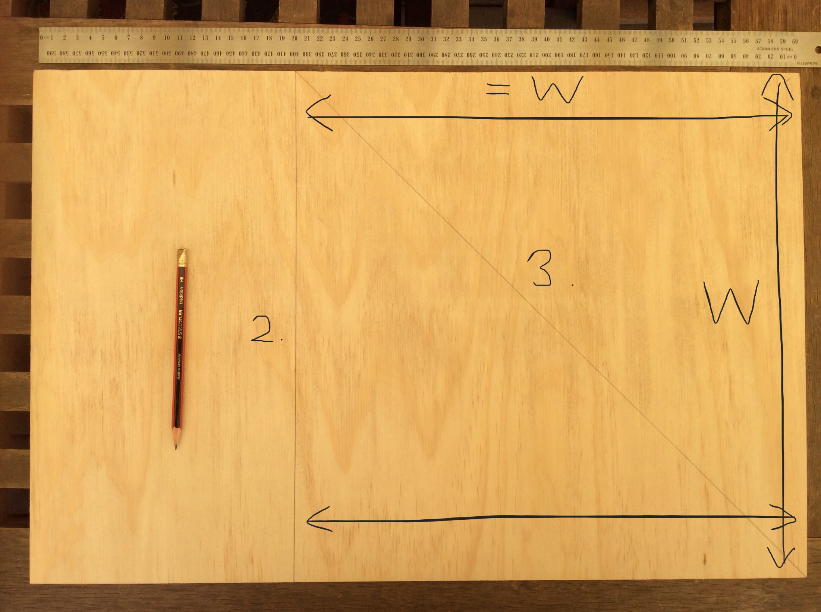
1.Measure the width W of your board
2. Measure the same distance along the top and bottom of the board and draw a line to make a square
3. Draw a diagonal line across the square.
All lines must be straight!

Slide 4
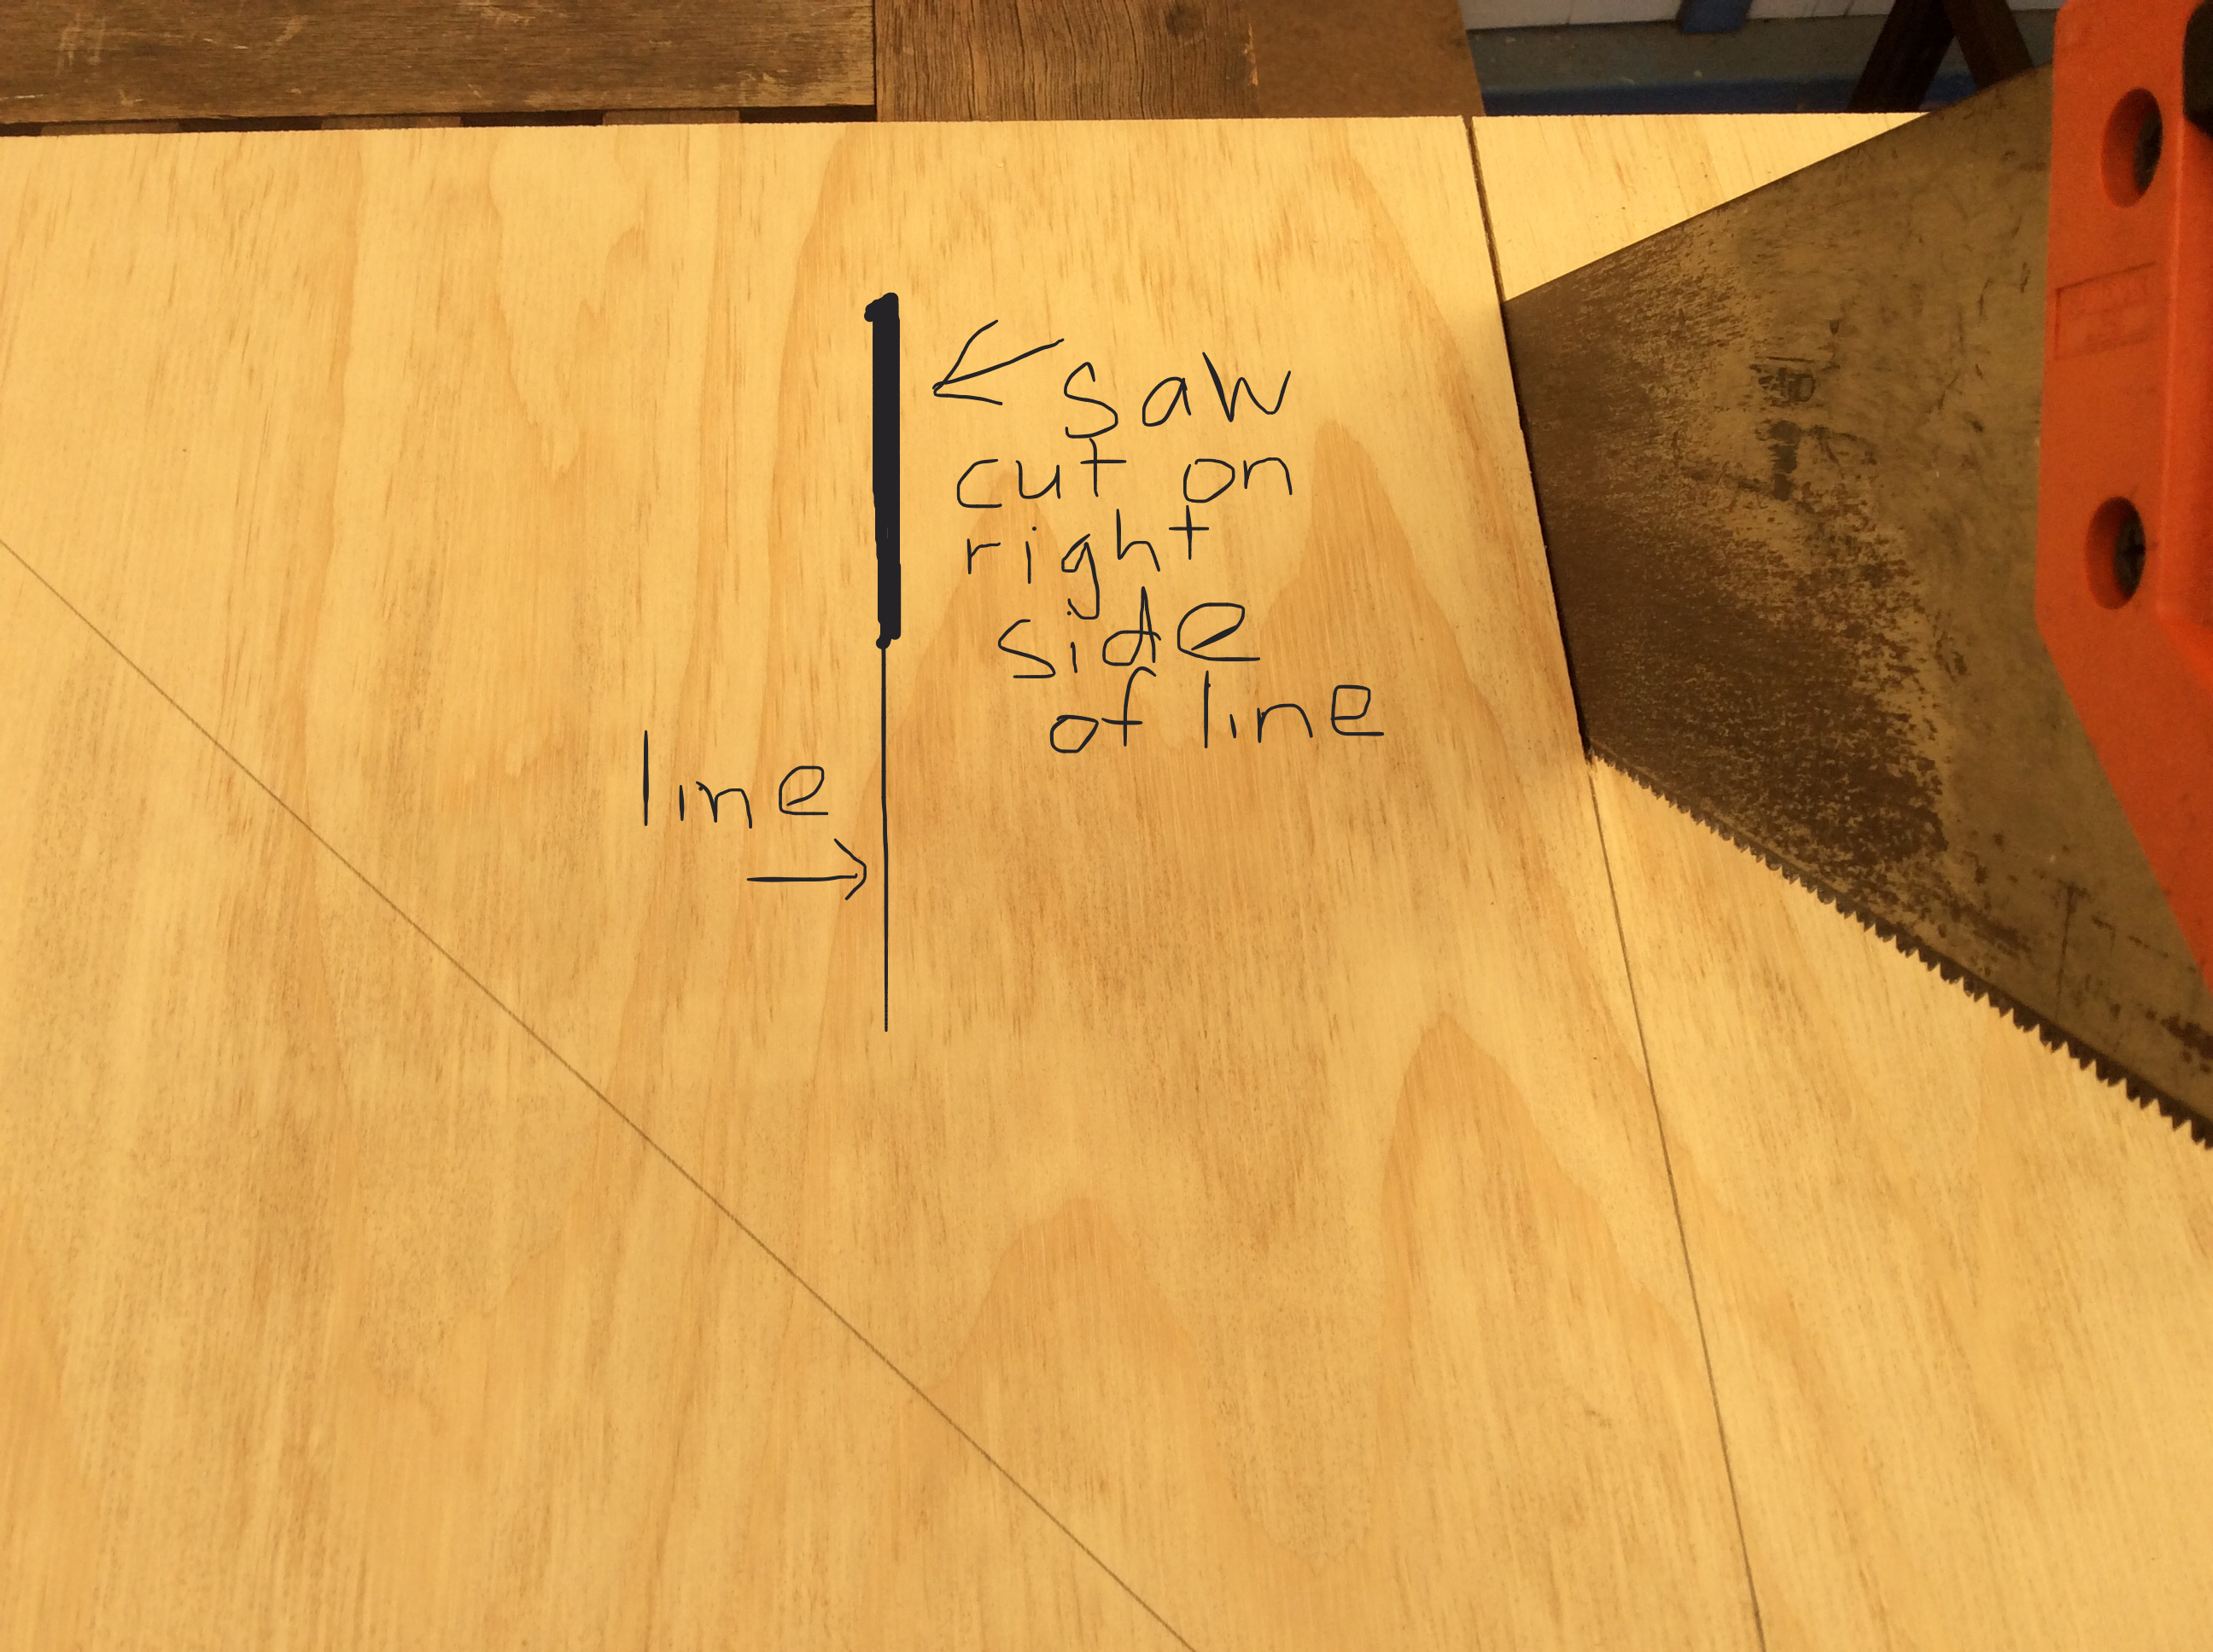
Cut off the smaller rectangle board.
Make the saw cut so that it just touches the RIGHT side of the line

Slide 5
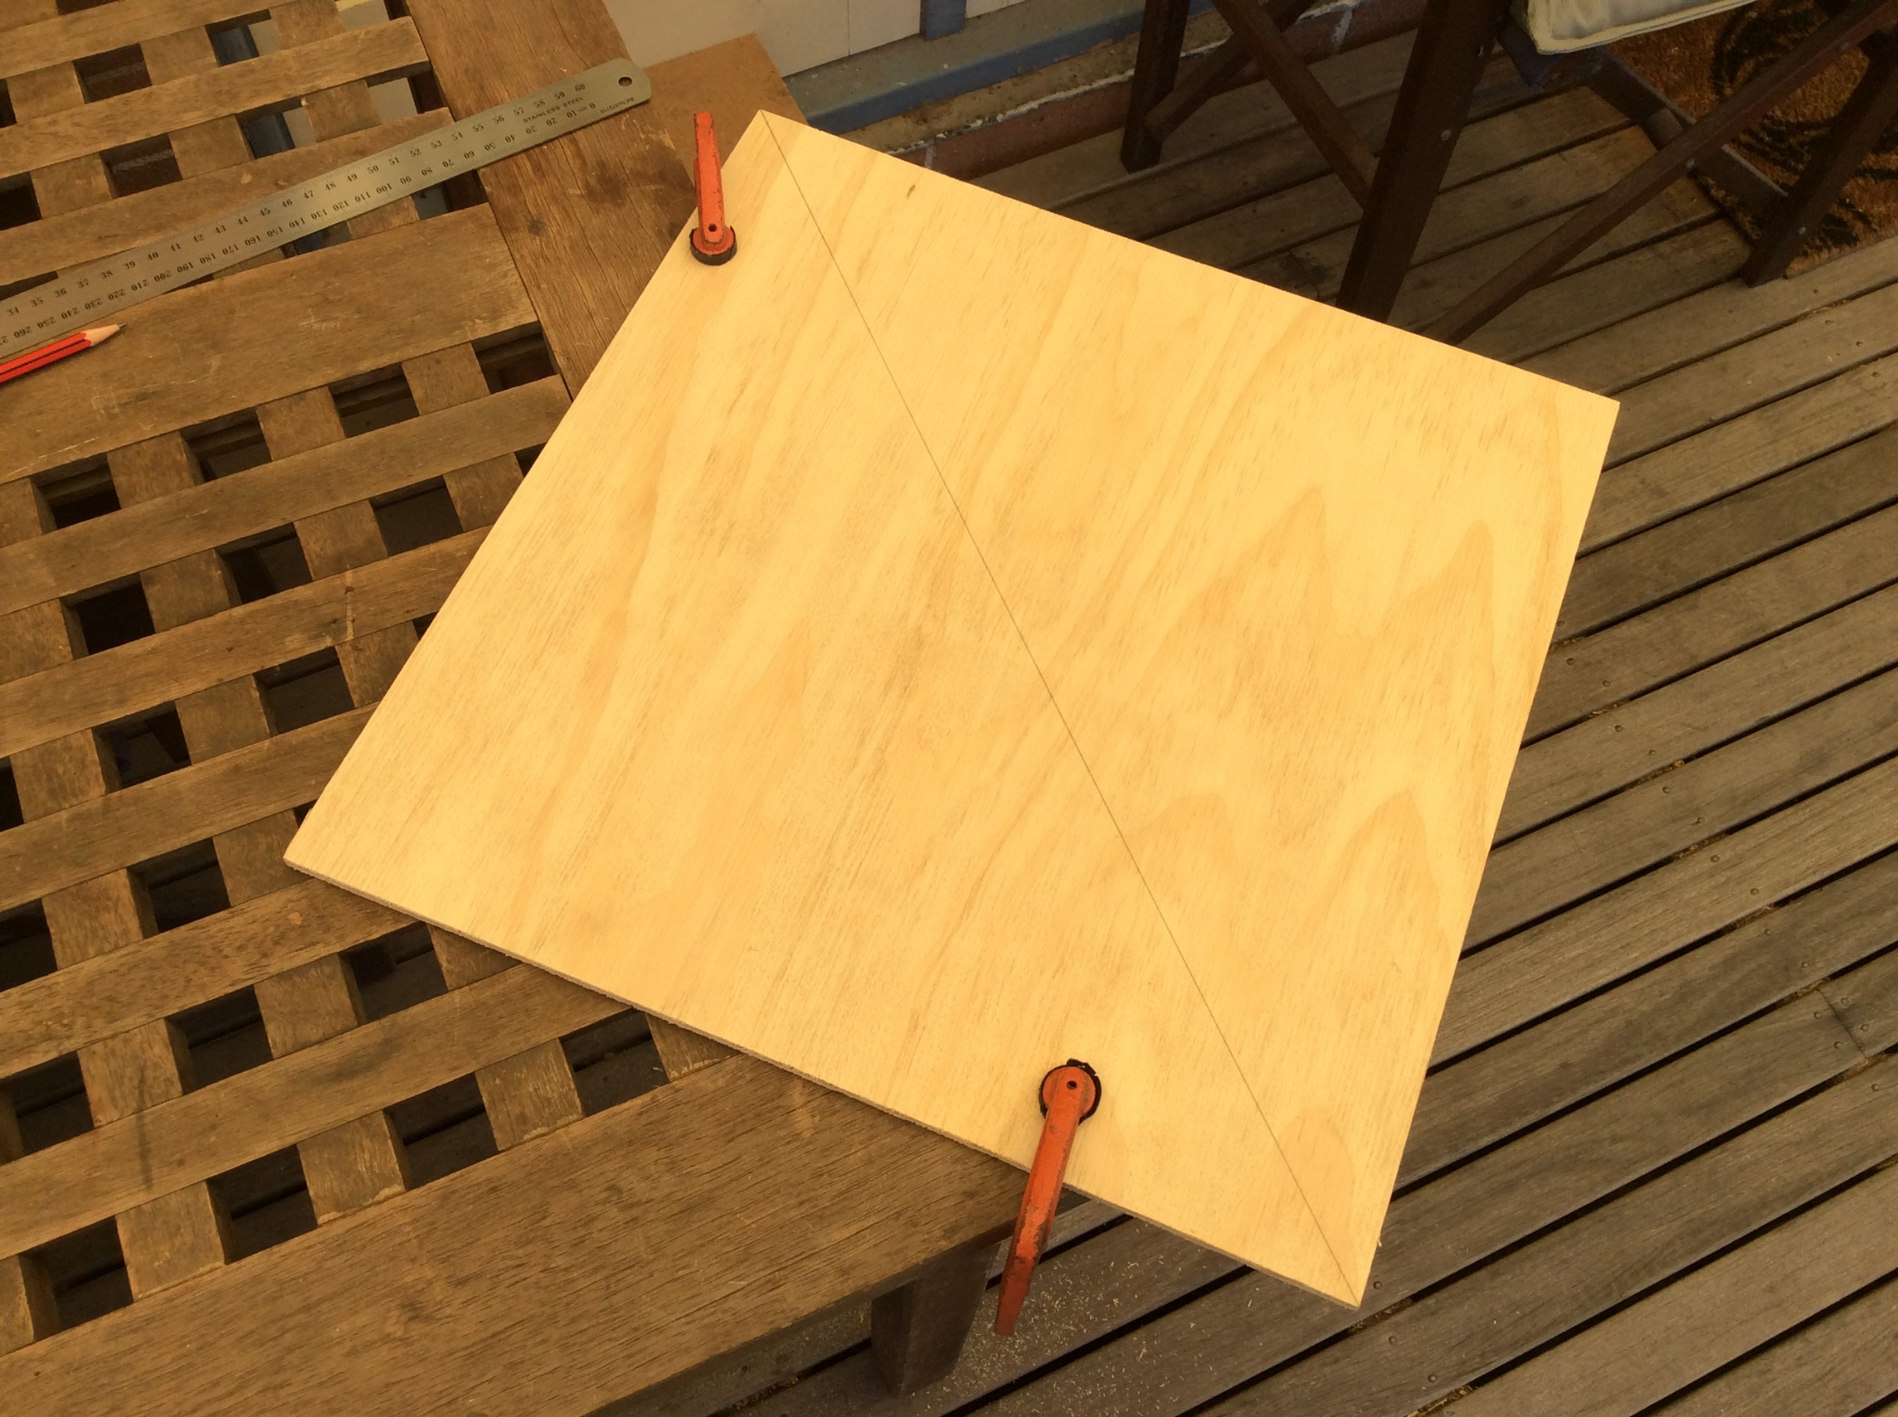
Get ready to cut the square diagonally.
Clamp the board so that the cut line will be away from the edge of your table

Slide 6
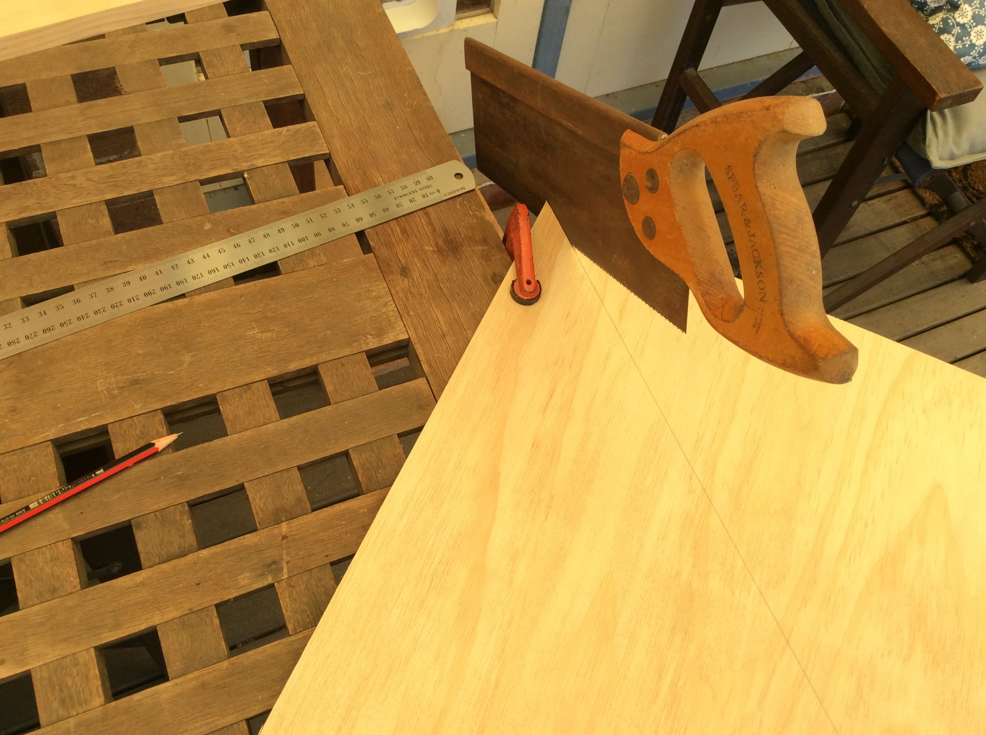
Begin the saw cut with a small tenon saw with small teeth.
Look at the NEXT picture BEFORE you cut!

Slide 7
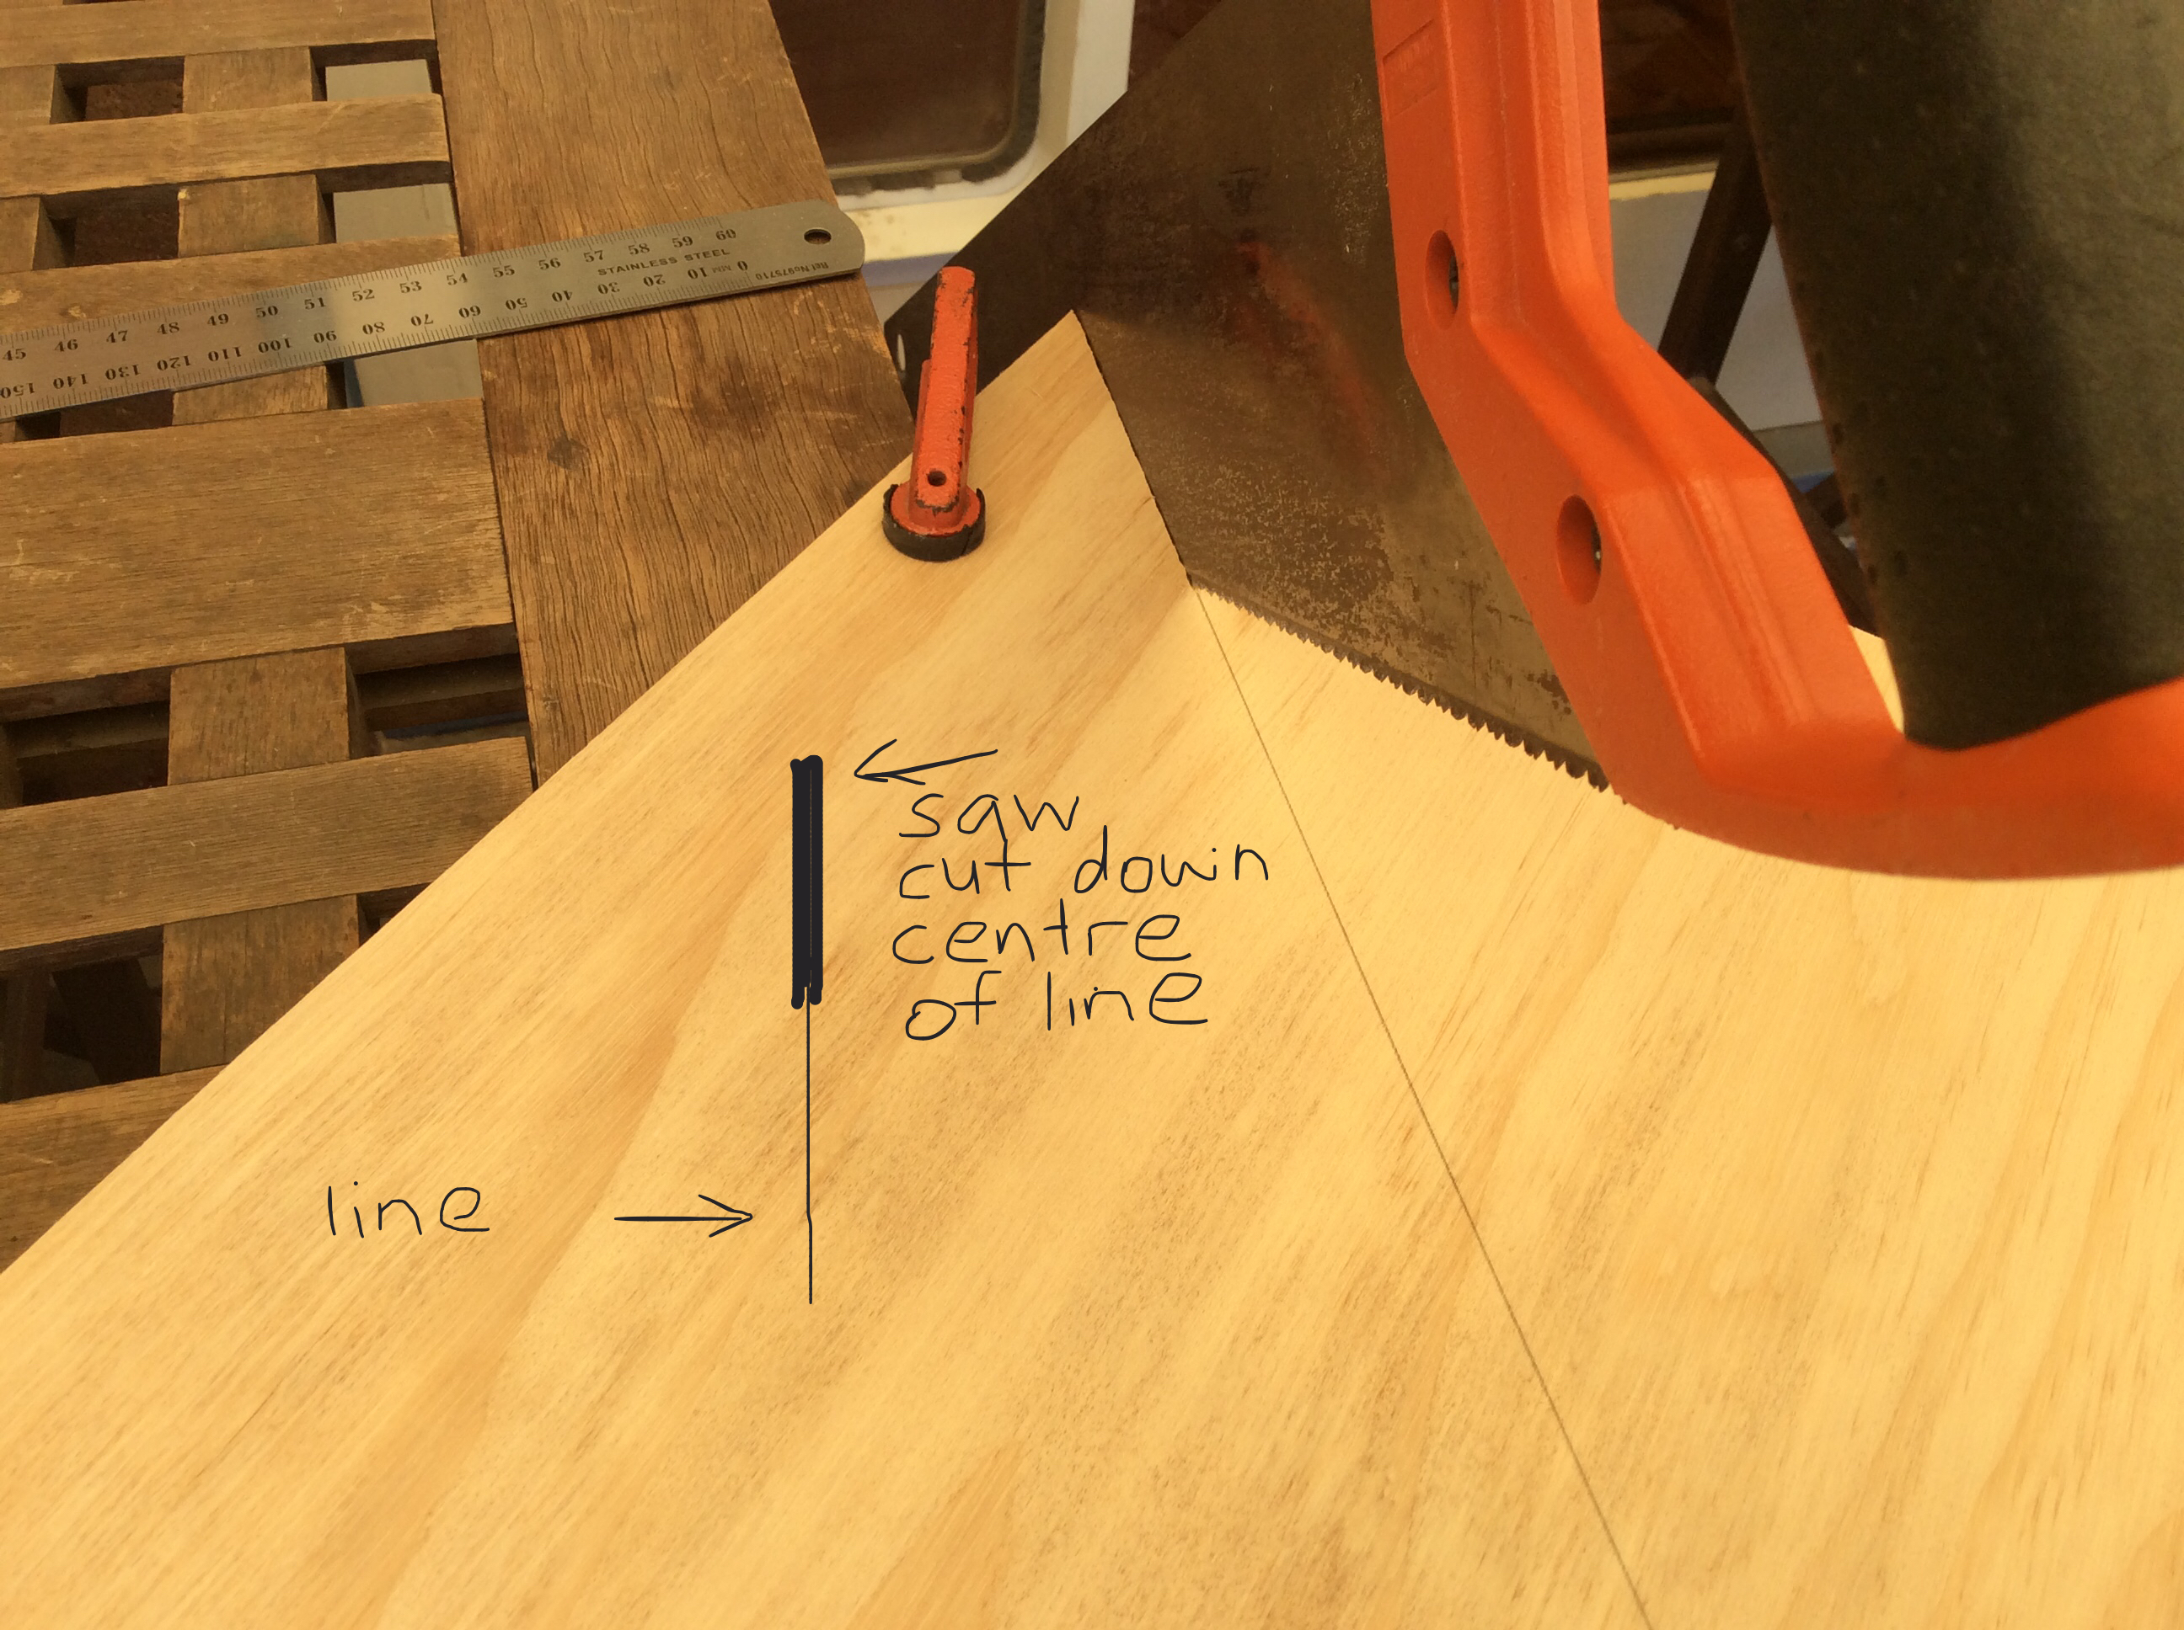
Cut down the centre of your cut line this time!
Change to a larger panel saw when you get the cut started.

Slide 8
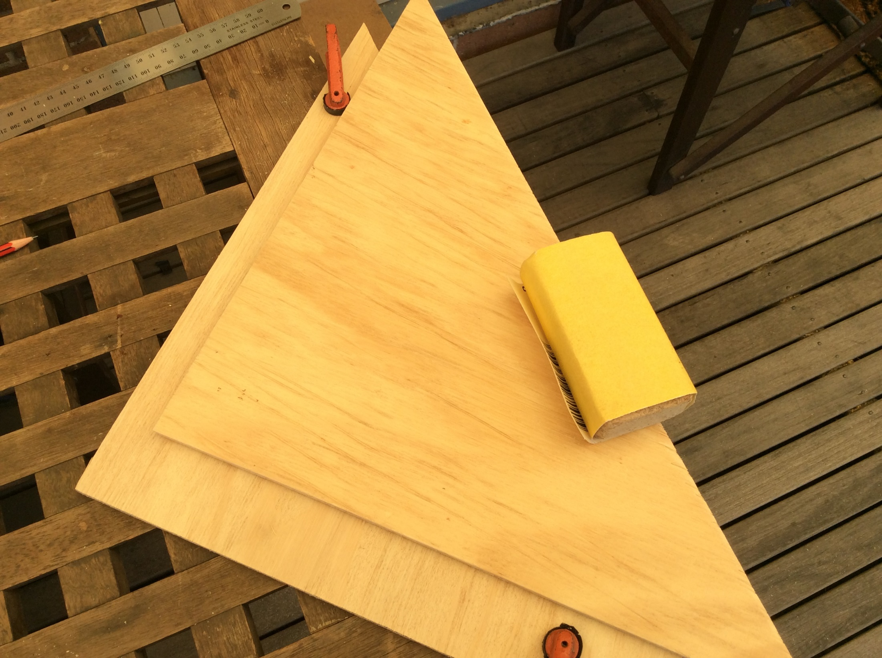
Use sand paper on a sanding block to remove wood splinters and smooth the edges and surface of the two triangle boards

Slide 9
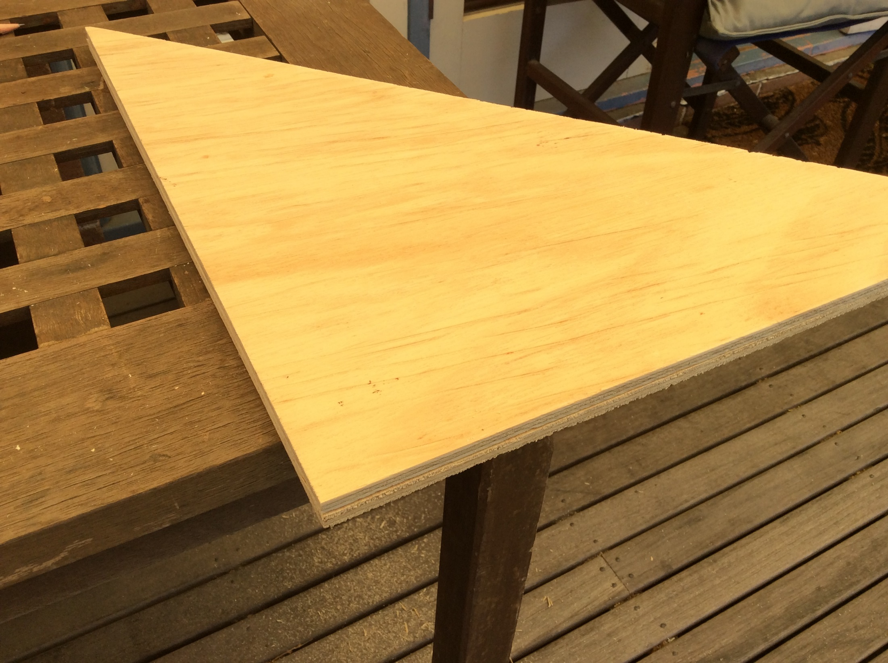
Line up the two triangles to check they are the same size

Slide 10
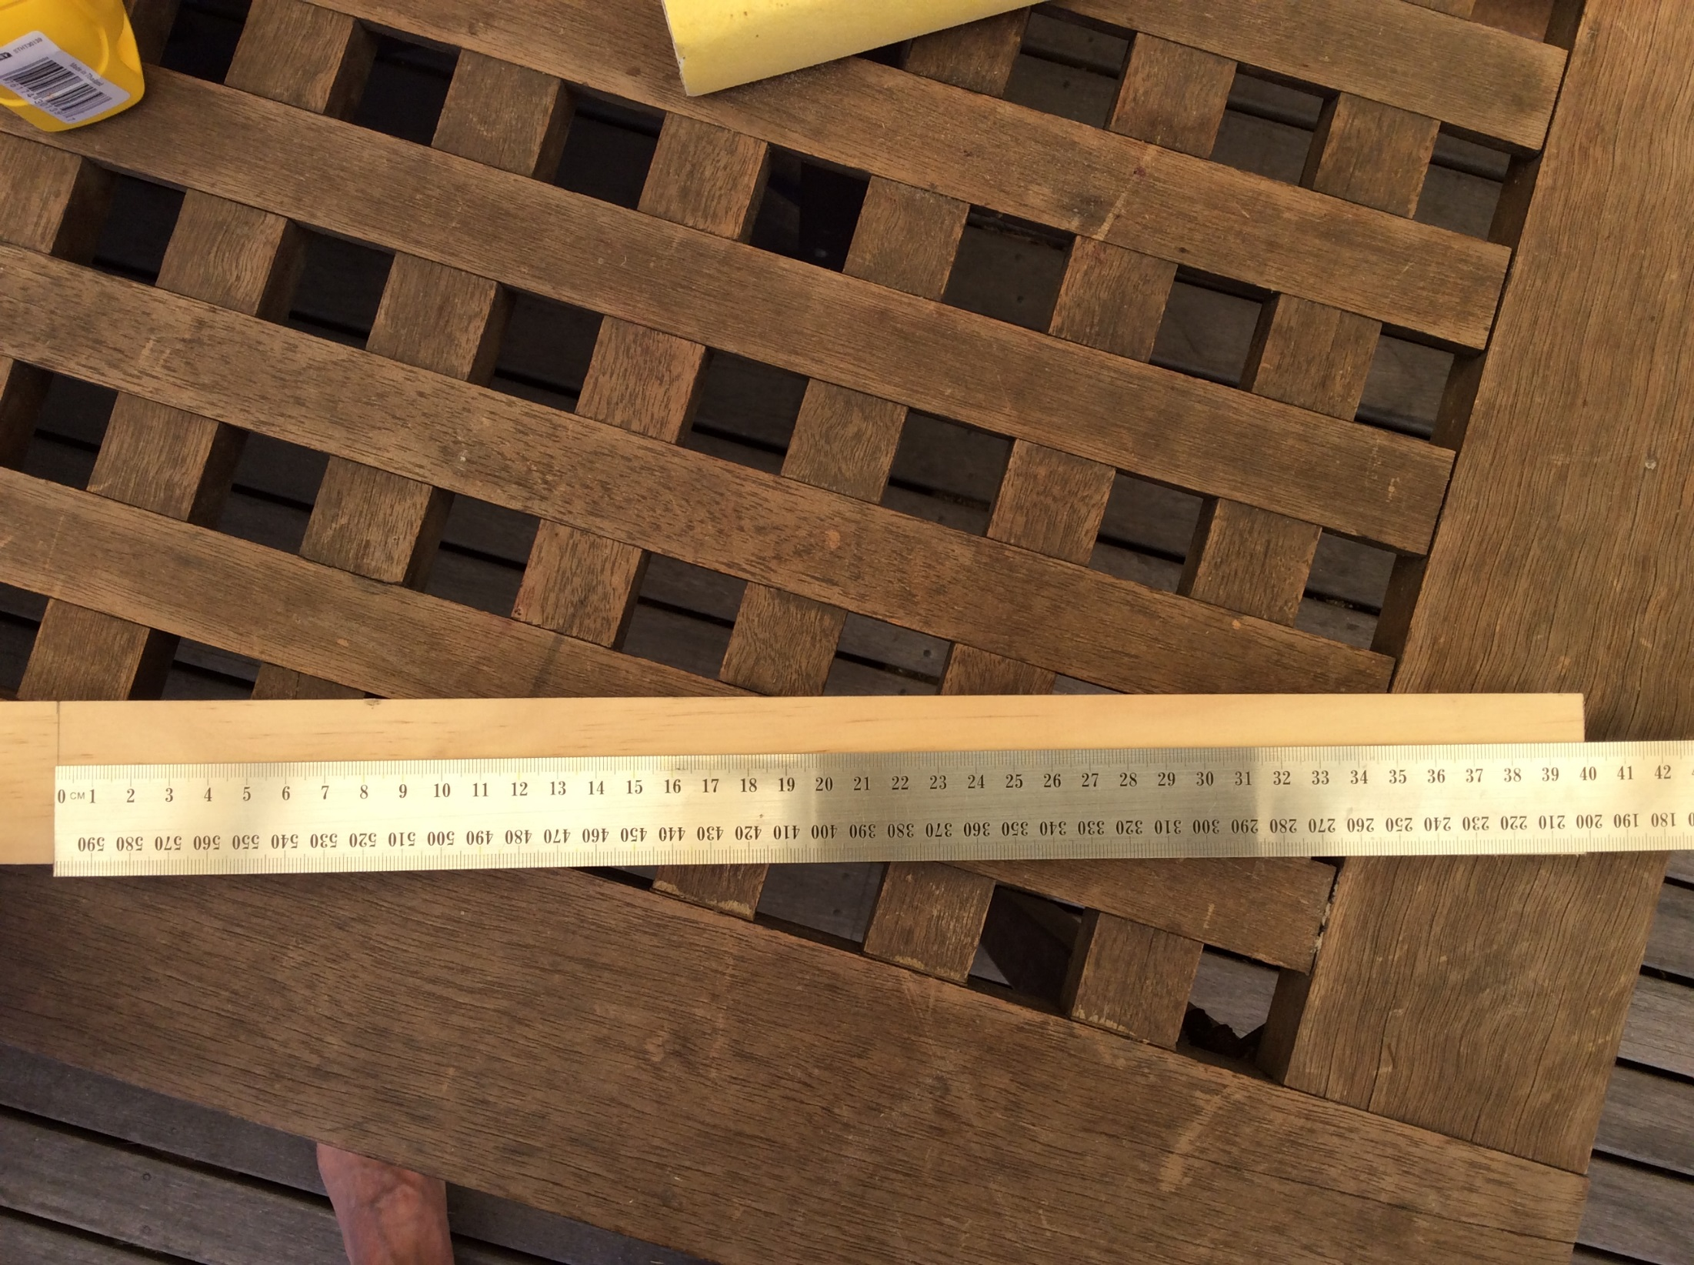
Next, cut a length of pine timber about 400mm, (or as long as the width W of your original square)
You can use a set square or small carpenter’s square to make sure the cut line is “square” (90 degrees to the side of the length of pine timber)

Slide 11
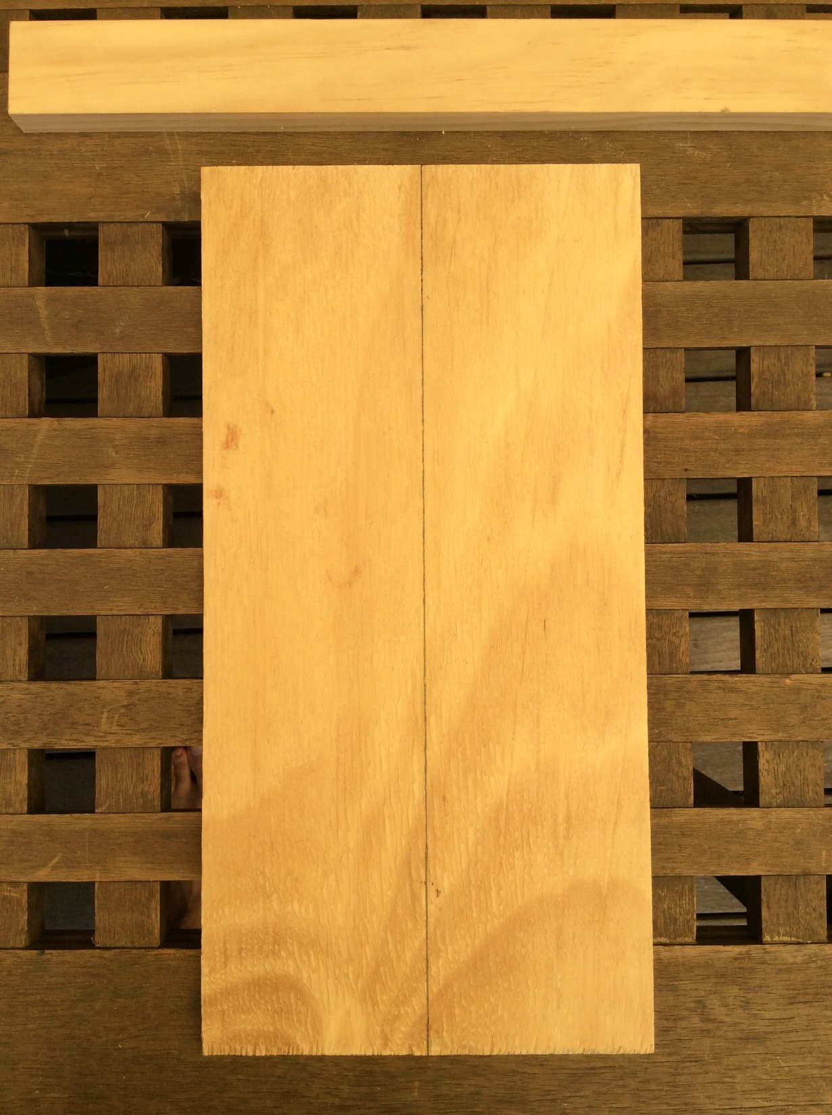
Next, measure and draw a line down the middle of your smaller rectangle board.

Slide 12
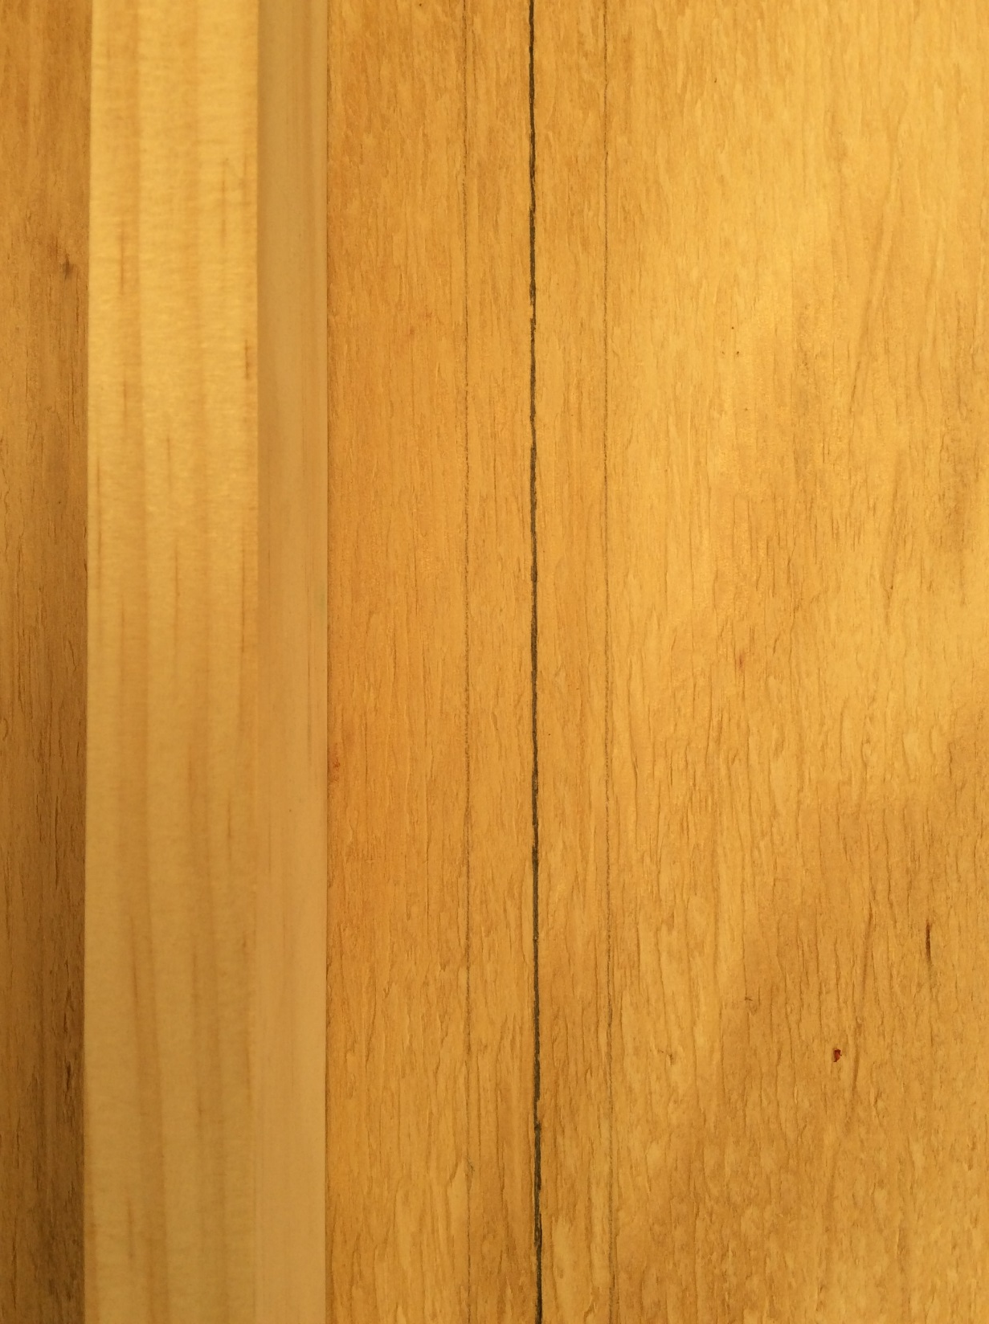
Place the side of the pine over the centre line and trace the width of the board on each side….
See the two faint lines!

Slide 13
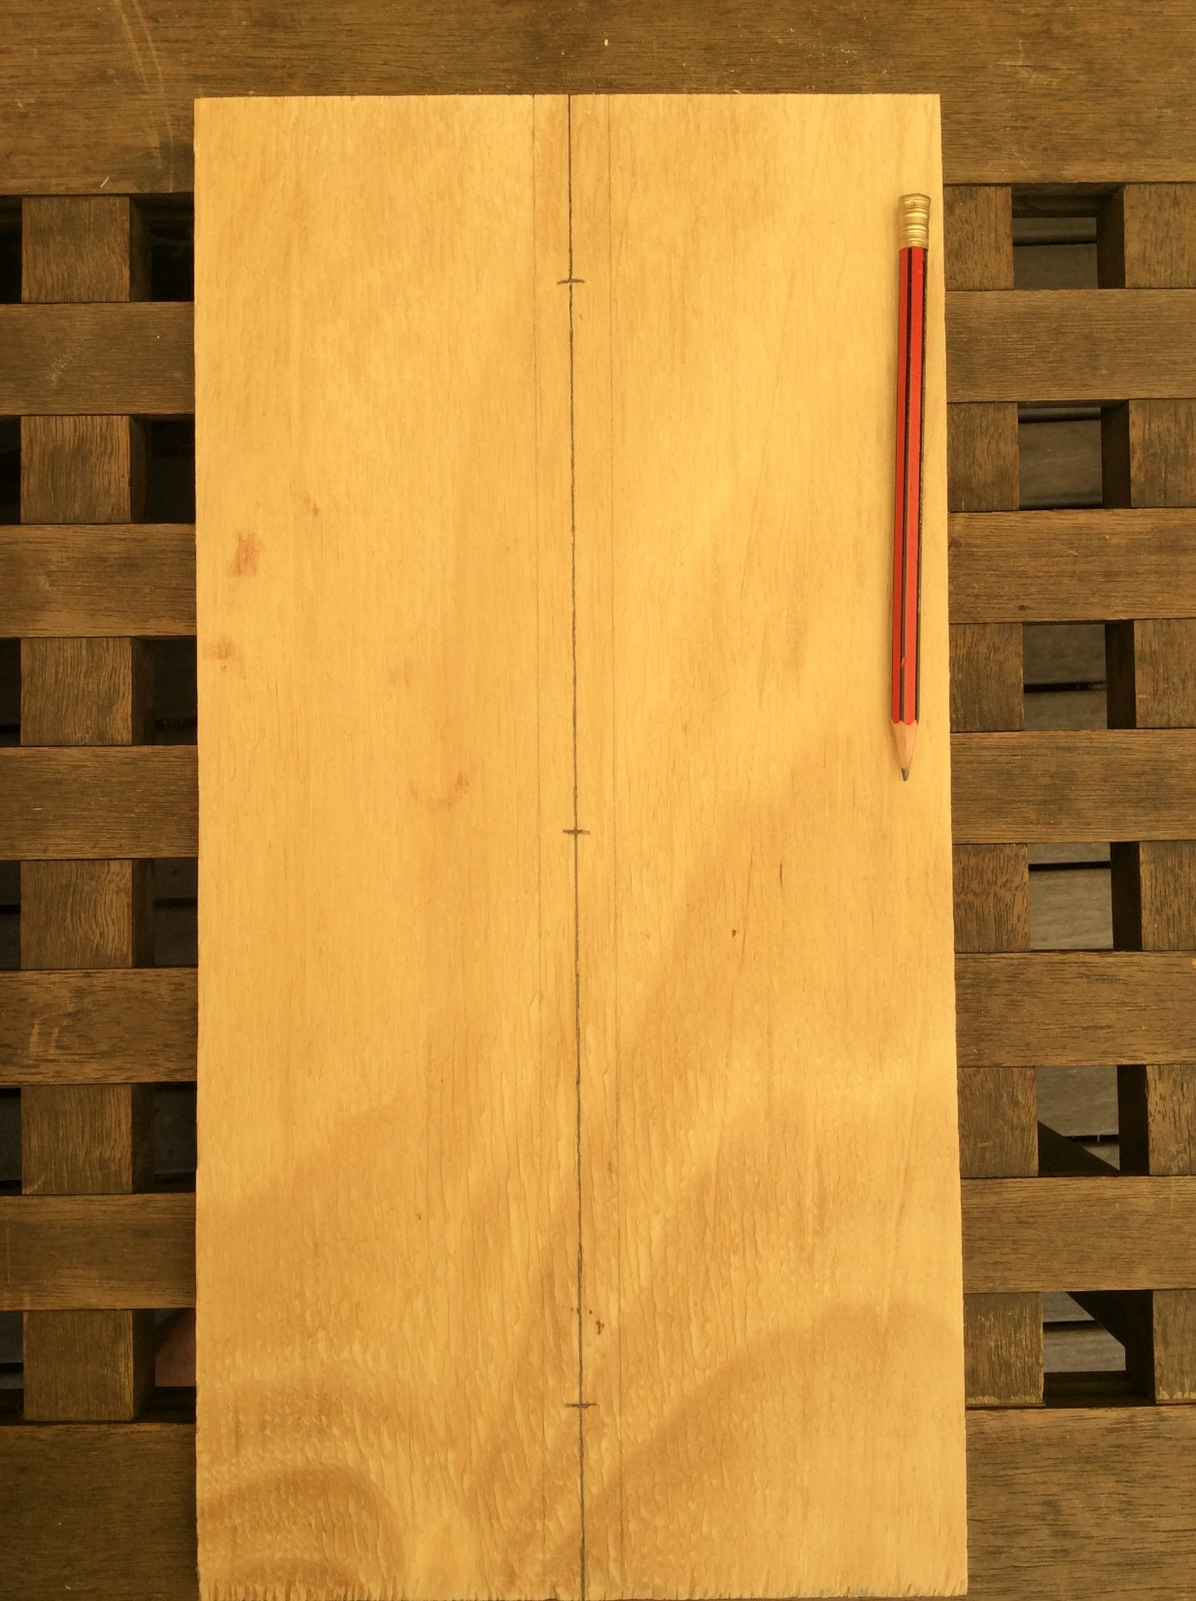
Mark three points on the centre line…
One in the middle and the other two about 50mm from each end

Slide 14
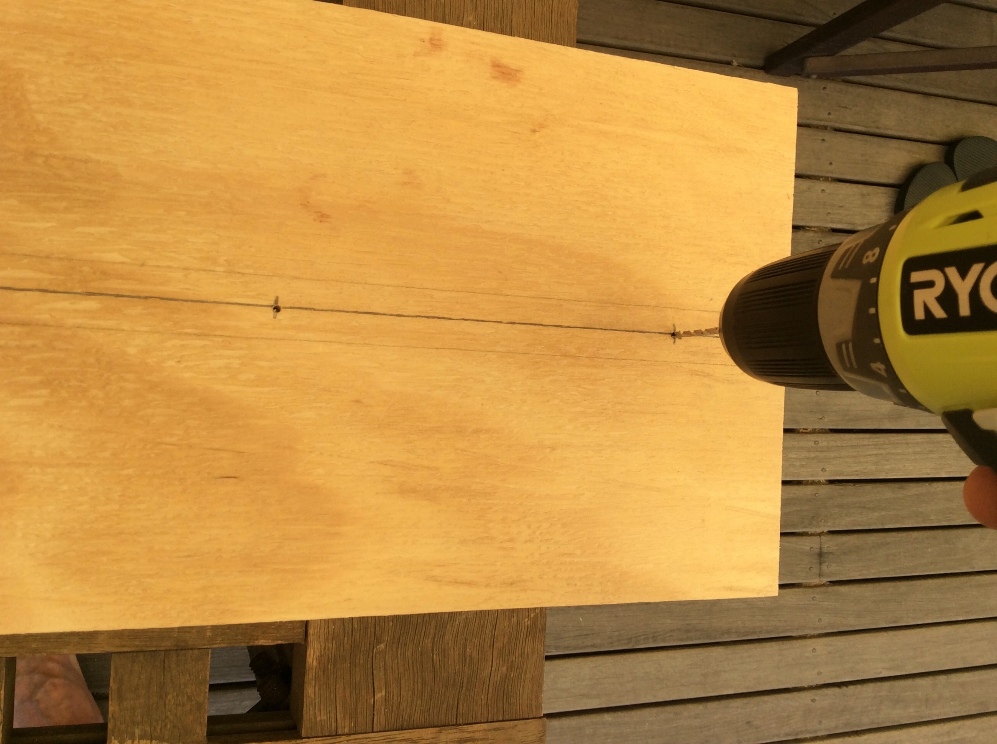
Use a small drill bit to drill a hole through each mark
DON’T drill into the table top !!
Move the board so that the hole is not over the table!

Slide 15
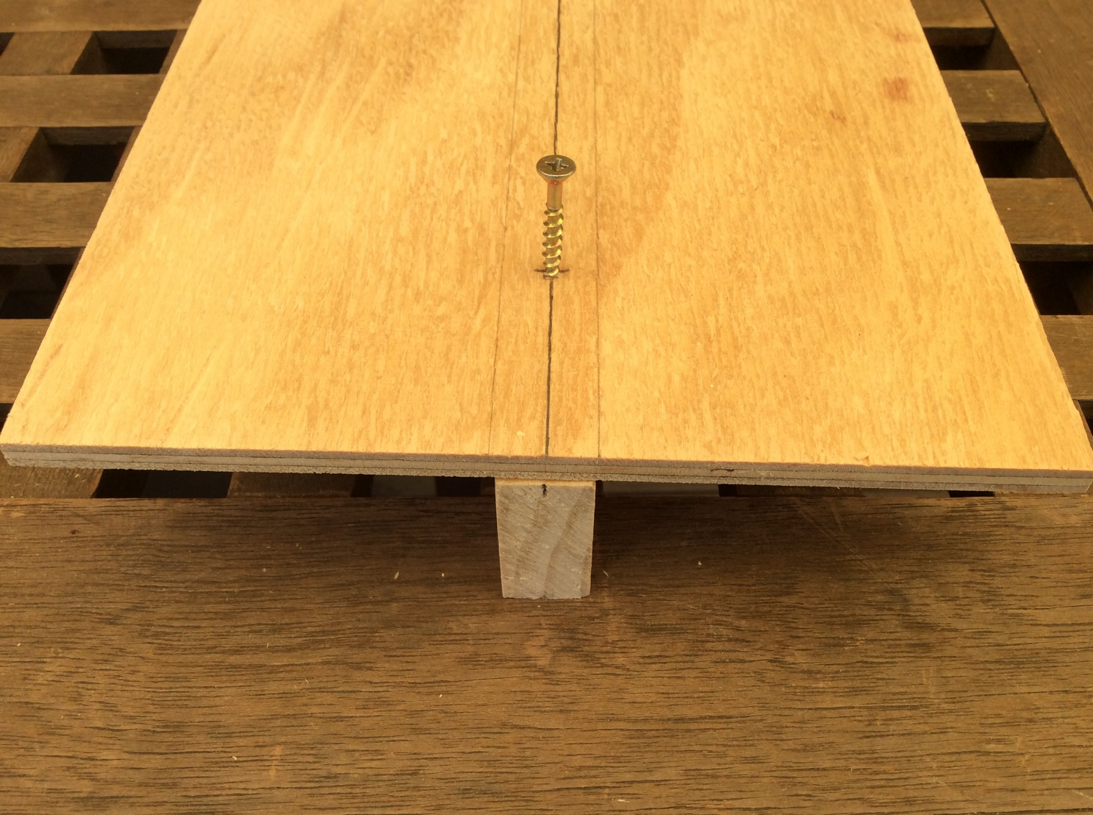
Line up the 400mm piece of pine under the small rectangle board
Slowly drive three long screws through the holes into the pine piece below so that the screws are about half way in.
Use the screwdriver bit in the electric drill.

Slide 16
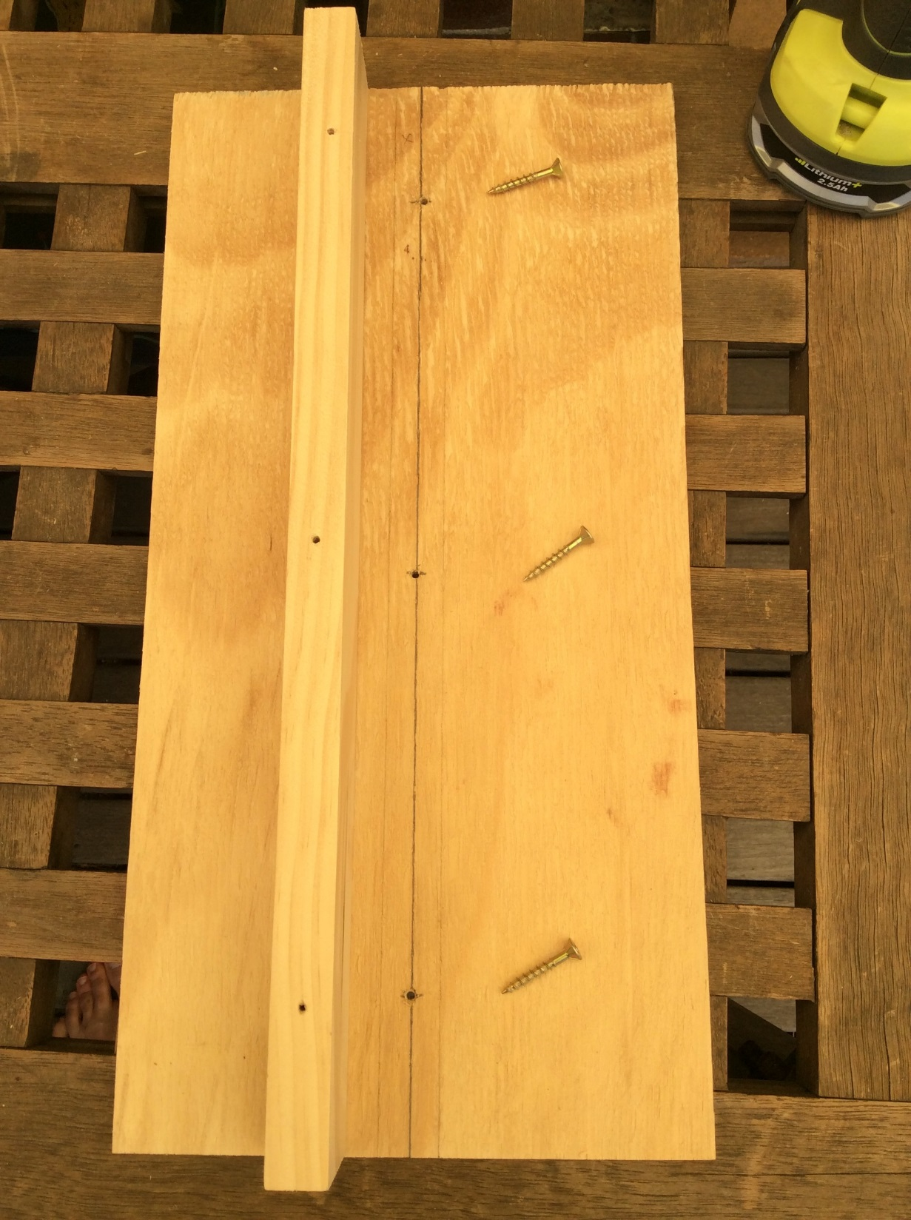
Reverse the drill driver direction, then unscrew and remove he three screws again.
There should be three holes in the piece of pine.

Slide 17
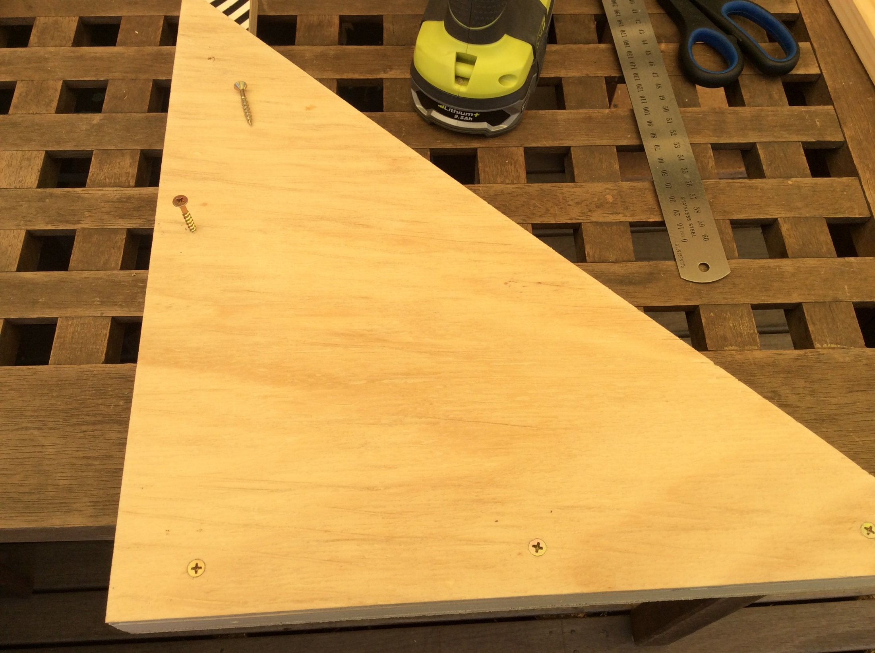
Line up the side of one triangle with the piece of pine.
‘Pre-drill’ three holes through the triangle and just into the top of the pine.
Then drive three SMALL screws into the holes
These holes in the pine should be facing the outside of the triangle !

Slide 18
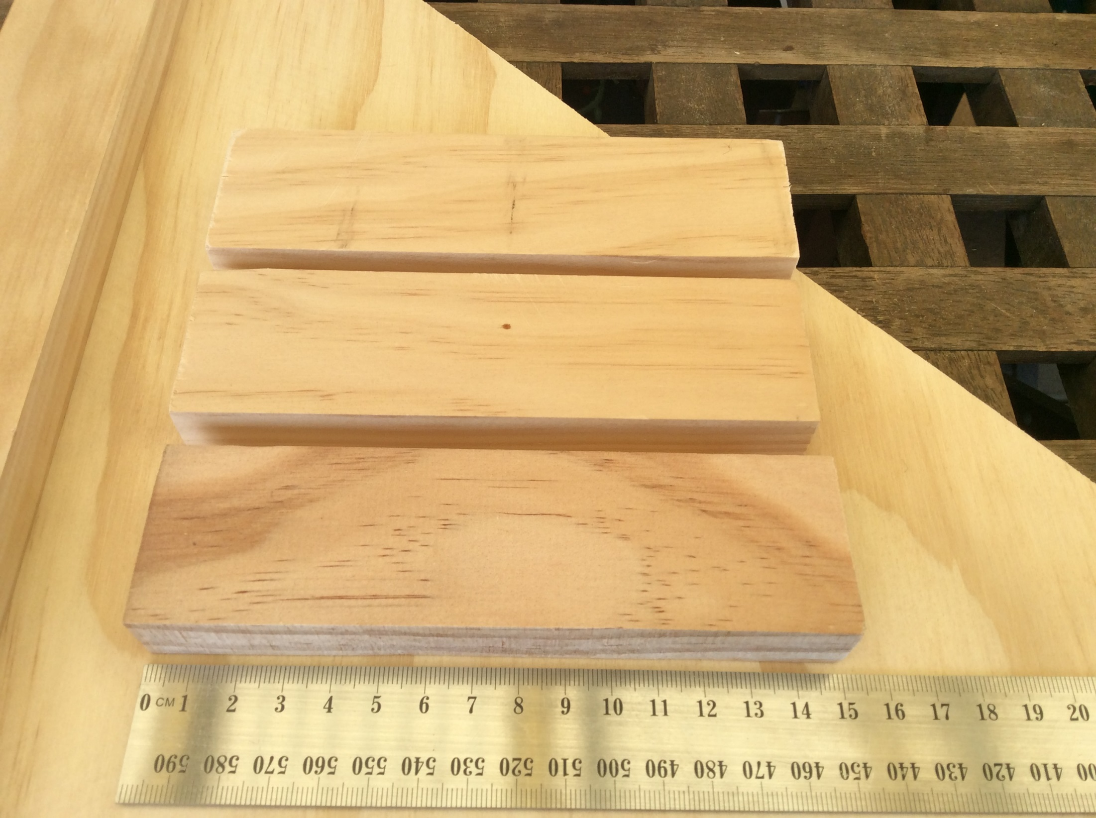
Cut three pieces of pine 150mm long

Slide 19
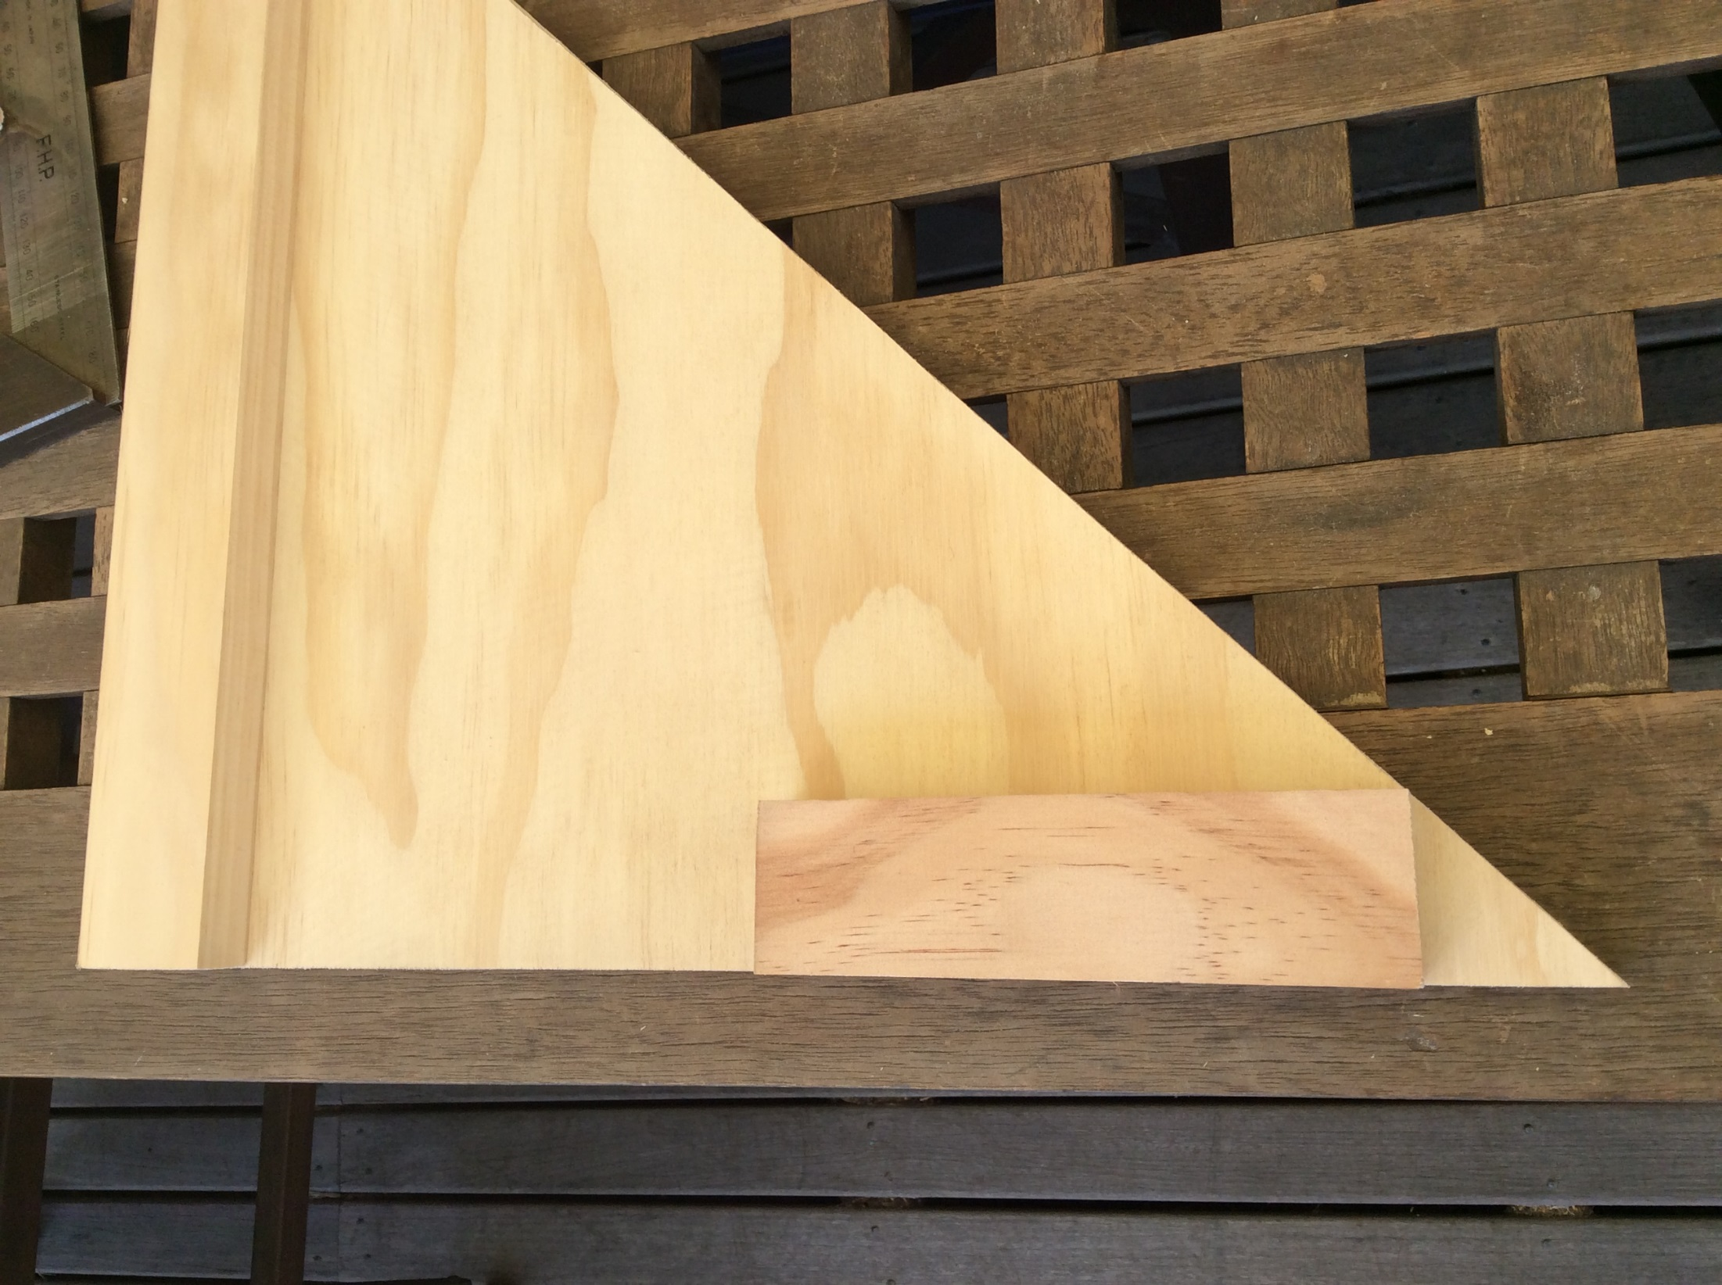
Attach one piece of pine at this position inside the triangle.
Pre-drill and use two SHORT screws though the triangle into the pine

Slide 20
Pre-drill and use two SHORT screws though the triangle into the pine

Slide 21
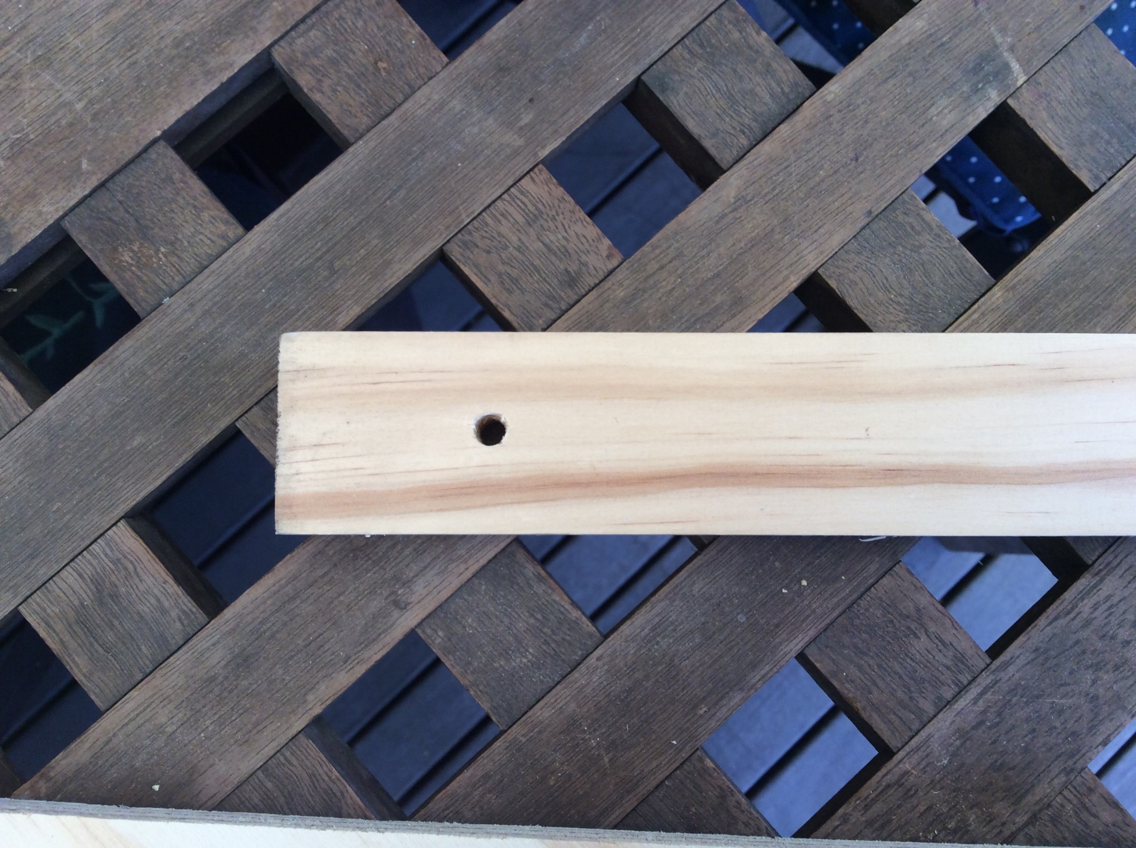
Drill a hole about 40mm from the end of the long piece of pine you have left. This piece is the “lever arm”.
The hole must be in the centre of the timber. Ask your teacher if they can use a ¼” drill bit on the Drill Press machine. Or else, use a ¼” drill bit and drill 90 degrees to the face of the wood.

Slide 22
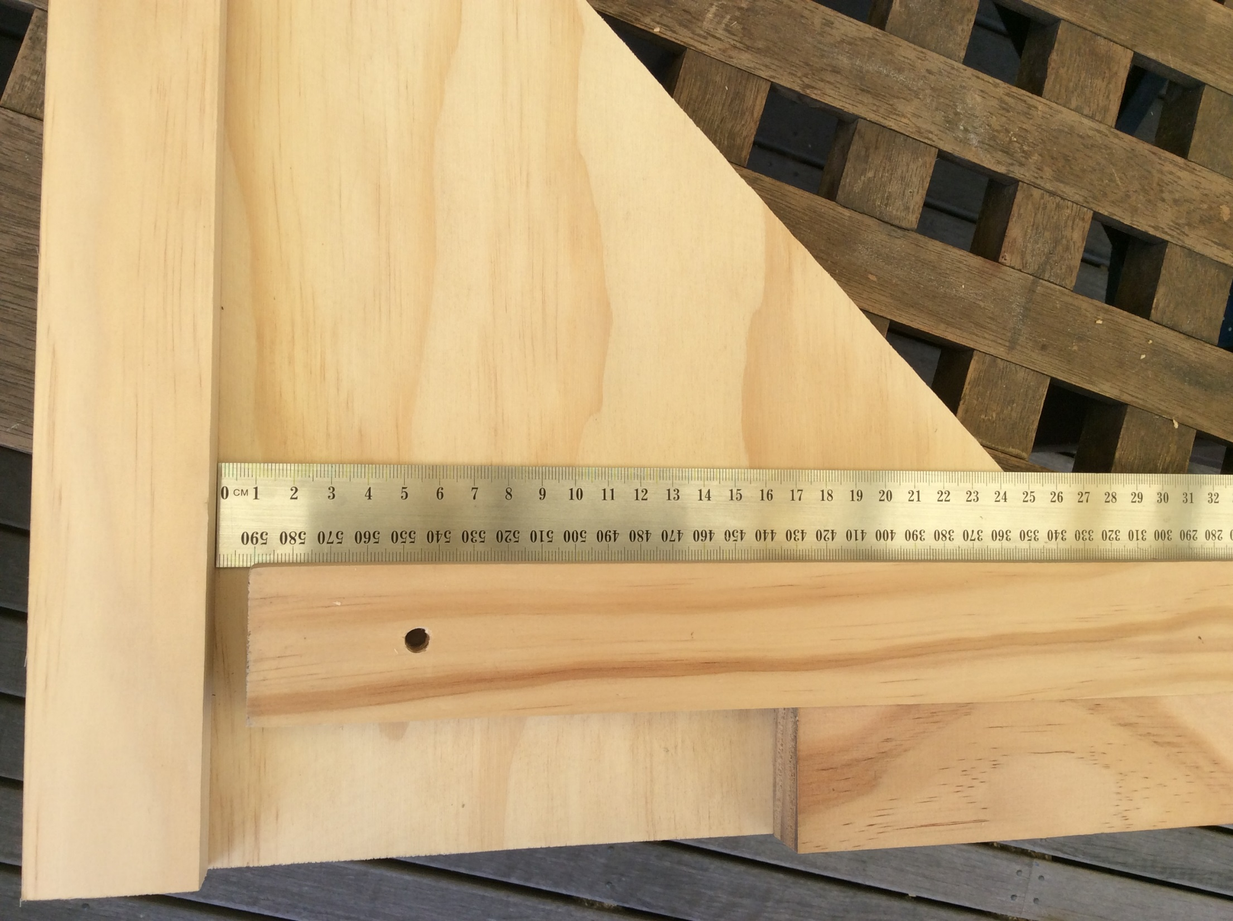
Next, line up your lever arm as shown. Leave a gap of about 10mm between the end of the lever arm and the pine piece on the left side!
Now, DRILL A HOLE though the lever arm hole and though the triangle board below.
DON’T drill into the table top!

Slide 23
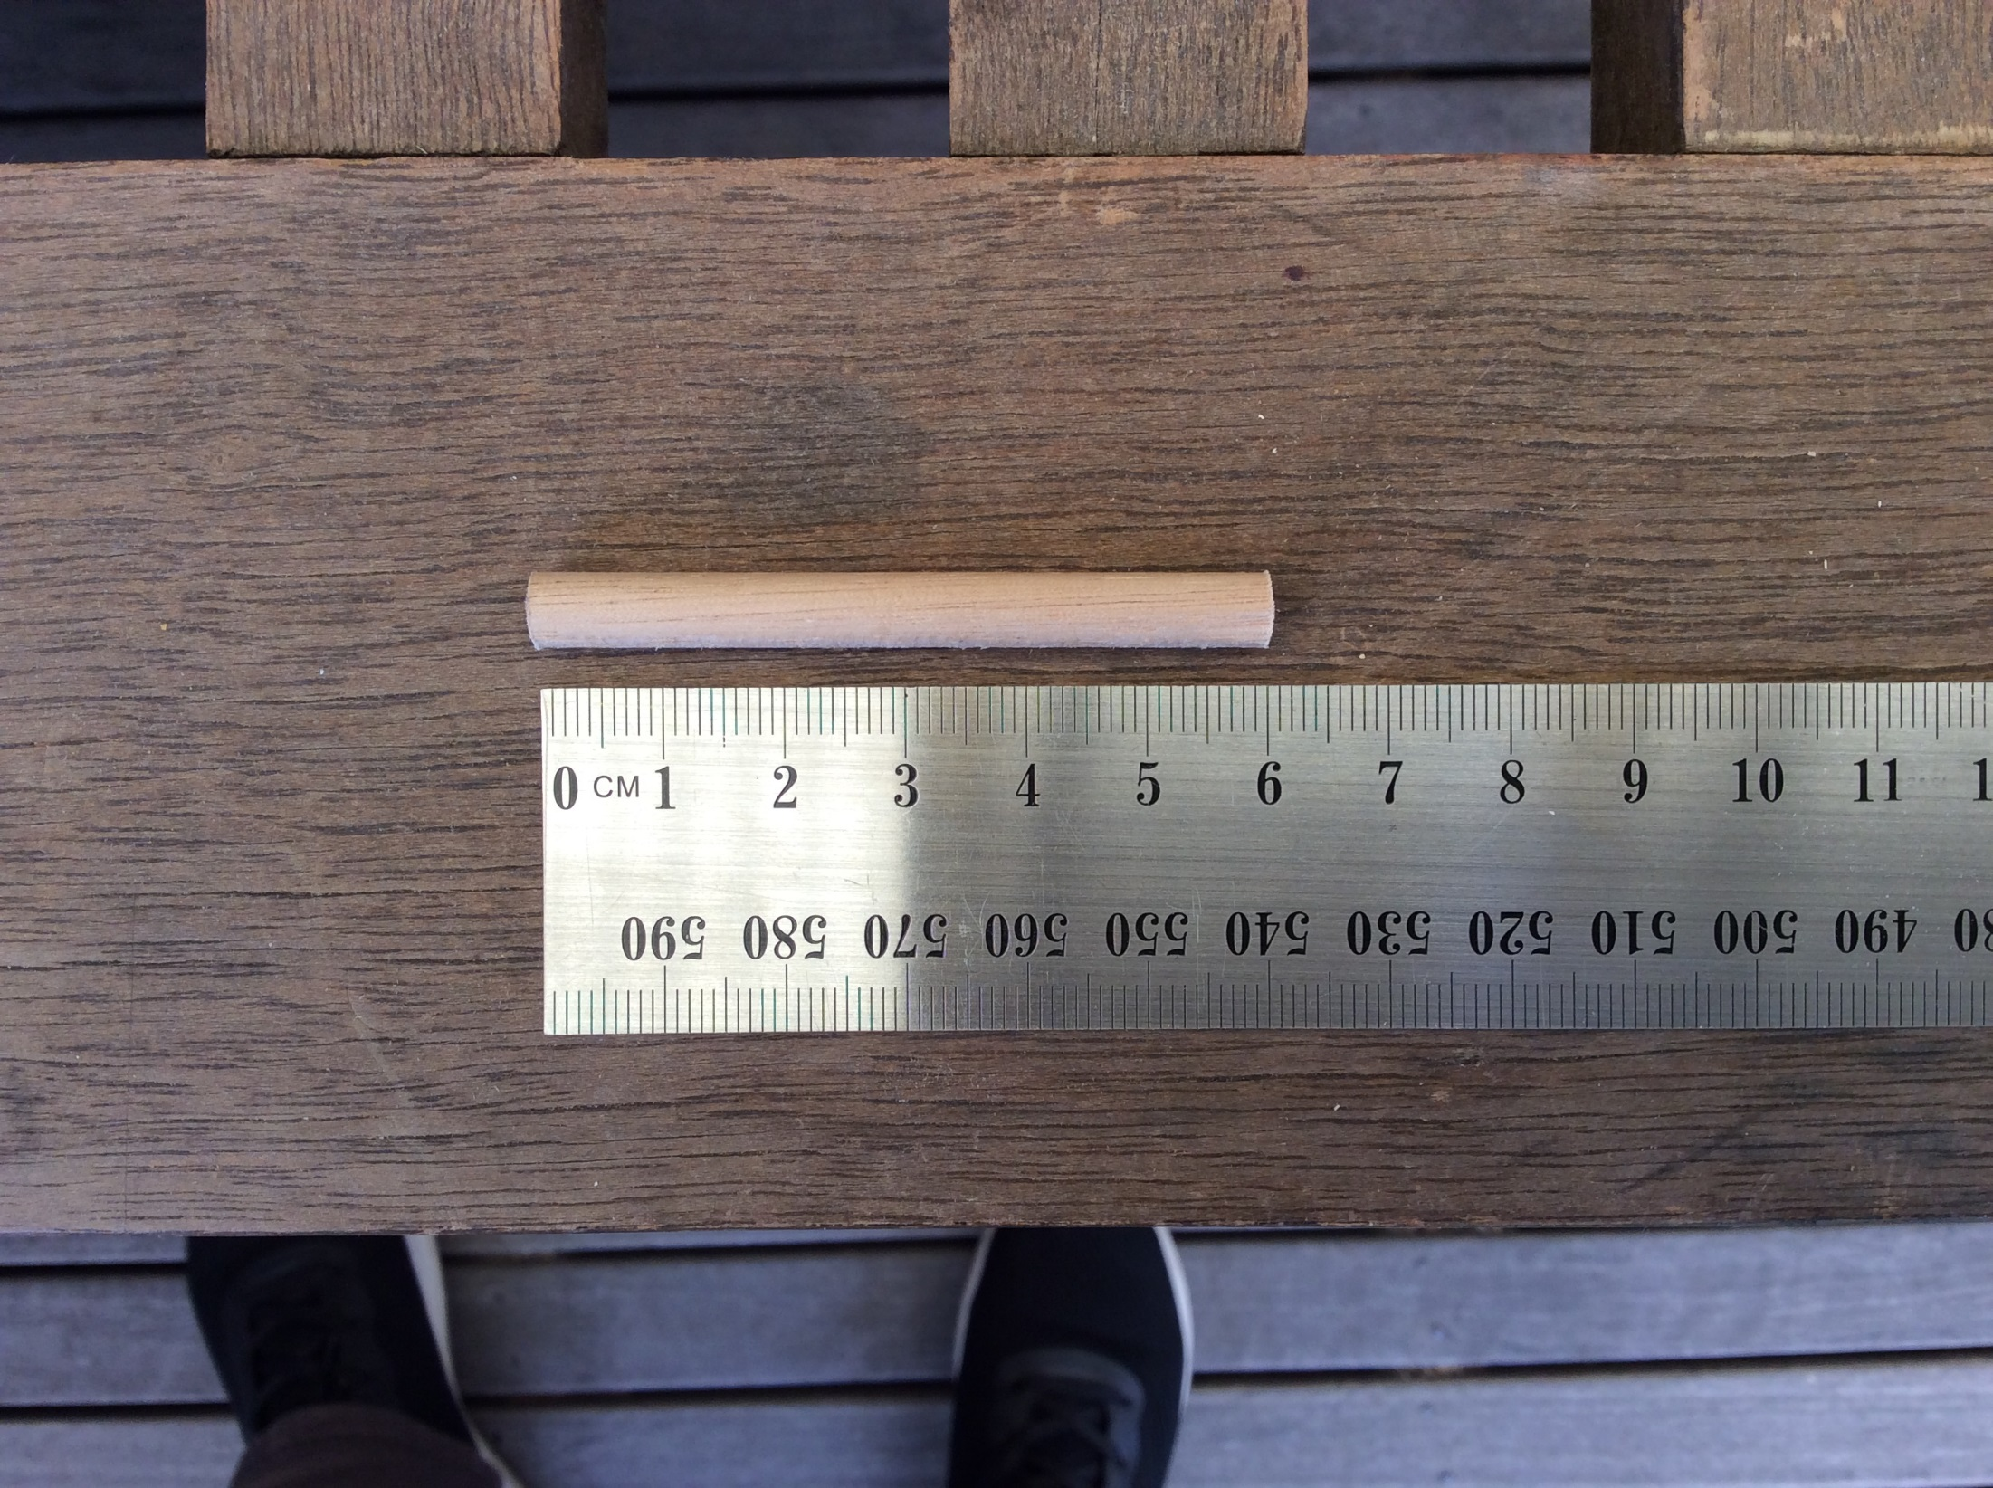
Cut a 60mm piece of ¼” dowel rod :

Slide 24
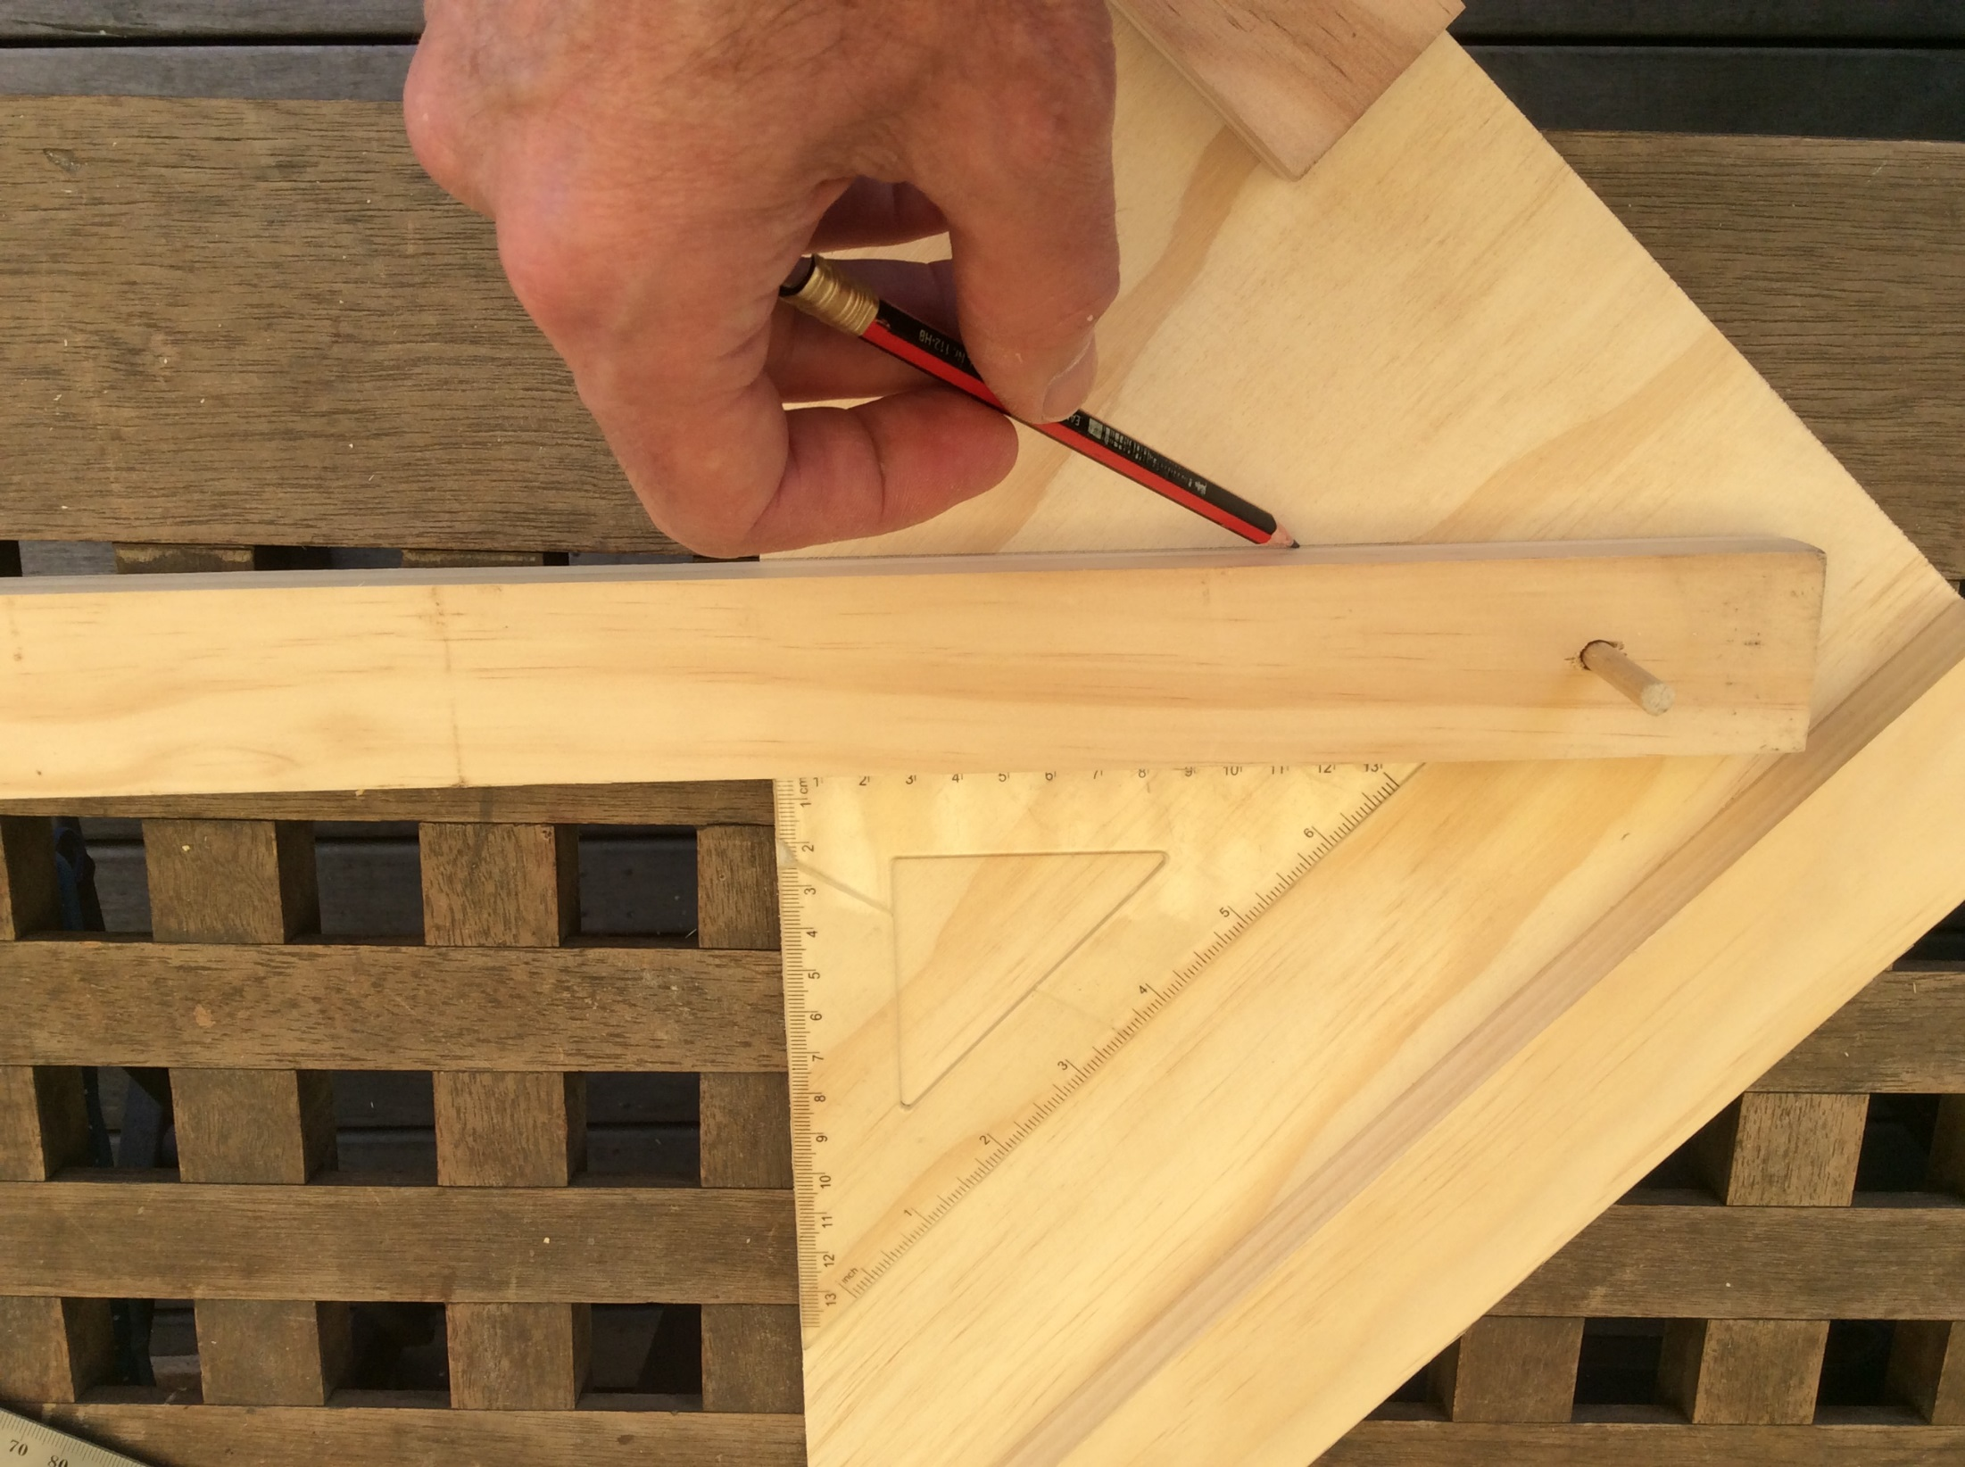
Move the lever arm 90 degrees to the long side of the triangle
Dowel rod
Trace a pencil line

Slide 25
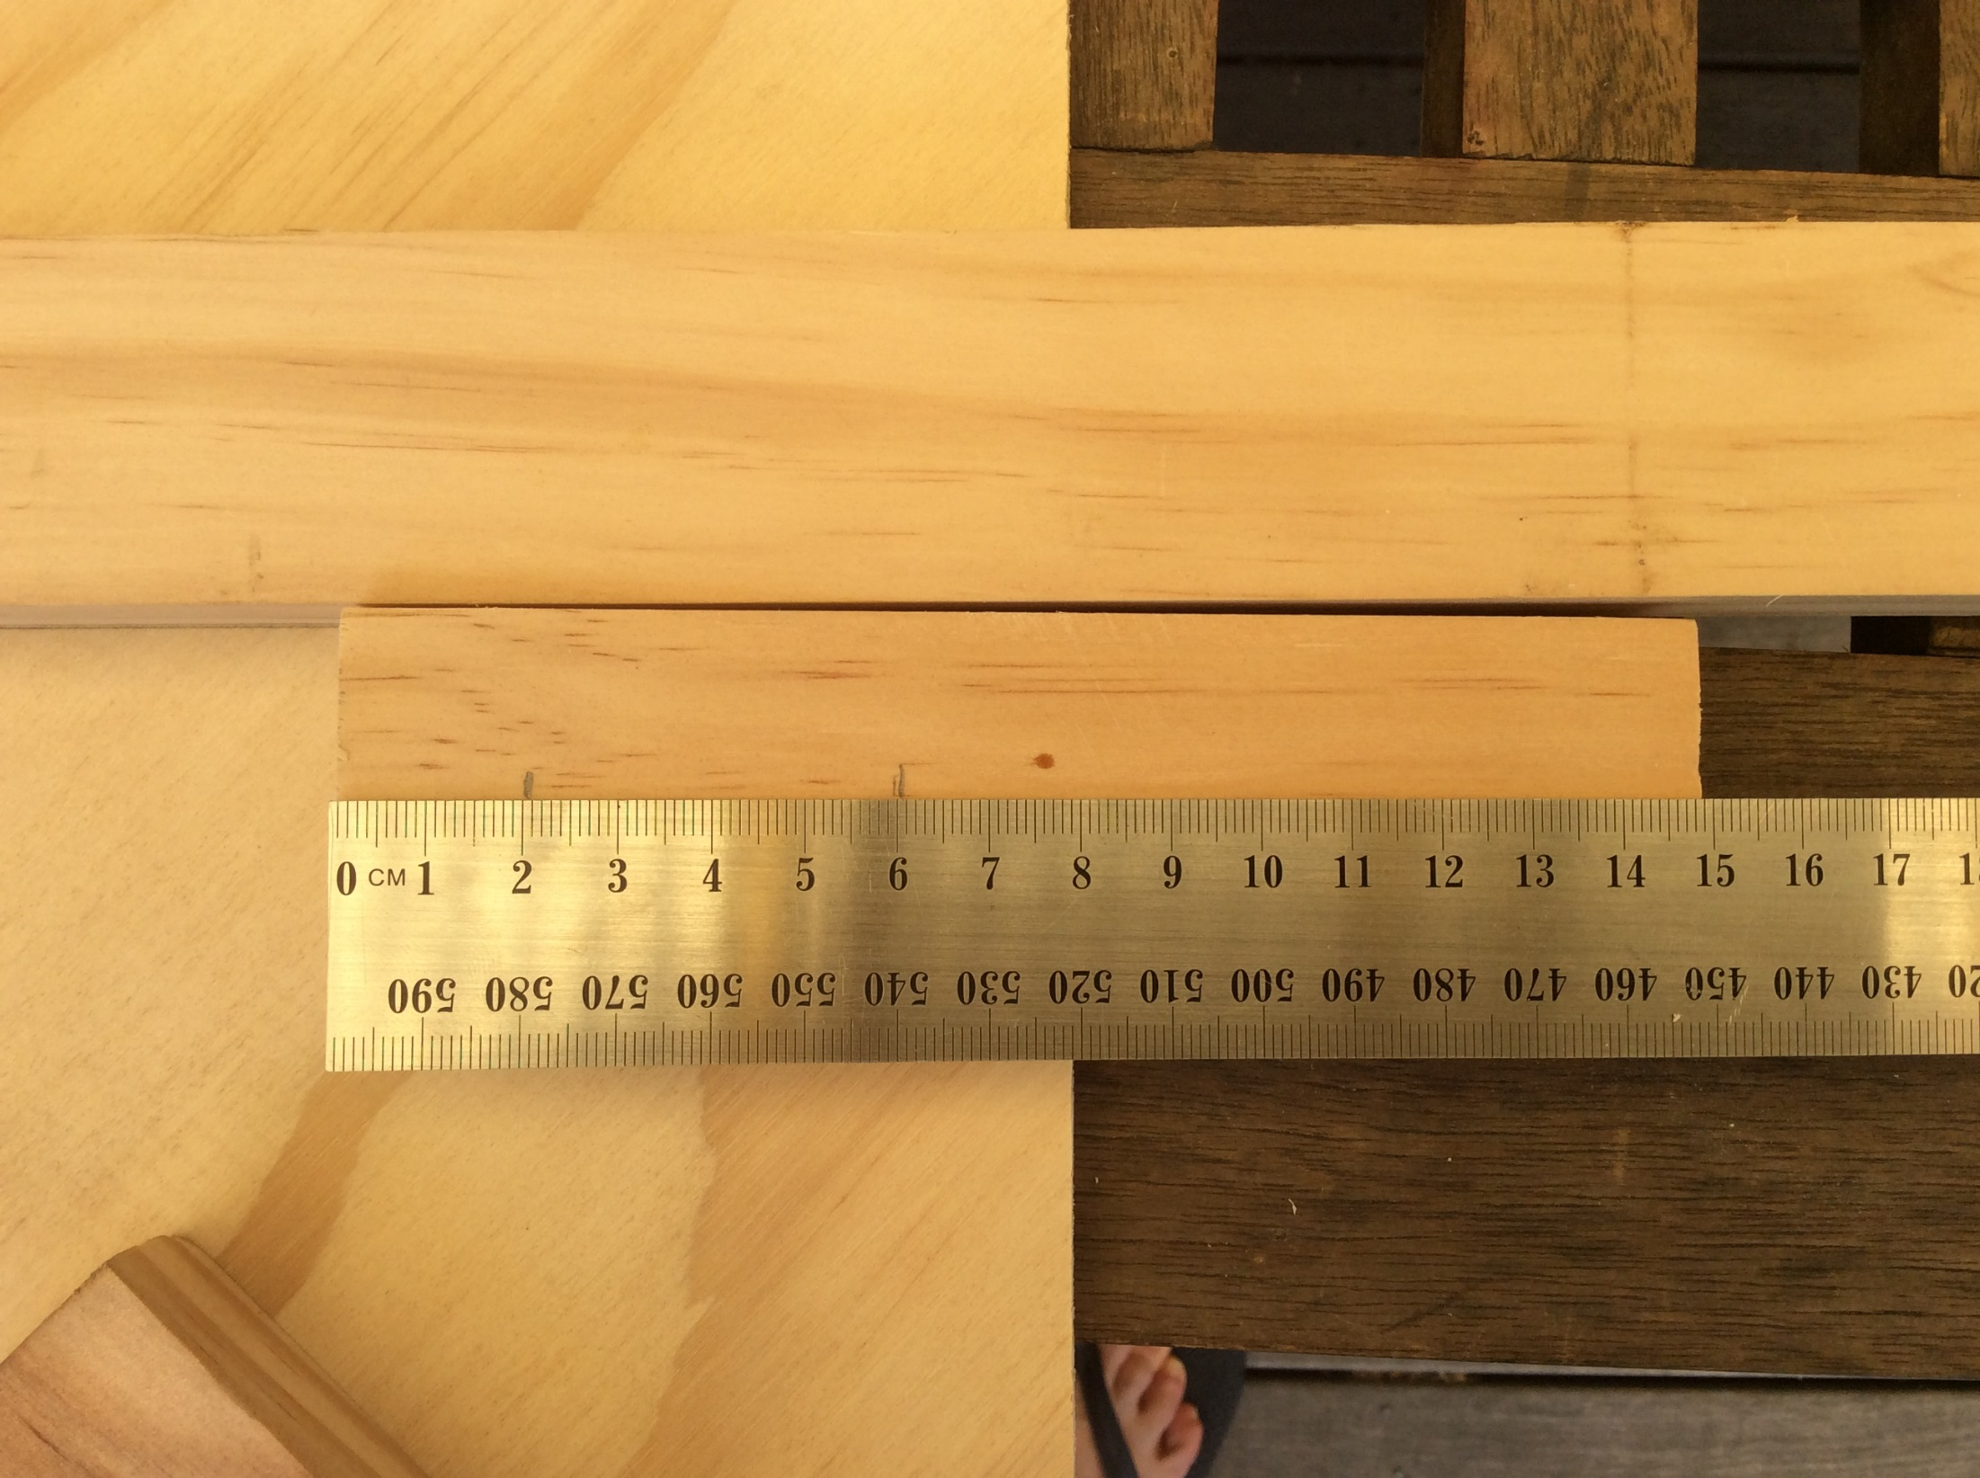
Next, pre-drill and screw one of the 150mm pine pieces. The next pictures show how….

Slide 26
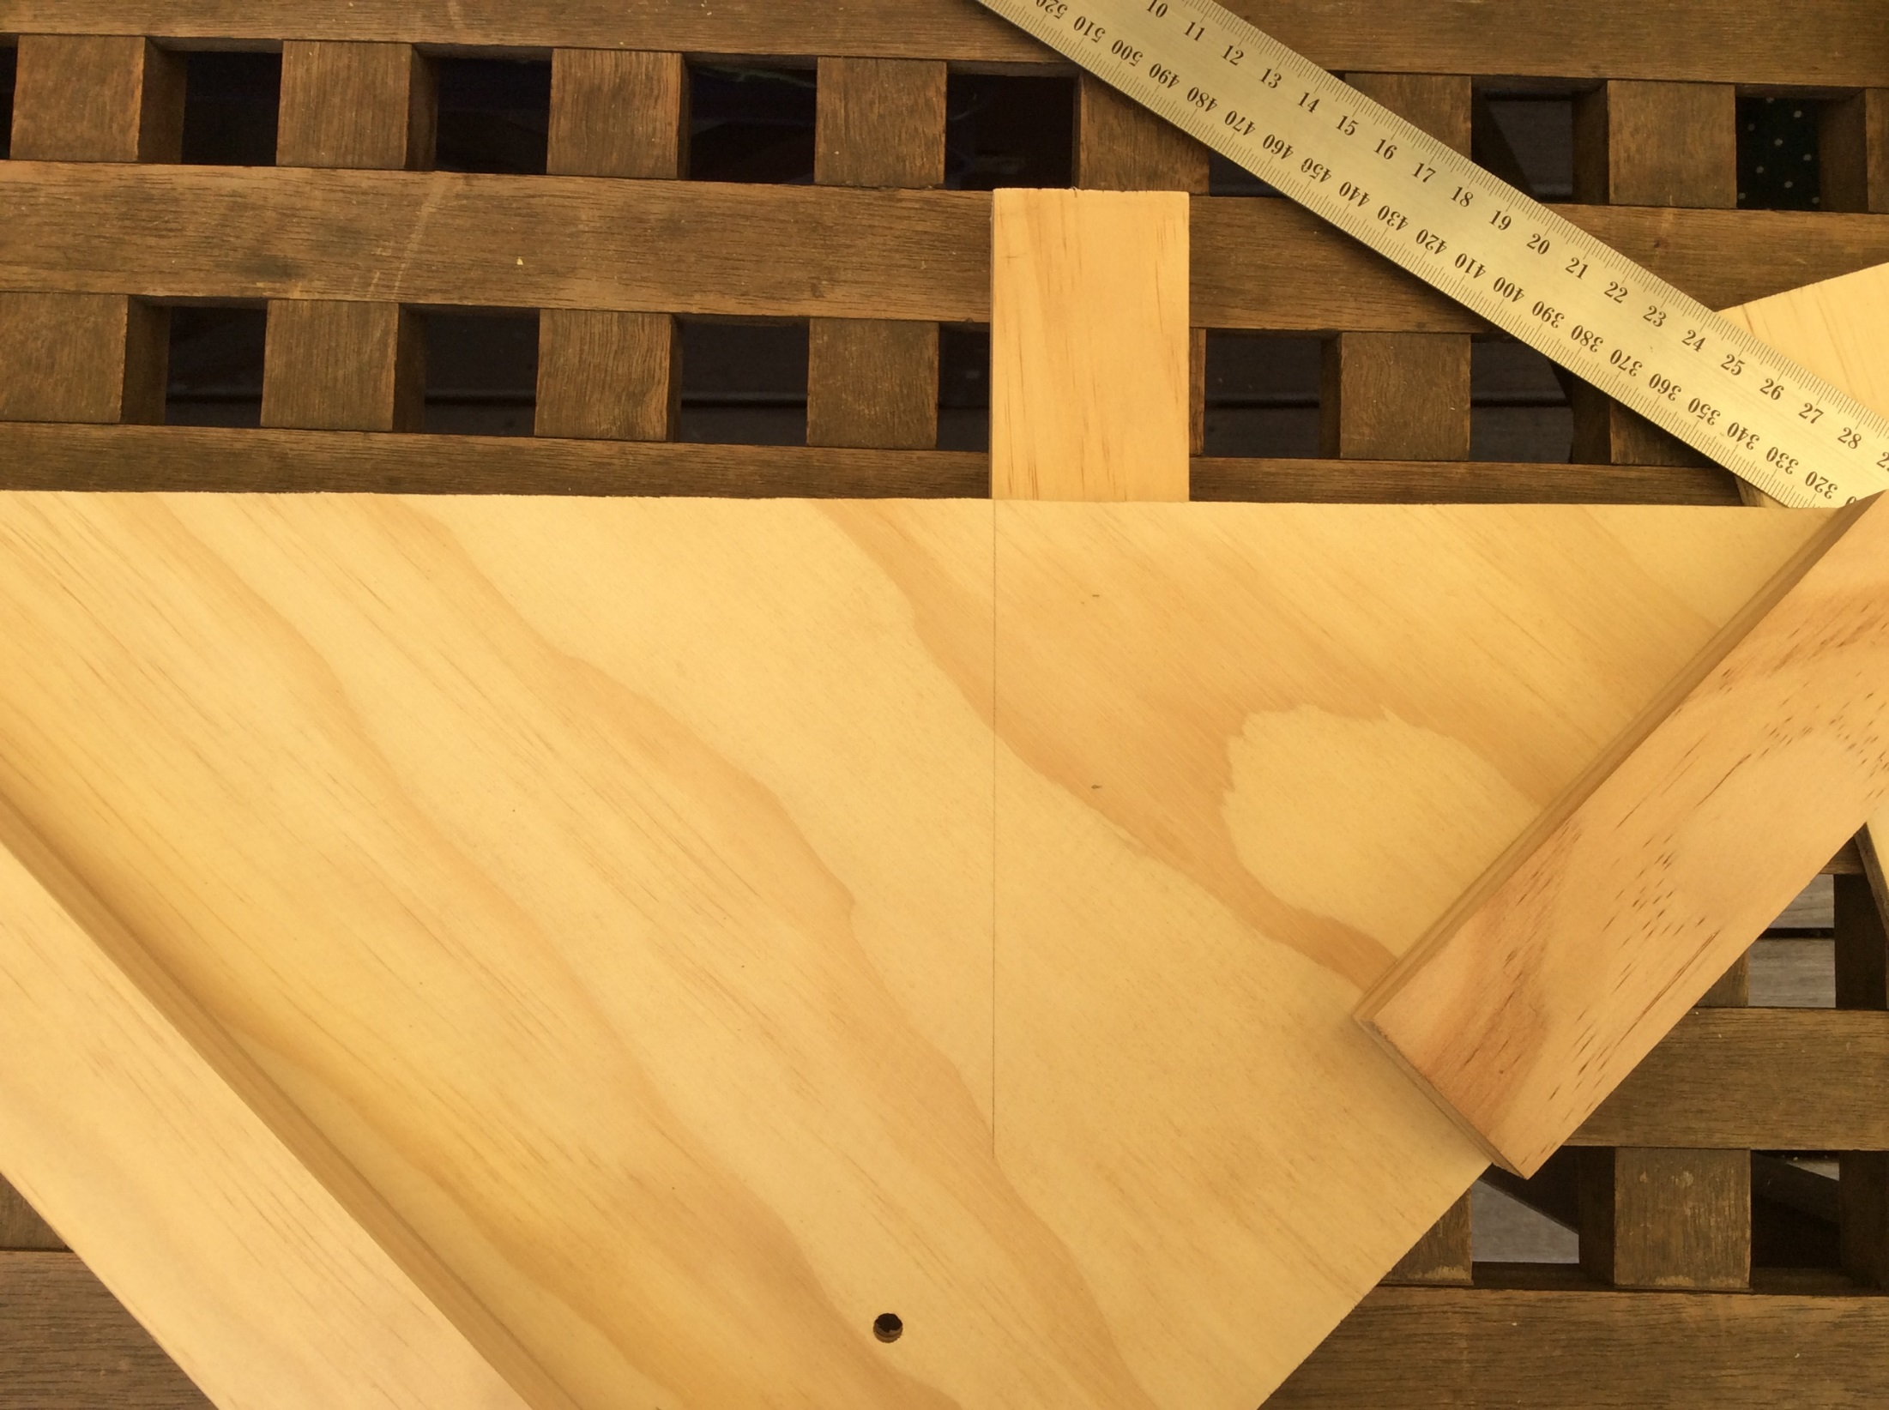
70mm of the pine piece sticks out from the side of the triangle
It should be screwed from this side,
through the triangle board into the pine

Slide 27
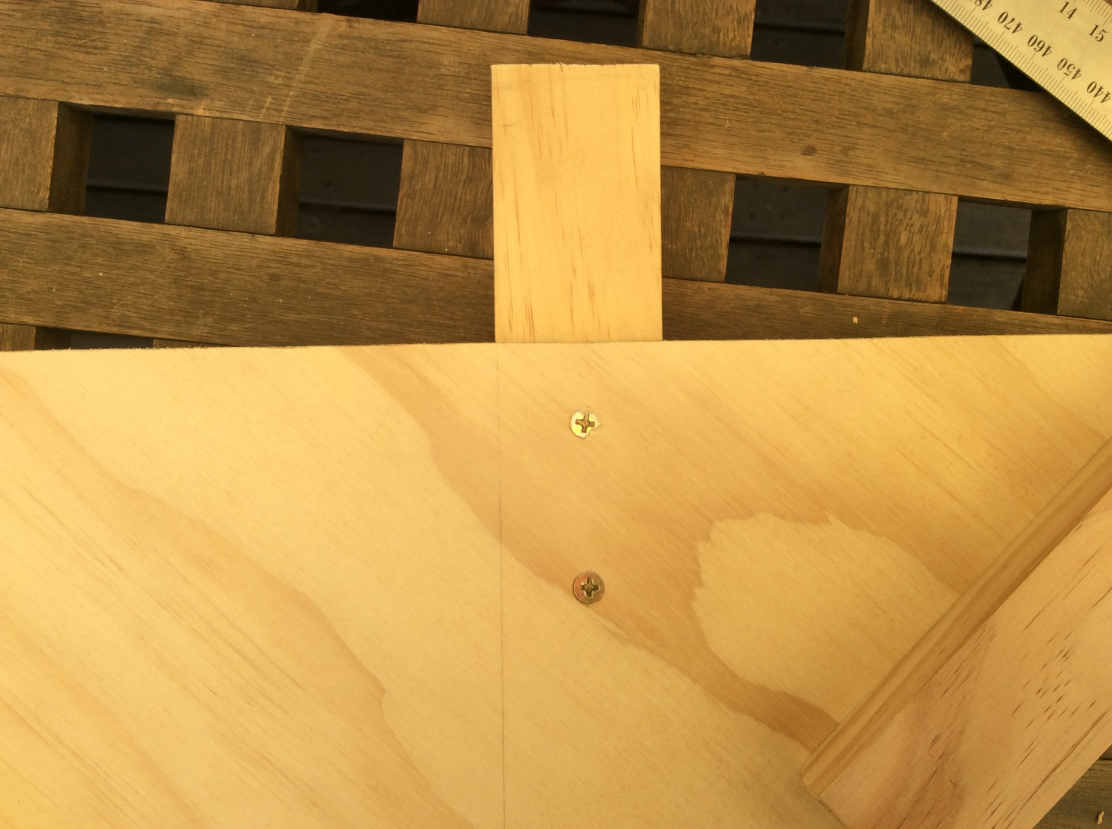
Use SHORT screws !!
Drive the screws just level with the surface

Slide 28
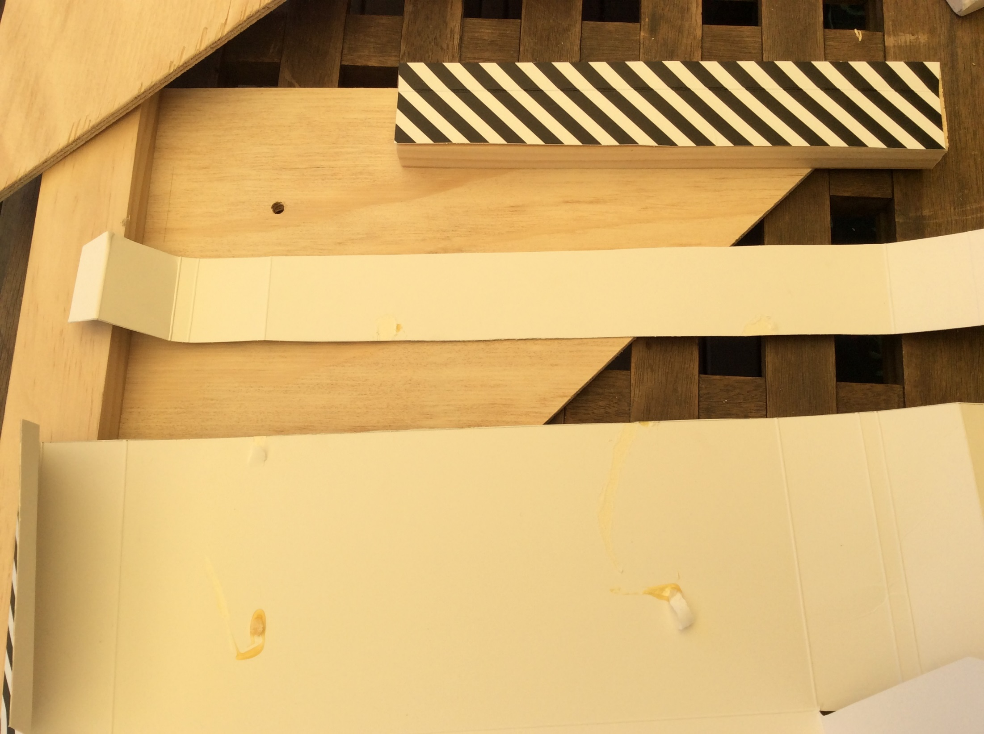
Find some thin cardboard…

Slide 29
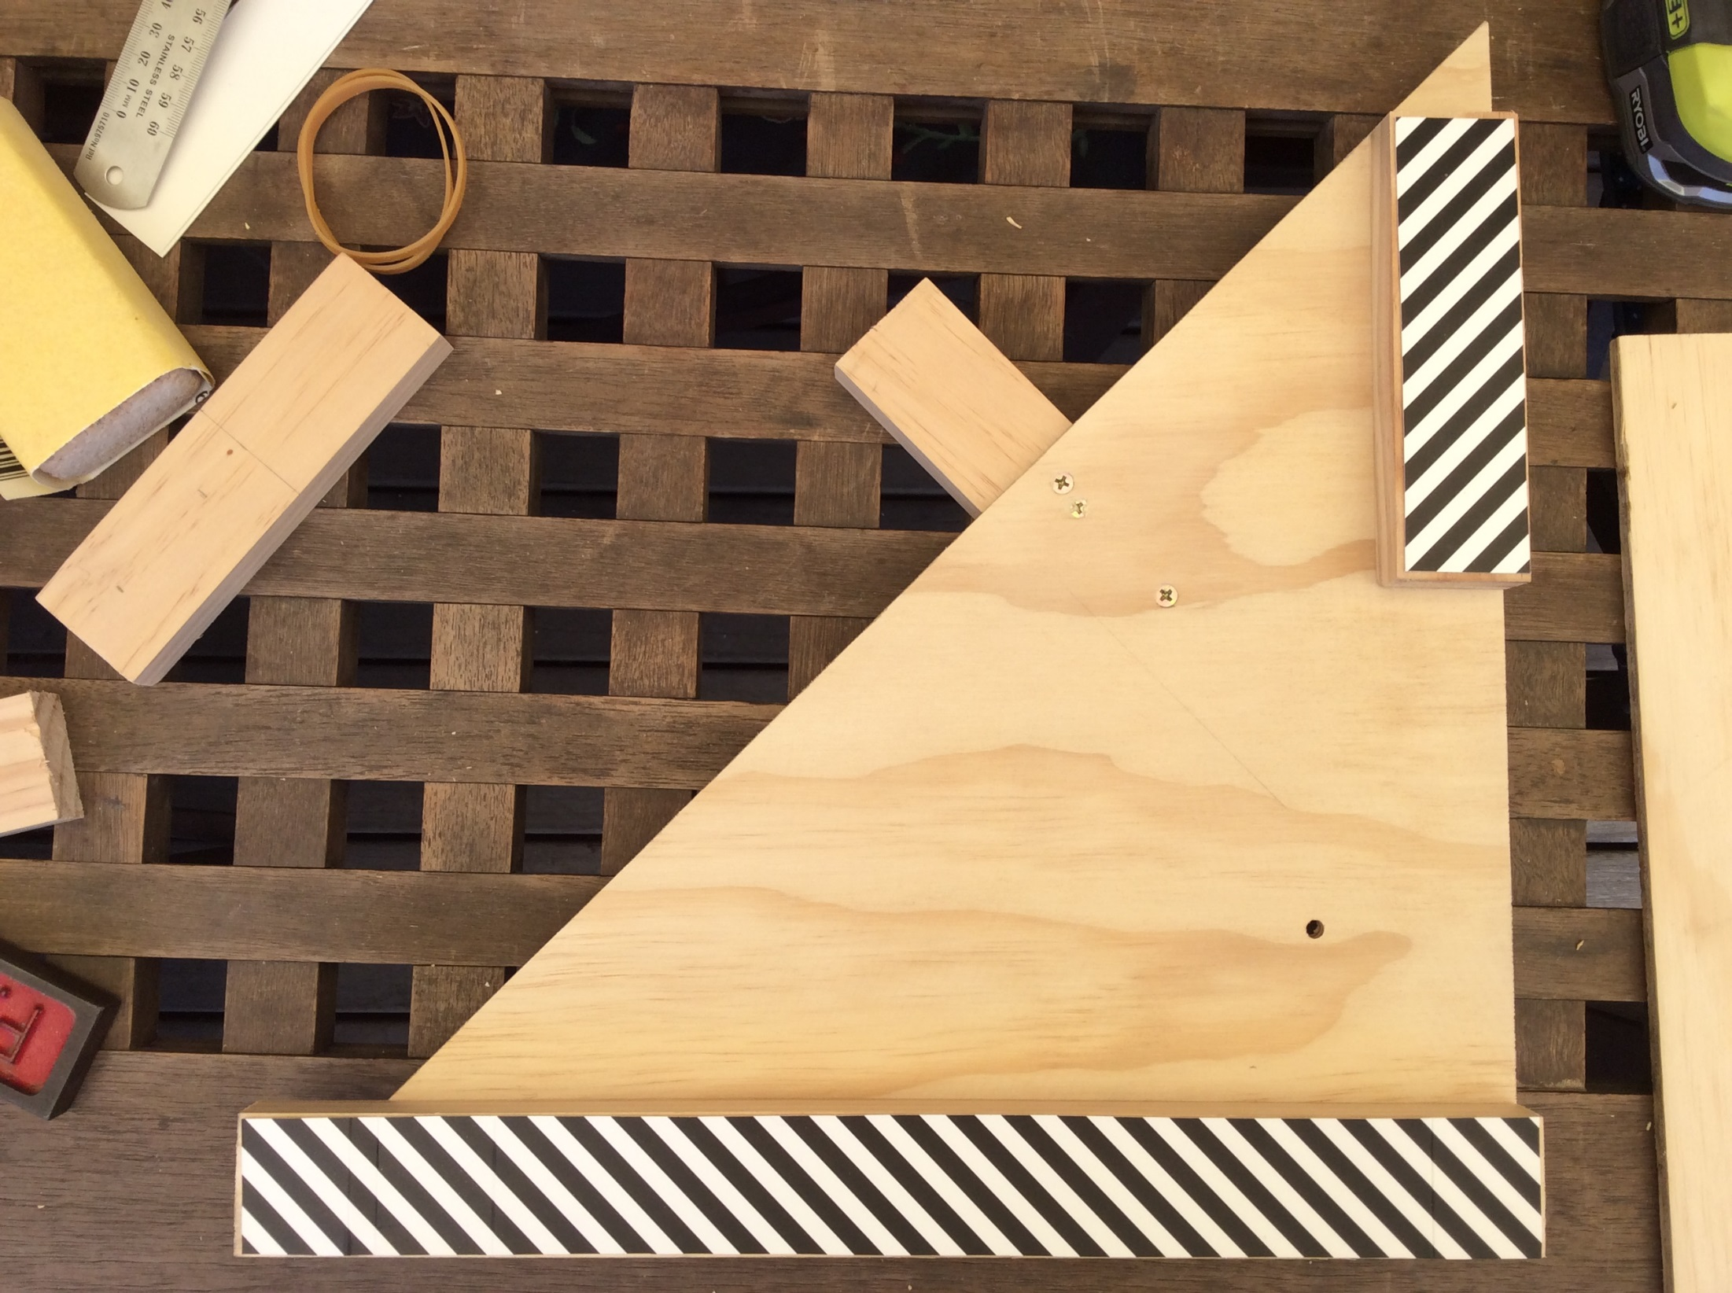
Cut and glue the cardboard to these pieces of pine

Slide 30
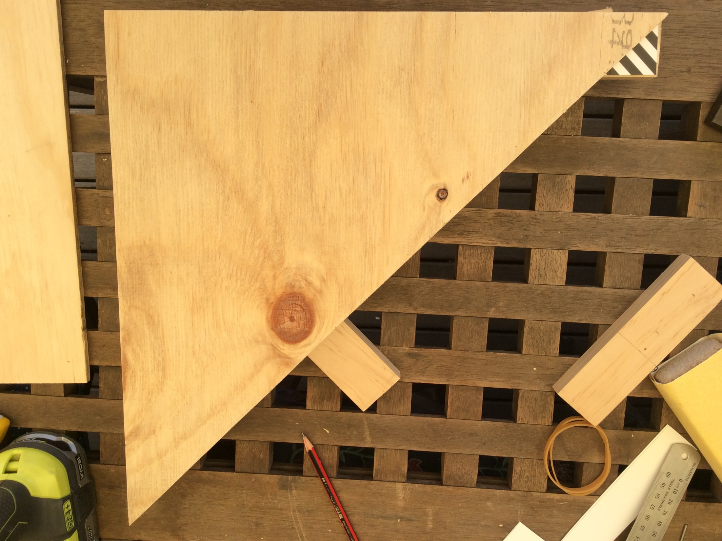
Line up the second triangle with the first triangle below

Slide 31
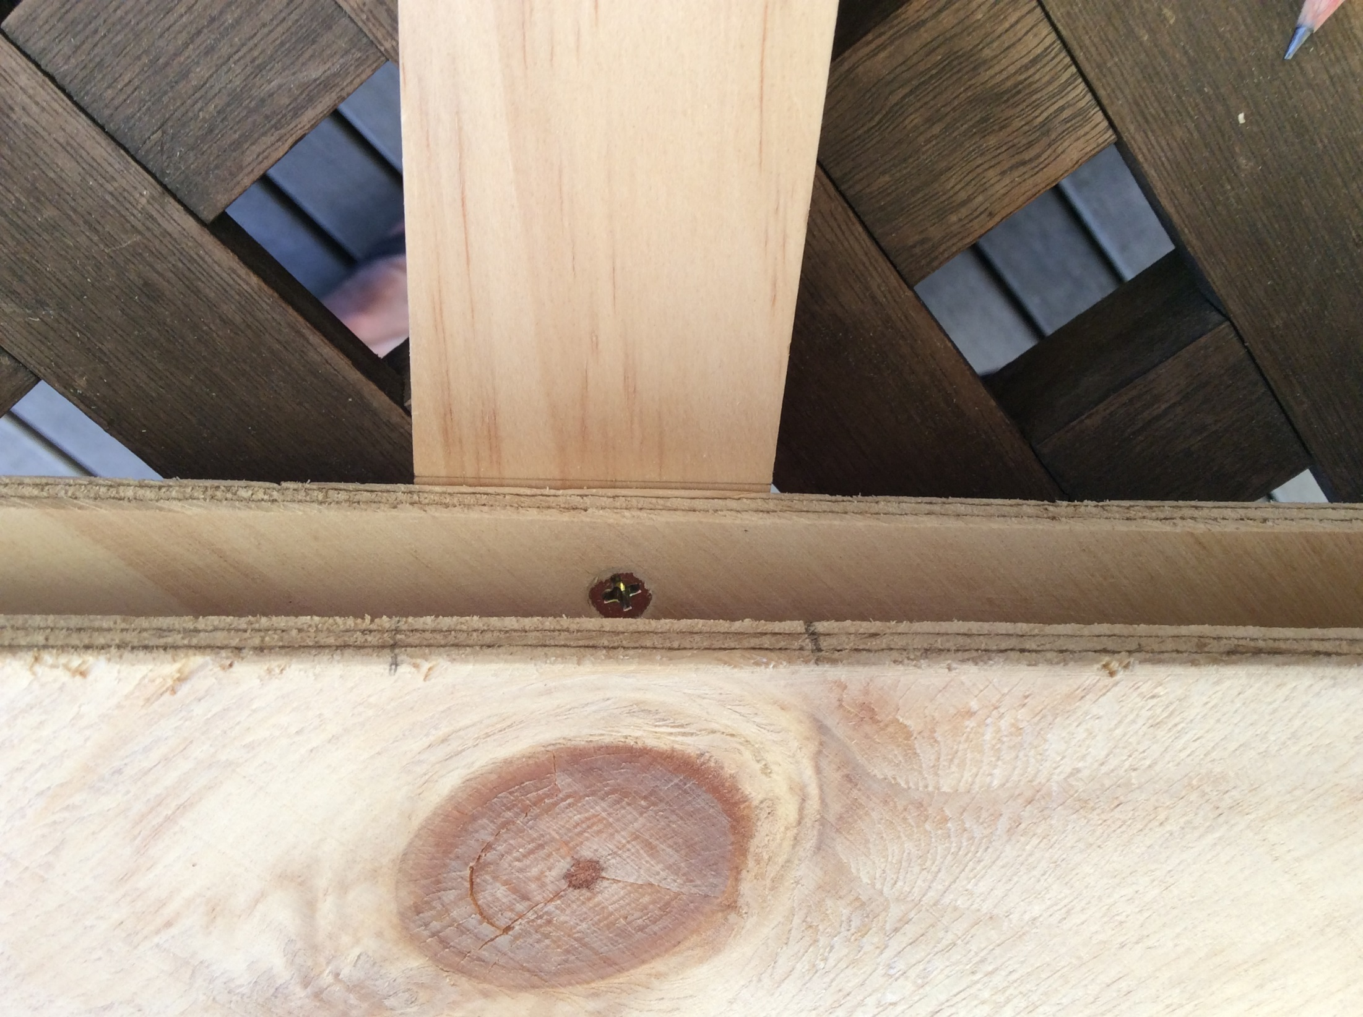
Make pencil marks to help join the last 150mm pine piece to the second triangle with SHORT screws.
Finally, use LONG screws to join the second triangle through the cardboard into the pine.

Slide 32
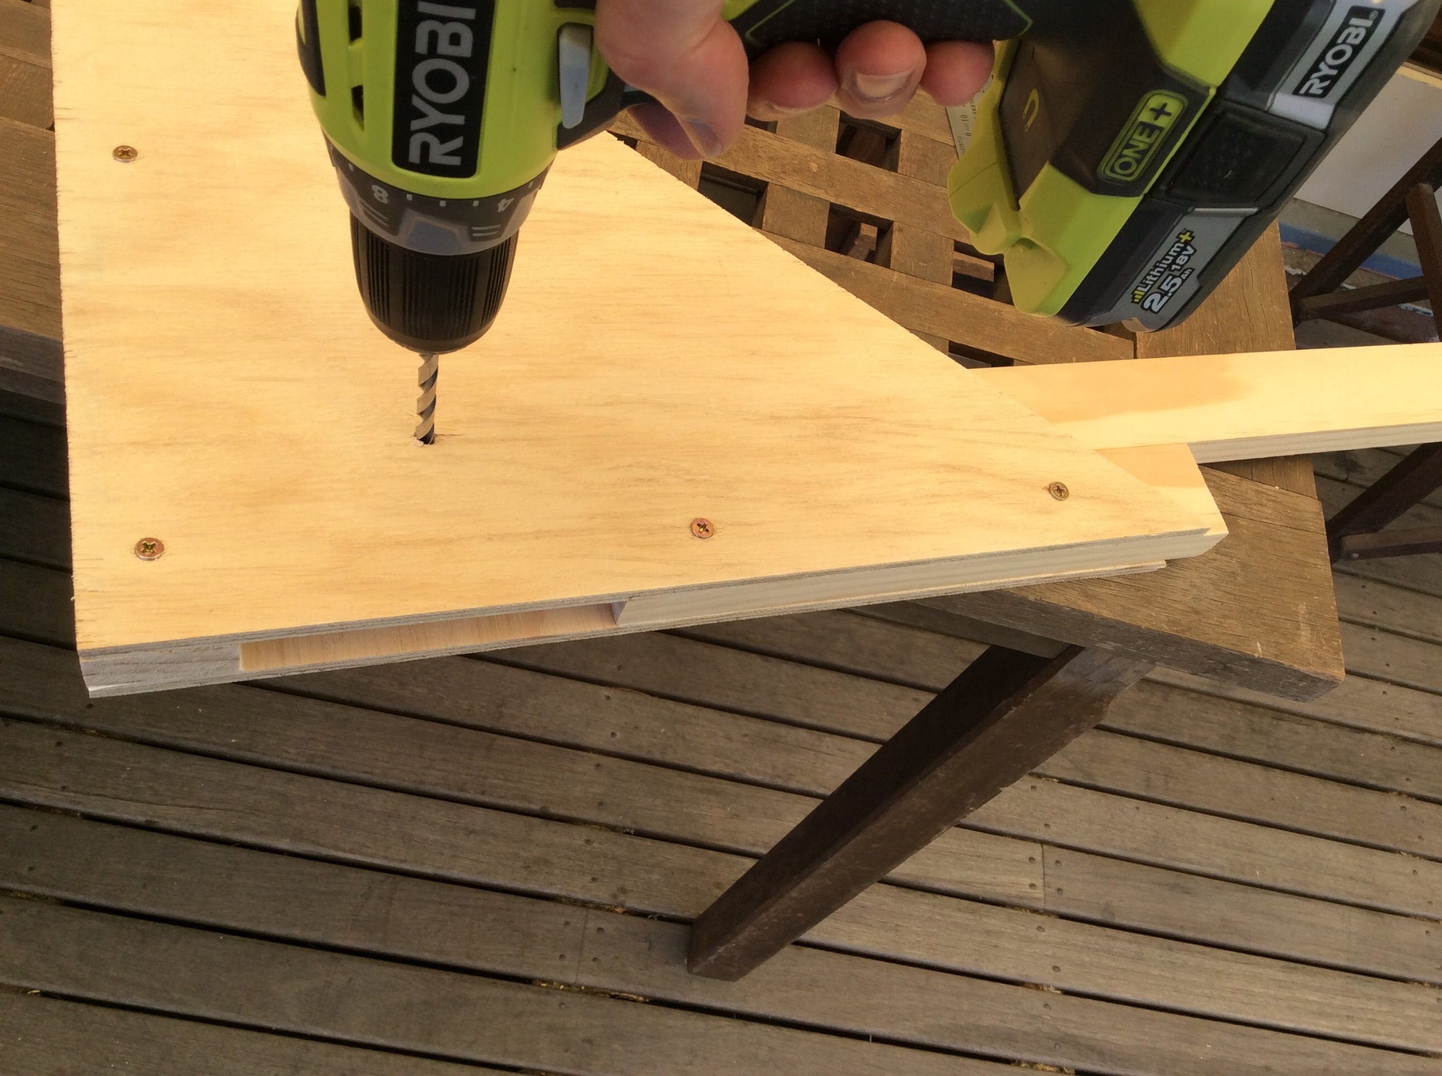
Put the lever arm in place and line up its hole with the hole in the side of the triangle
Drill through the hole, through the lever arm and both triangles
Push the dowel rod through the holes

Slide 33
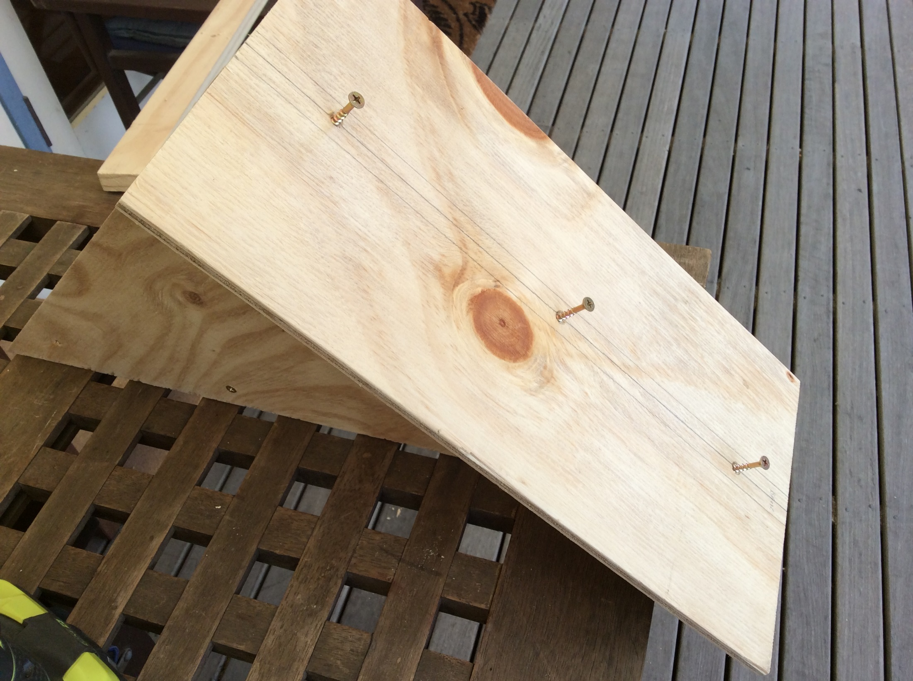
Screw on the rectangle board to make the base of the launcher

Slide 34
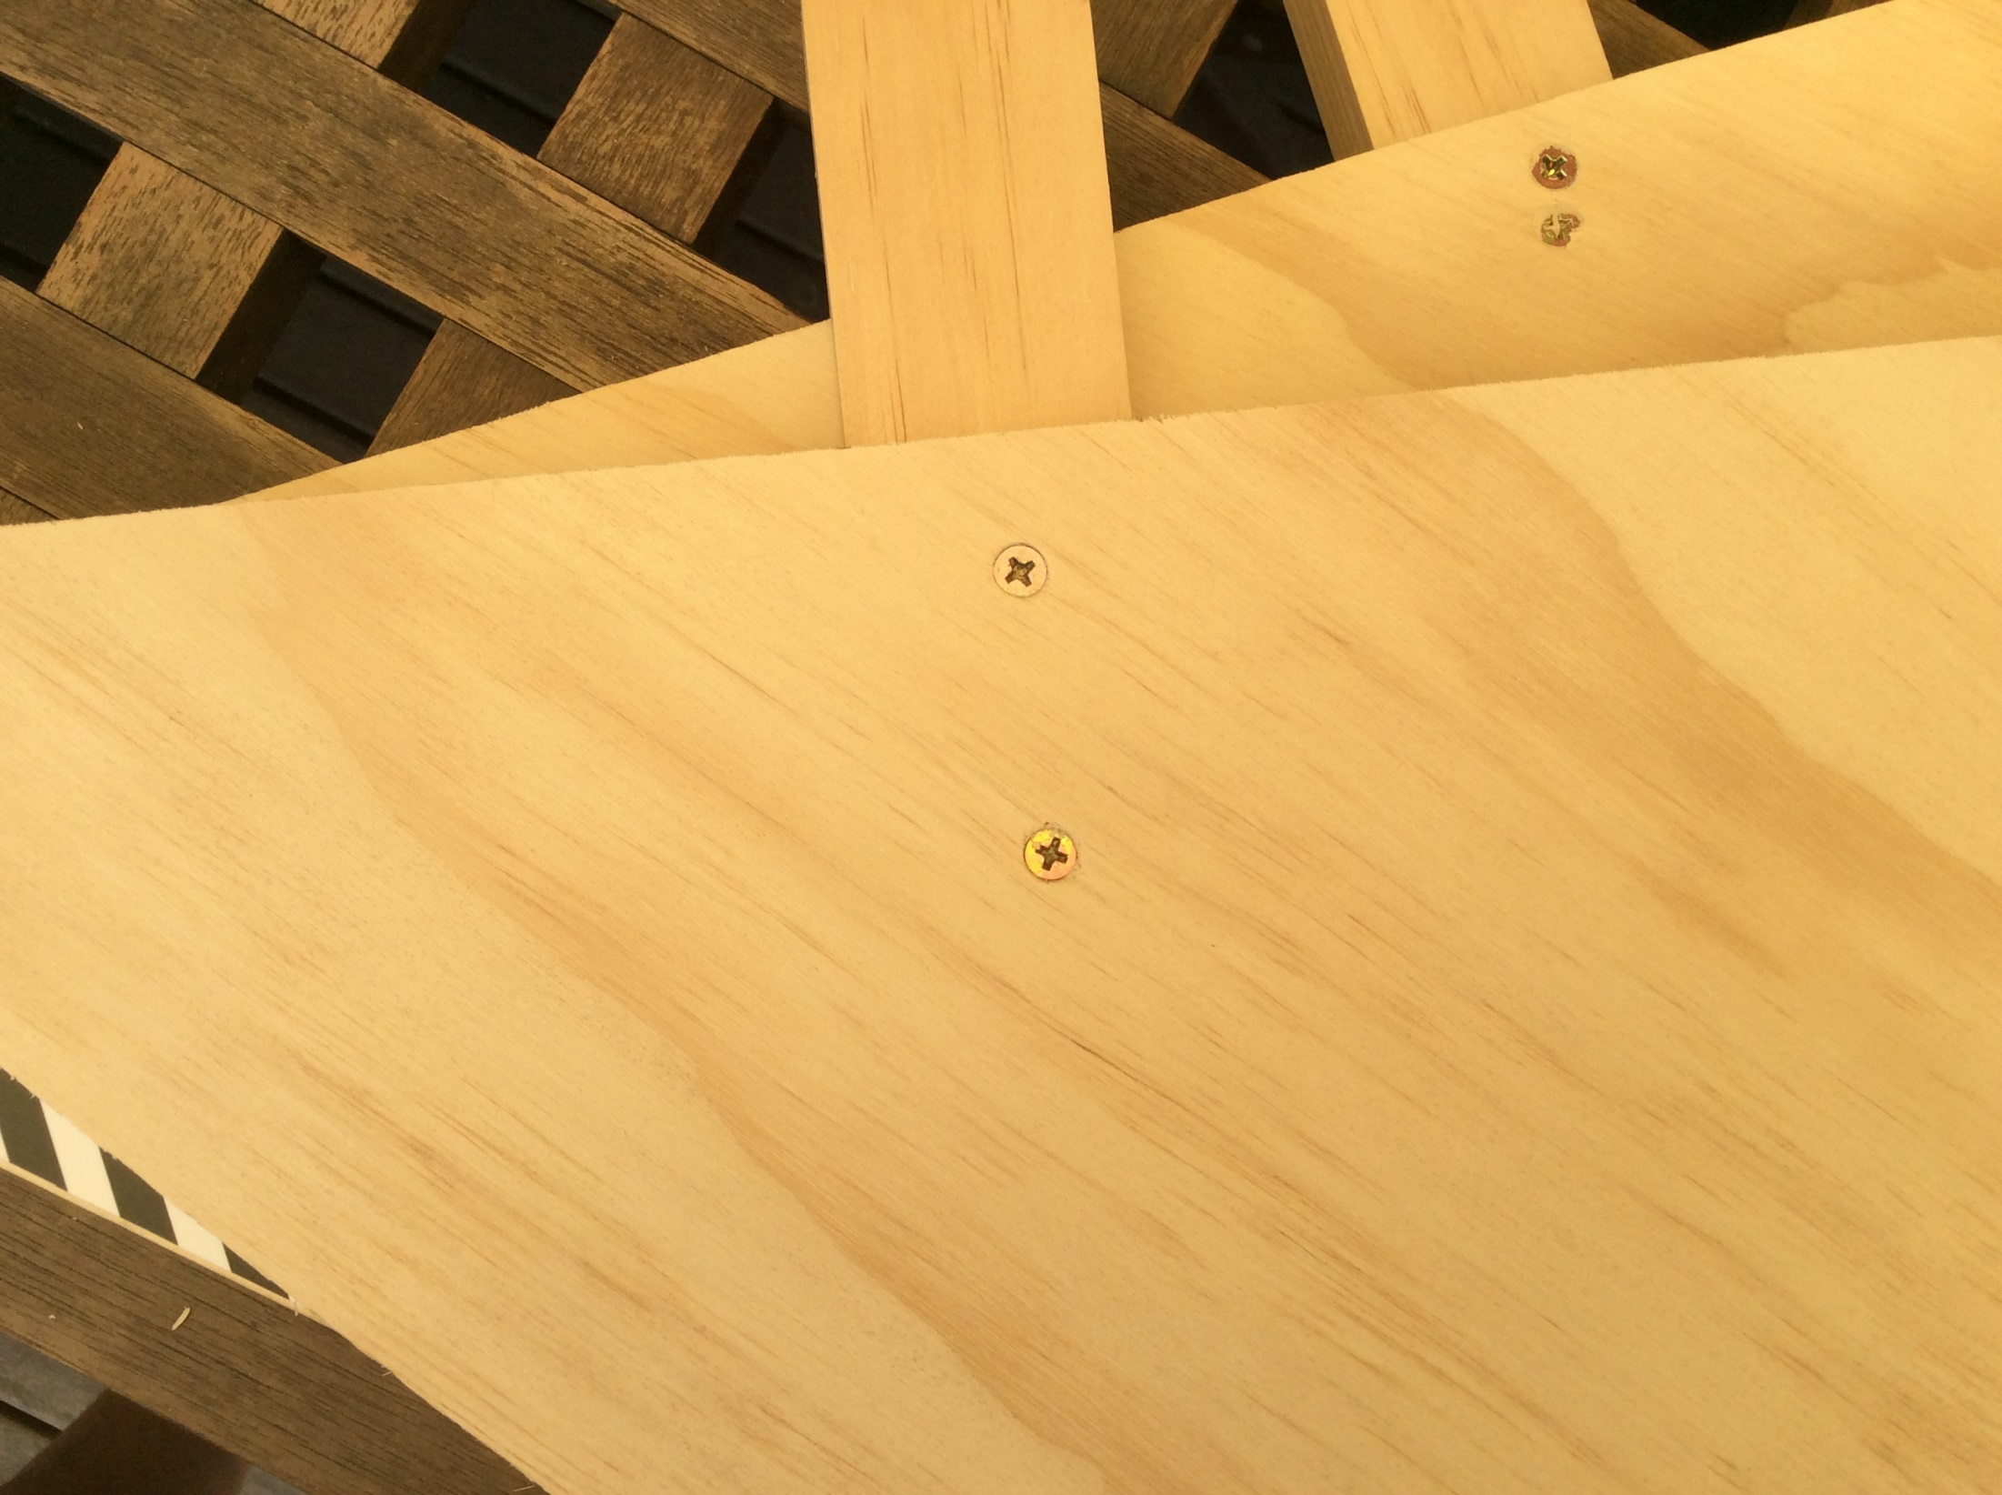
Add “screw eyes”, rubber bands and a ball holder

