Slide 1
STEM Construction
Safety Tips

Slide 2
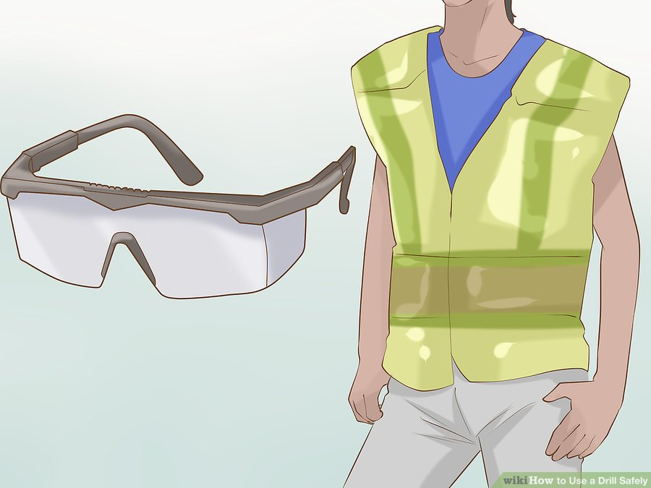
Safety when using power tools
Wear safety goggles to protect your eyes e.g. from splintering pieces of wood
Tie long hair back
Remove dangling jewellery

Slide 3
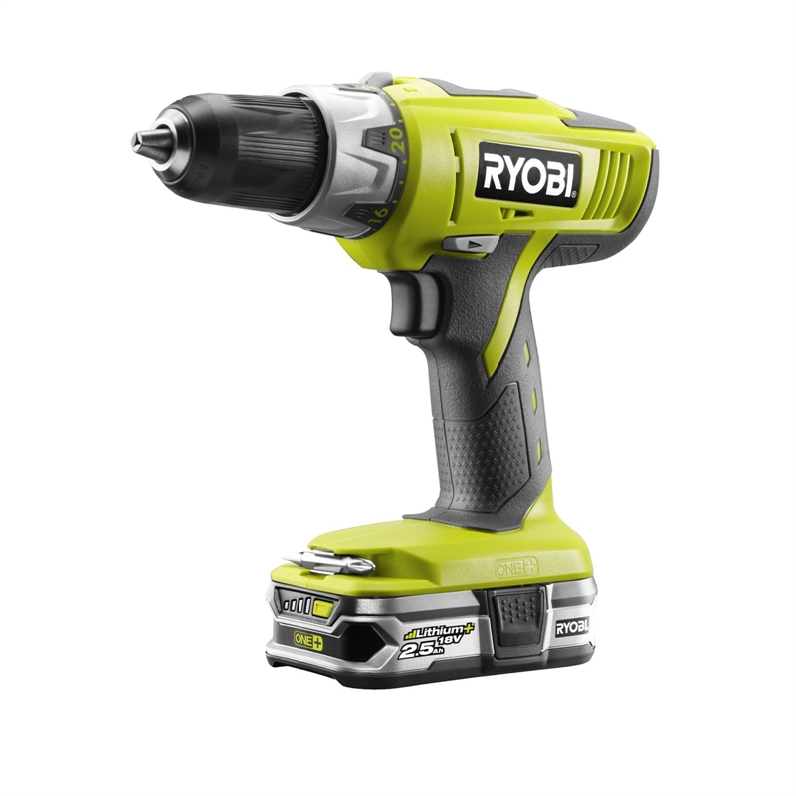
Screw
Cordless drill
Drill bit

Slide 4
Safety when using a drill
To replace a drill bit, take out the battery, then loosen the chuck by rotating it with your hand
Fit the drill bit firmly into the chuck. This holds the drill bit in place as it spins.
Chuck
Battery

Slide 5
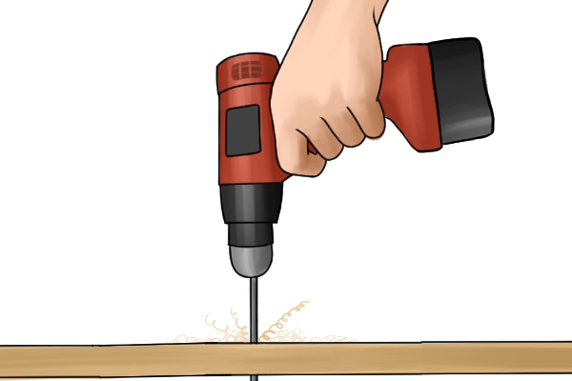
Safety when using a drill
Keep your fingers and hands away from the drill bit or screw when using the power drill

Slide 6
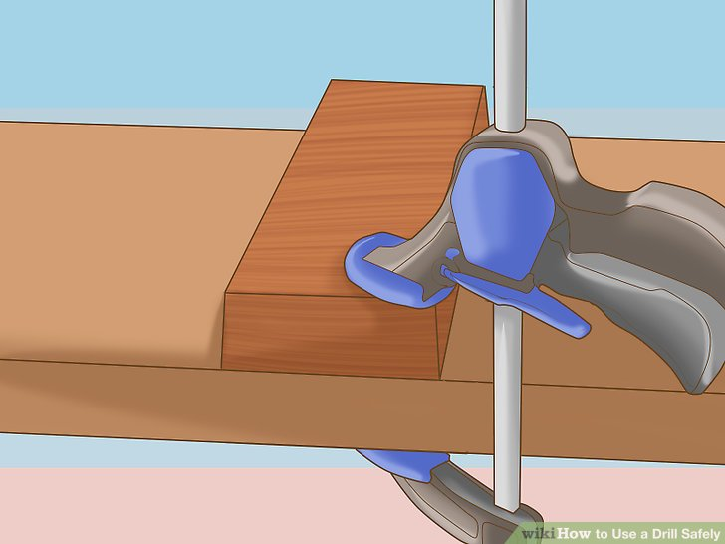
Safety when using a drill
Clamp small pieces together. Do not hold the piece down with one hand while drilling, as the drill could slip and injure you.

Slide 7
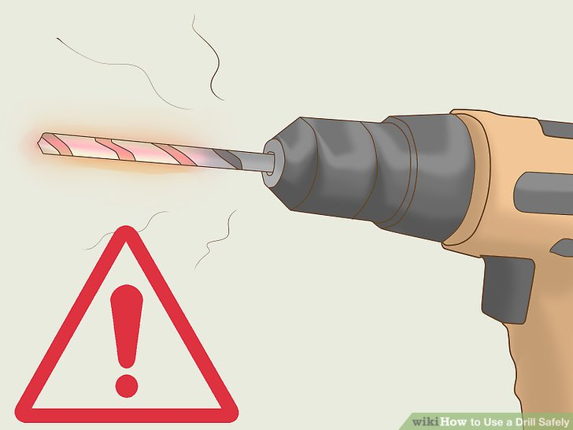
Safety when using a drill
Beware of hot drill bits. Give the drill bit time to cool down before touching it.

Slide 8
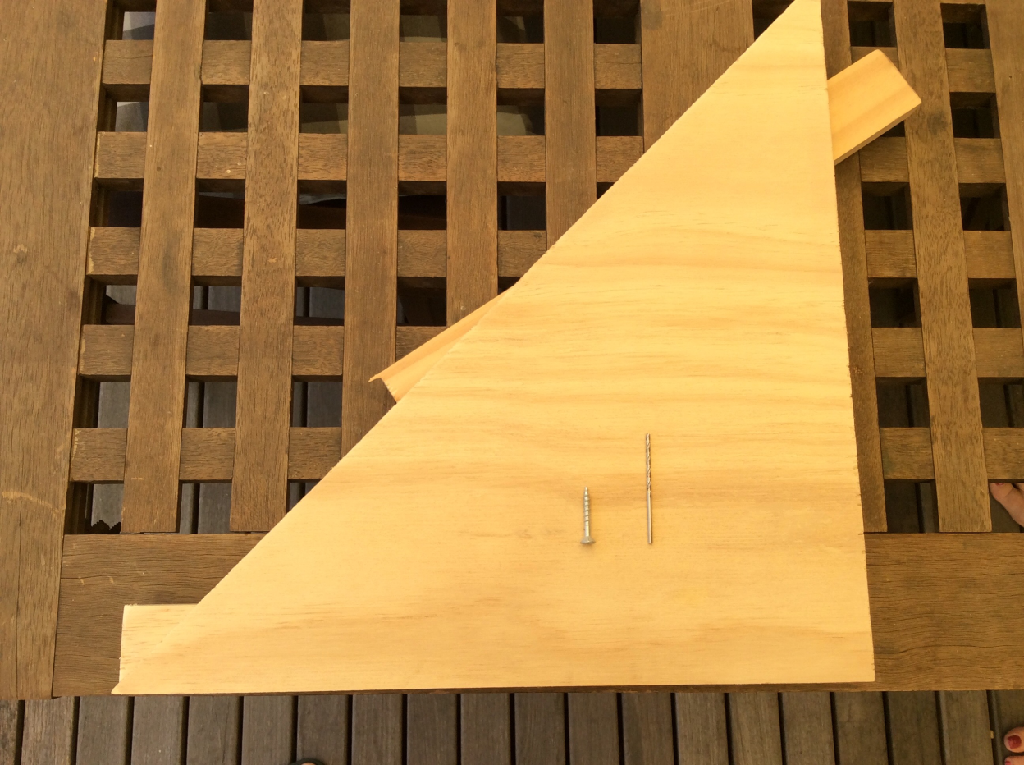
Safety when using a drill
When joining wood together using screws, drill a pilot hole first.

Slide 9
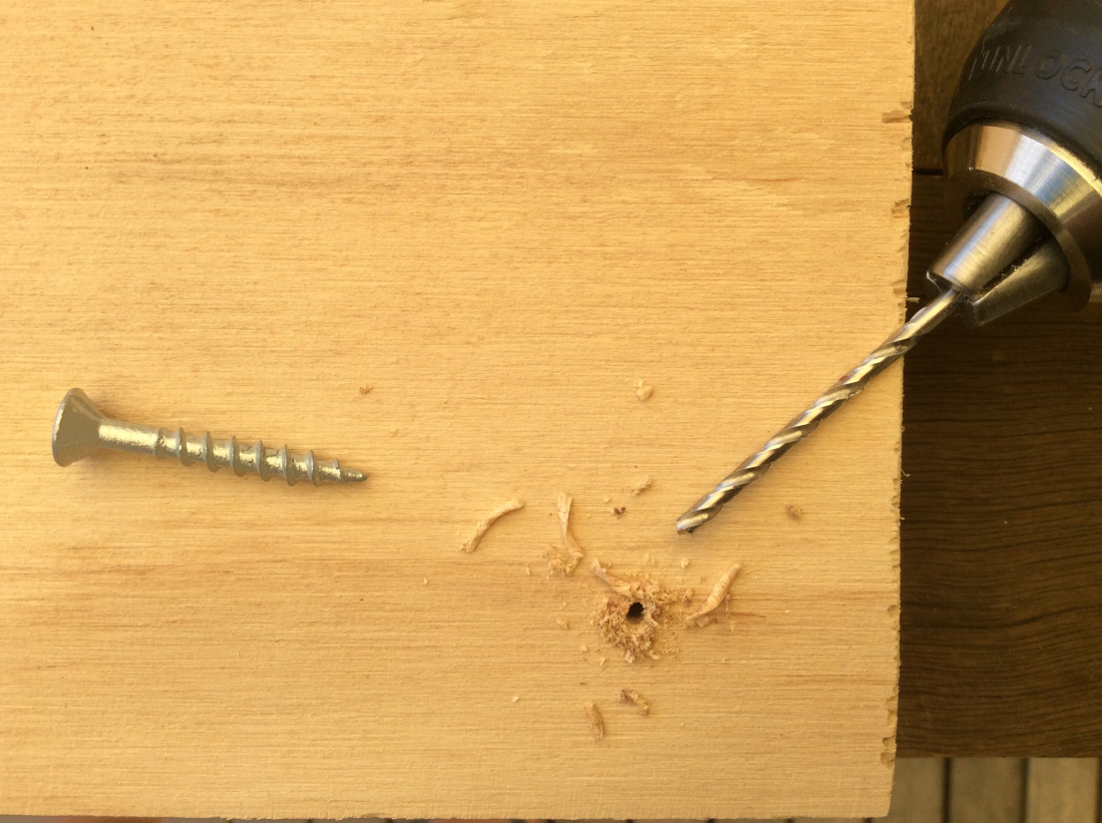
Steps when drilling a pilot hole
Use a drill bit which is thinner than the screw to drill the hole
Pilot hole

Slide 10
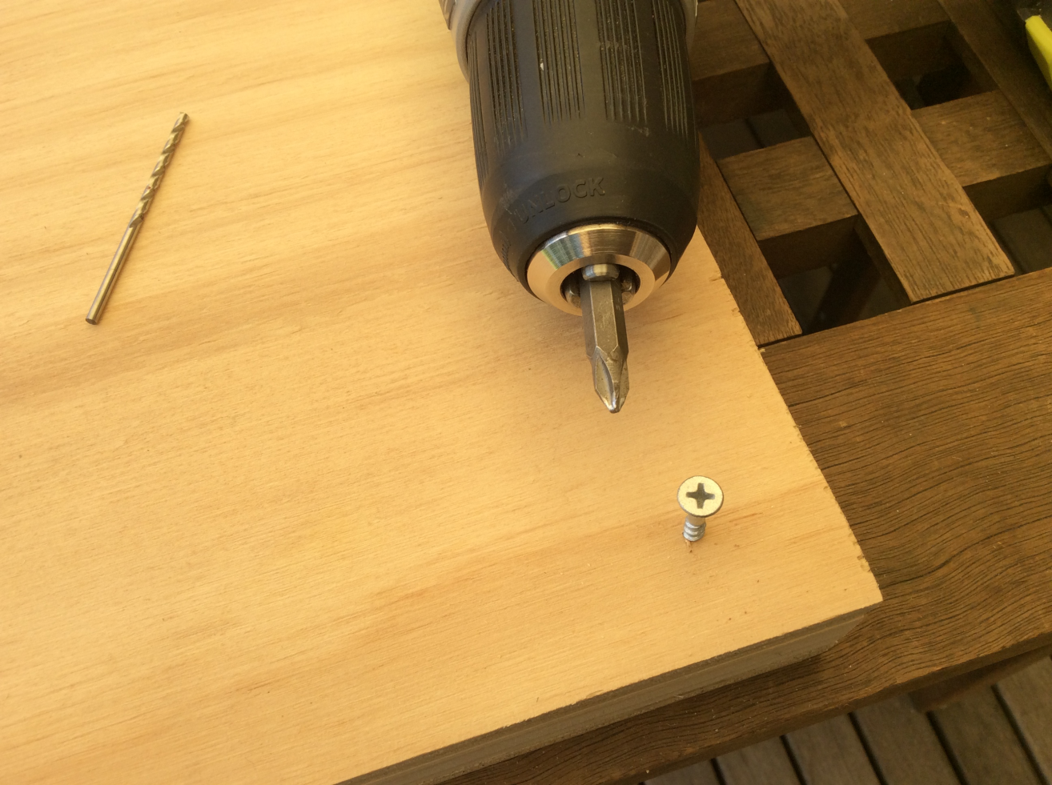
Steps when drilling a pilot hole
Then insert the screw and fasten it using the screwdriver bit in the drill
Screwdriver bit
Screw

Slide 11
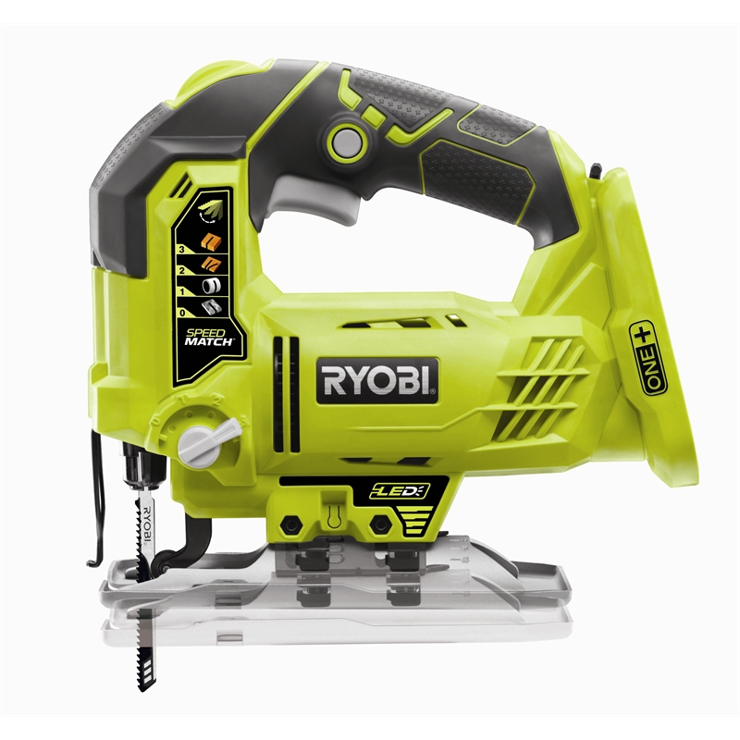
Trigger
Battery port
Blade
Baseplate
Cordless jigsaw

Slide 12
Safety when using a jigsaw
Measure and mark out your cut line on the wood

Slide 13
Safety when using a jigsaw
Your TEACHER MUST mount the blade for you and will check it doesn’t move in the clamp

Slide 14
Safety when using a jigsaw
Use a couple of clamps to secure the wood to the worktable

Slide 15
Safety when using a jigsaw
Put the battery in the port just before cutting
Keep hands away from in front of the cutting operation

Slide 16
Safety when using a jigsaw
Line up the blade with the cut line on the wood
The baseplate should stay flat against the wood throughout the whole cut

Slide 17
Safety when using a jigsaw
Slowly pull down the trigger and wait a moment for the jigsaw to get to full speed

Slide 18
Safety when using a jigsaw
Push the jigsaw firmly, but slowly, into the wood
On completion, wait for the blade to stop moving before lifting the jigsaw from the wood, remove the battery and rest the saw on its side

Slide 19
Safety when using a jigsaw
If the blade breaks, stop sawing immediately. Remove the battery and report it to your teacher.

Slide 20
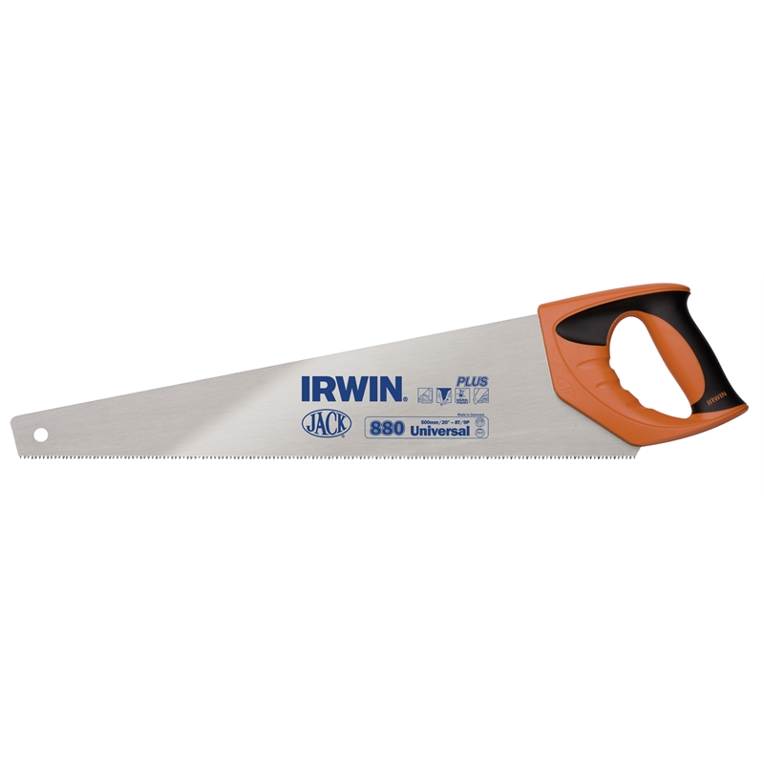
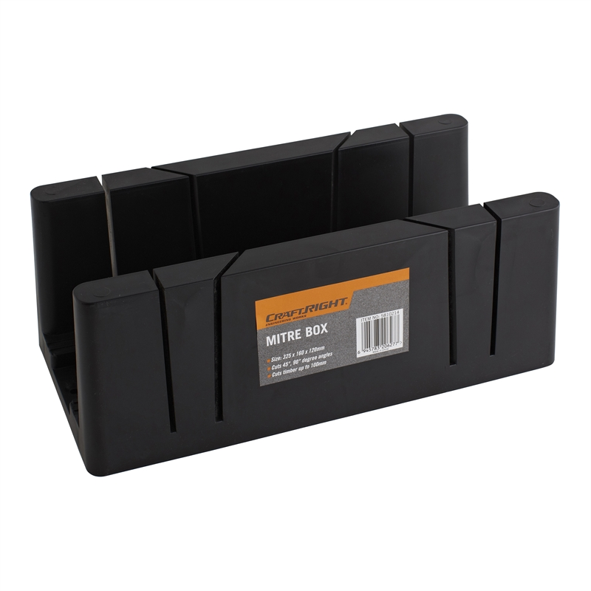
Mitre box
Hand saw
A tray that helps hold wood in place while you make angled cuts with the saw

Slide 21
Safety when using a hand saw
Always carry a hand saw by its handle with the saw end pointed down
Use a helper or clamp to hold the wood firmly in place on the worktable

Slide 22
Safety when using a hand saw
Use long, even strokes to start cutting the wood. Apply pressure on downstroke only.
Keep hands away from the cutting operation

